Slide 1
The lost tribes of Neuropsychiatry
How patients with organic mental disorders were kicked out of NHS psychiatry (except in Stoke!)
*May contain elements of pub quiz (13 questions)

Slide 2
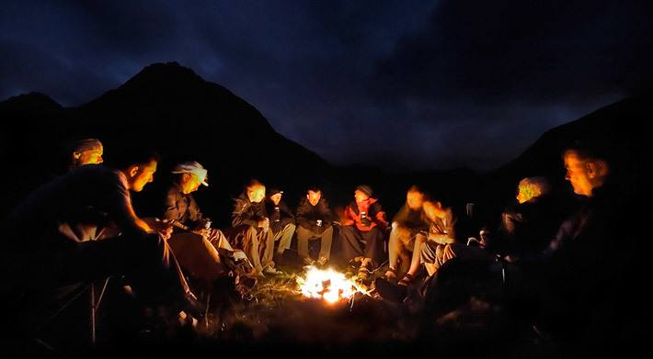
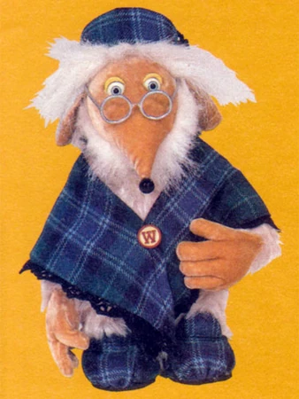
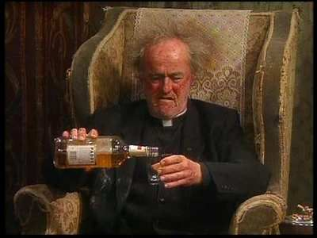
*

Slide 3
Contents
What sorts of illnesses?
Evidence for exclusion
Potential reasons for this.
What is to be done?

Slide 4
What sorts of illnesses?

Slide 5
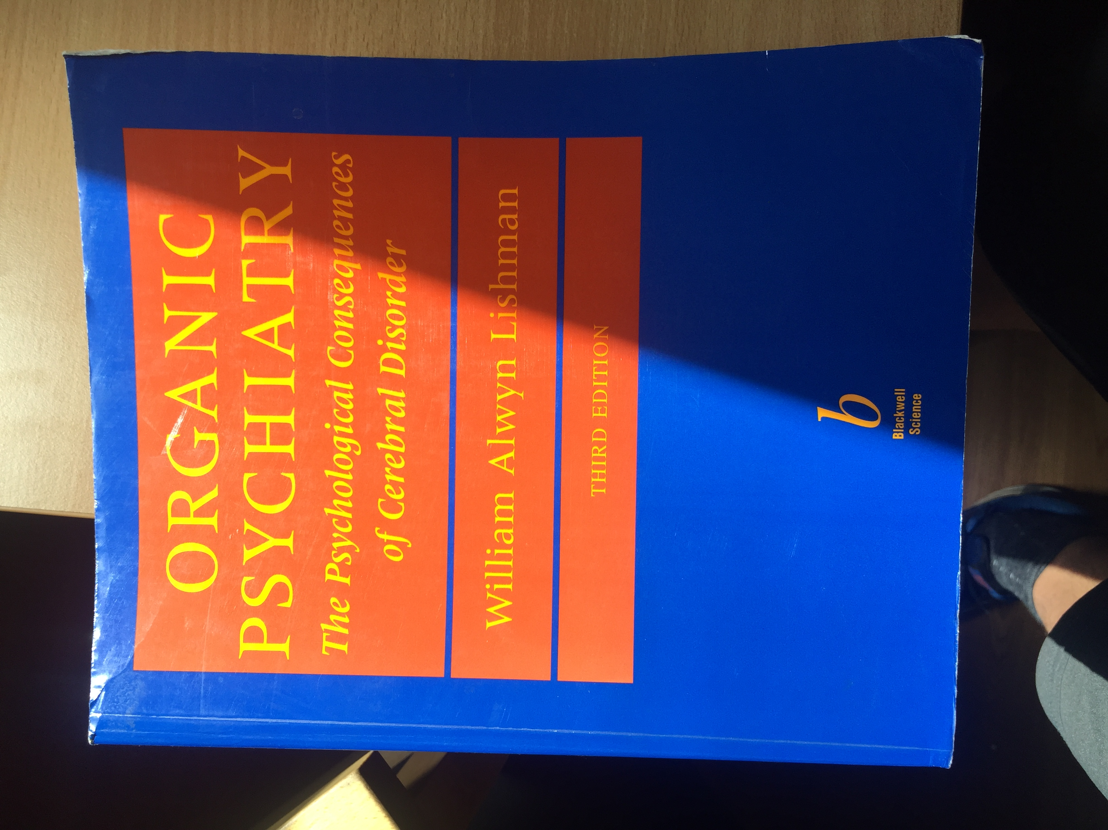
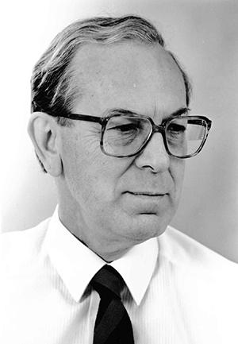

Slide 6
THREE types of mental illness connected with brain disorders.
Mental illness caused directly by the damage in the brain
Mental ill health related to the social/psychological context of neurological illness
Mental illness happening at the same time as neurological illness but unrelated.

Slide 7
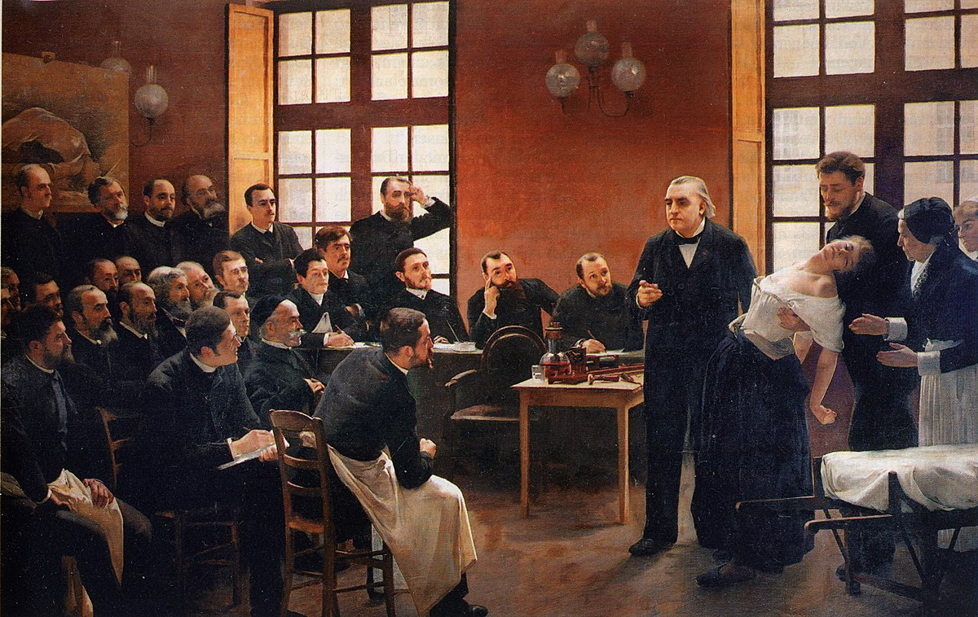
We’re not talking about FND today….that’s another story..

Slide 8
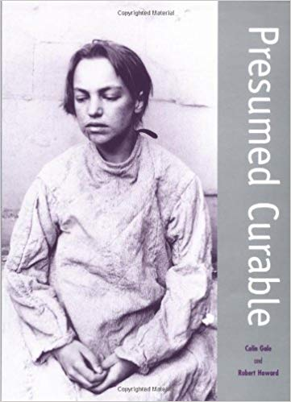
19th Century
Notes:
It was not always so

Slide 9
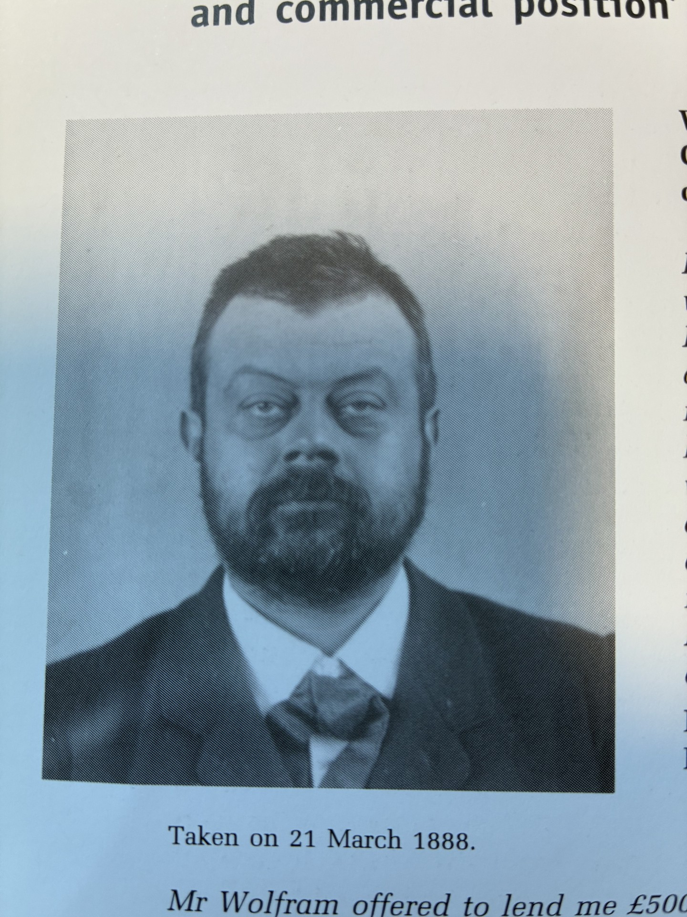
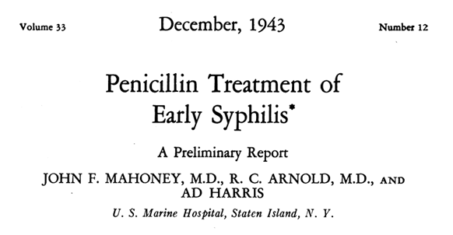
MR W.W. 40 year old male.
Highly anxious and restless
Overspending
Hypomanic
1888 diagnosis “general paralysis of the insane”
ICD-11 diagnosis.
  6E62.1.Secondary mood syndrome, with manic symptoms
Died in 1890.

Slide 10
Social exclusion 2025
“This is a physical, not a mental disorder”
“I’m not confident to look after these conditions”
“I thought you clever boffins cured them all”
“This person is not appropriate for our service/ward”
“We are not commissioned to do this work”
“Our service policy specifically excludes these patients”
“We are at capacity dealing with core business”
All these statements would have been unthinkable in 1888, or 1988.
Notes:
It’s happened in my lifetime!

Slide 11
WHY did this happen?

Slide 12
Why did this happen?
Dualism
Conflation of social construction/social causation
UK mental health policy focused on “functional mental illness”
Reduced supply/increased demand
  Closure of asylums
  Increased focus on risk management
  More diagnoses
Growth of new private asylums
The existence of neuropsychiatry

Slide 13
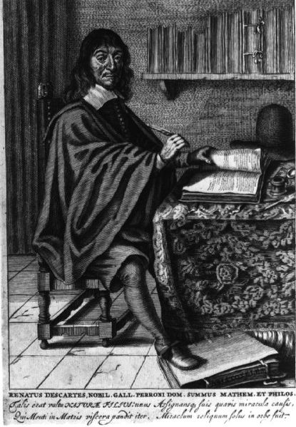
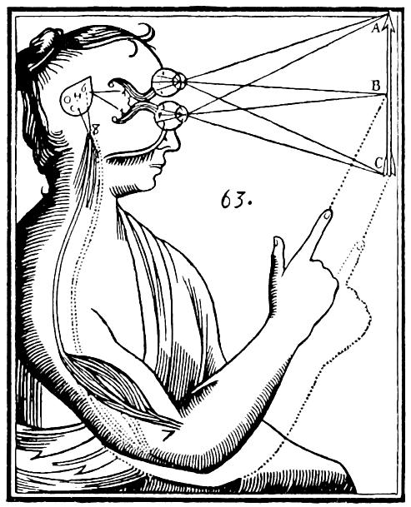
*
17th Century dualism

Slide 14
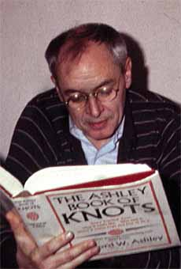
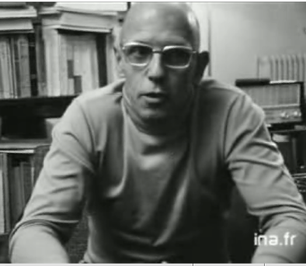
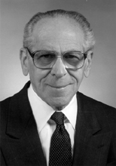
The flawed heroes of my earlier life!
Social construction conflated with social causation
*
*
*
Notes:
Social construction vs social causation

Slide 15
Organic mental illness. An inconvenient truth. A (Rubbish) syllogism.
All mental illness is a social construction.
All mental illness is caused by oppression.
If mental illness is caused by something else (brain change) it’s not “mental” it’s “physical”.
Organic mental illness has to be excluded from psychiatry.

Slide 16
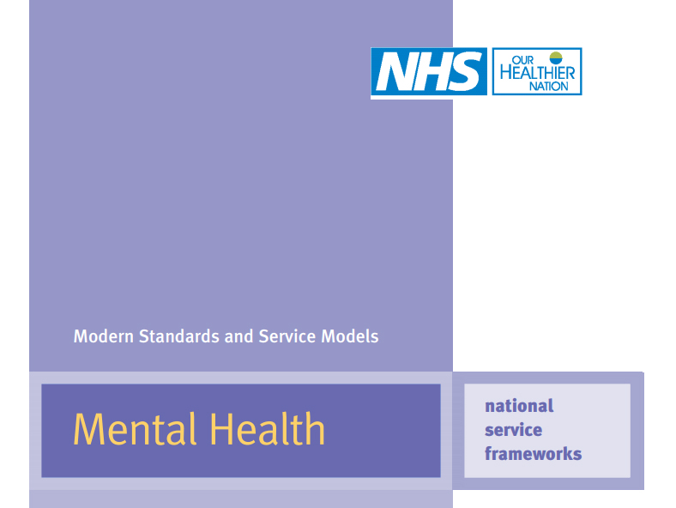
Focus on functional mental illness. Redefinition of “severe and enduring mental illness”
Notes:
Clunis 199

Slide 17
Why did this happen?
Dualism
Conflation of social construction/social causation
UK mental health policy focused on “functional mental illness”
Reduction in supply/increase in demand
  Closure of asylums
  Increased focus on risk management
  New diagnoses
Growth of new private asylums
The existence of neuropsychiatry

Slide 18
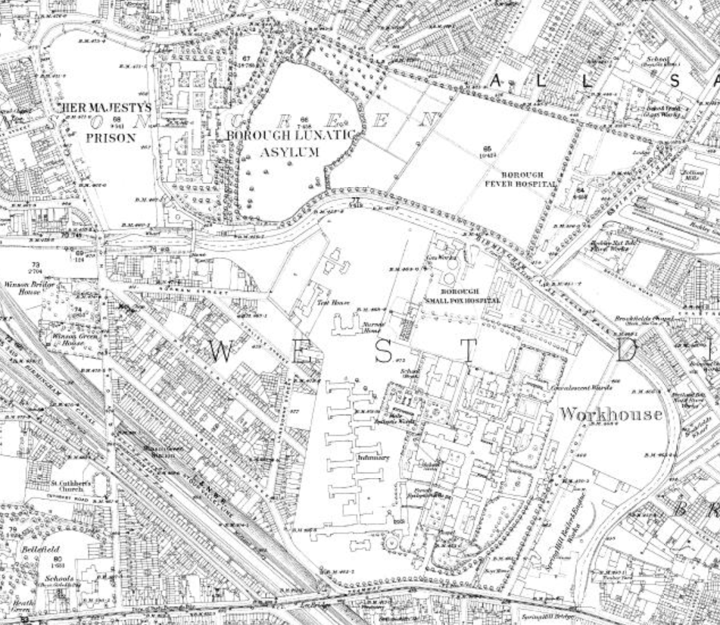
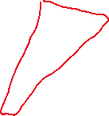
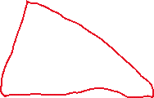
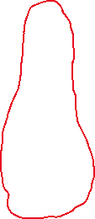
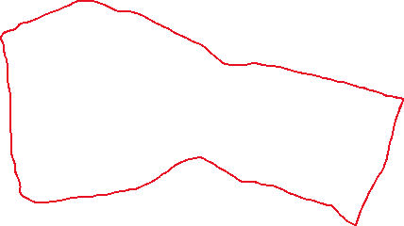
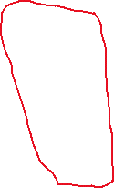
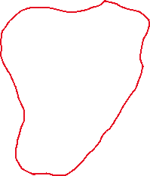
West Birmingham 1903
Winson Green Prison
Fever Hospitals
All Saint’s asylum
Birmingham Union Workhouse
Dudley Road Hospital

Slide 19
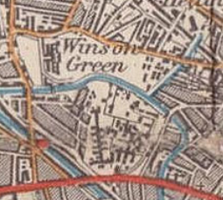
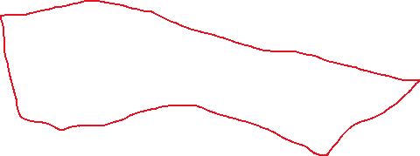


Birmingham 1988
All Saint’s Psychiatric Hospital
HMP Winson Green
Dudley Road Hospital

Slide 20
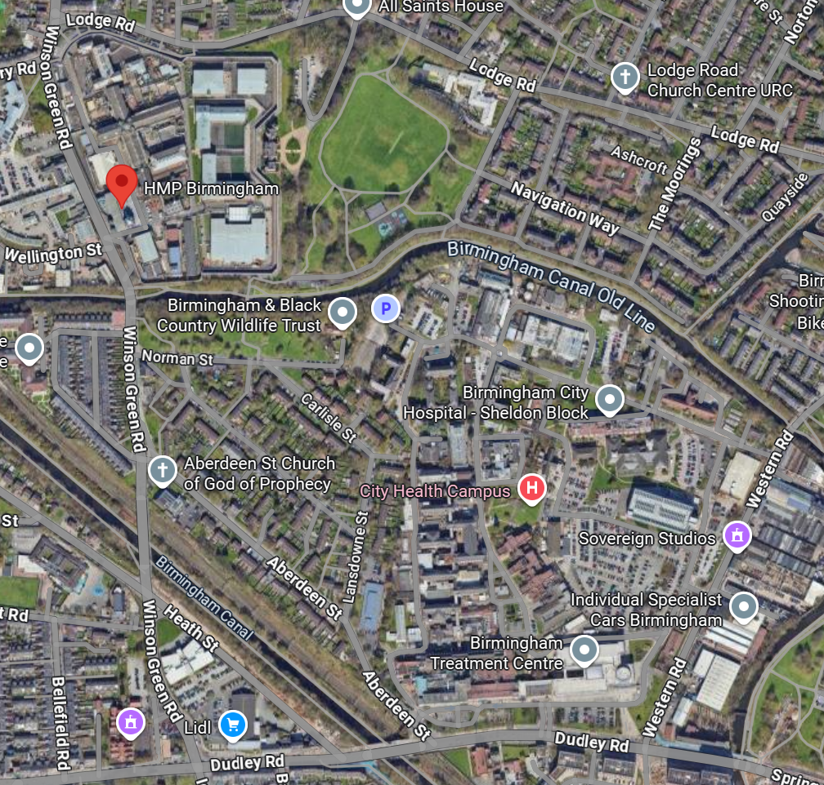




Birmingham 2025
Acute mental health unit (Mary Seacole House)
HMP Birmingham (including new mental health wing)
City Hospital remnants (OPD and eye hospital)

Slide 21
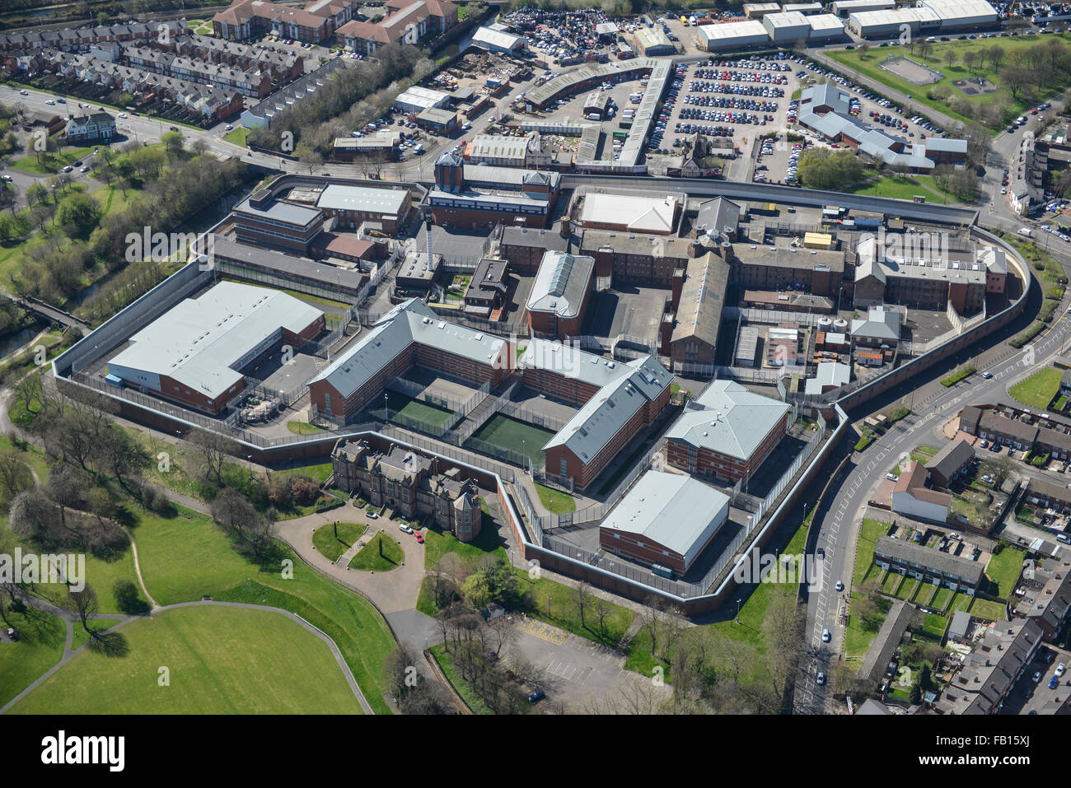
Hospital wing

Slide 22
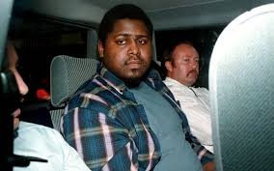
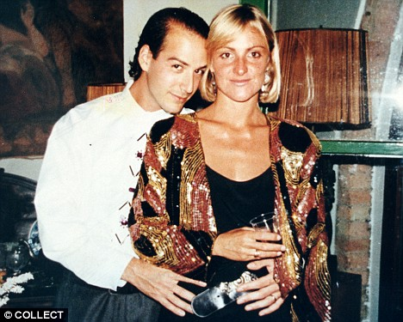
1992
**

Slide 23
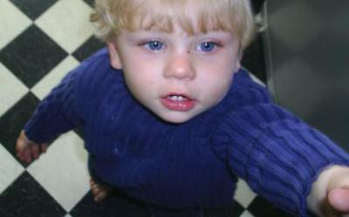
*

Slide 24
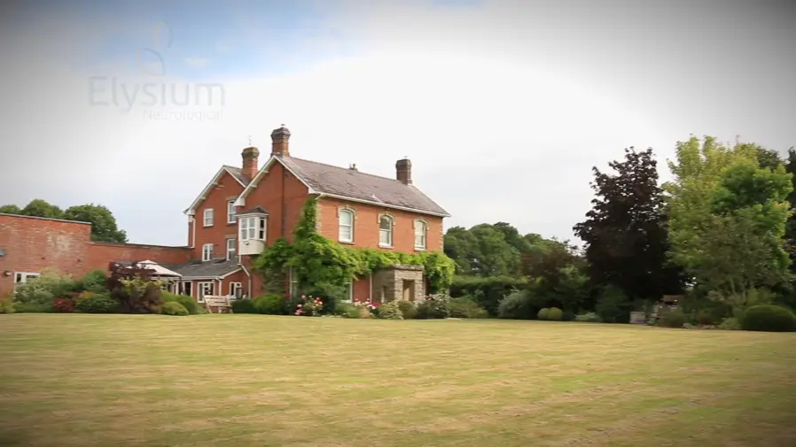
This is what an asylum looks like..
Notes:
Elysium Healthcare worth £900 million

Slide 25
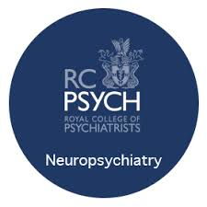
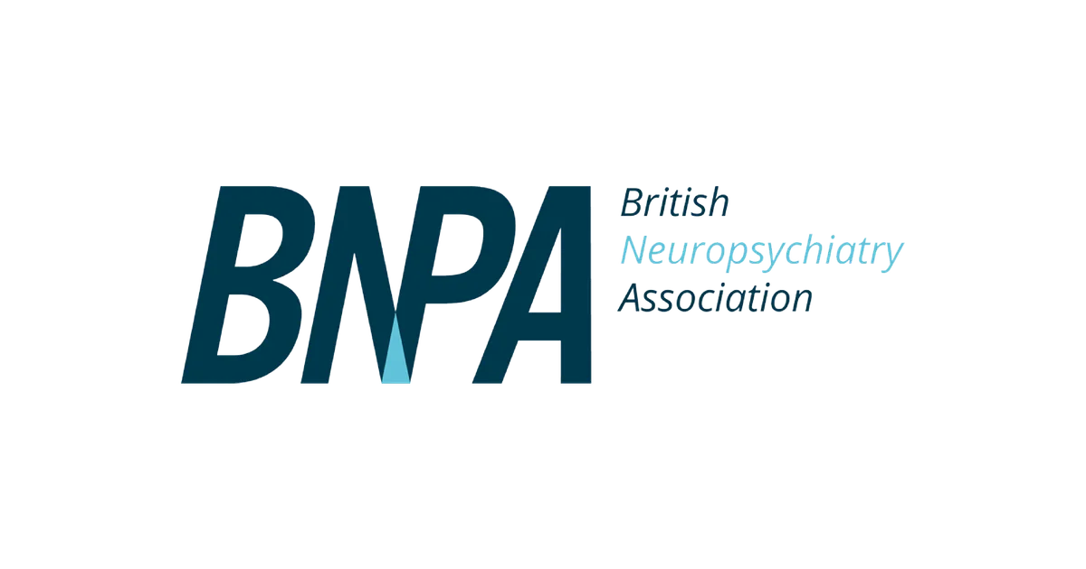
1987 onward
Did we actually make things worse?

Slide 26
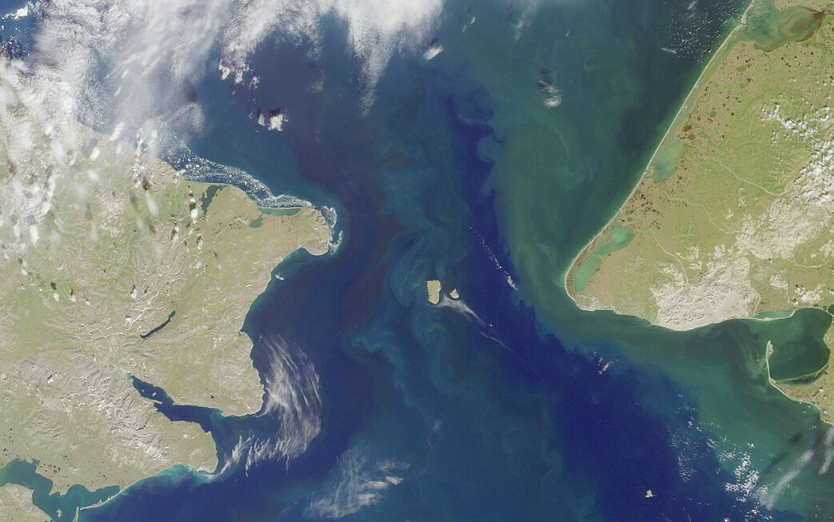
****
NEUROLOGY
Neuropsychiatry Island
PSYCHIATRY
Behavioural neurology Island (always one day behind)

Slide 27
Stoke (and Leicester and Newcastle) are the exceptions!

Slide 28
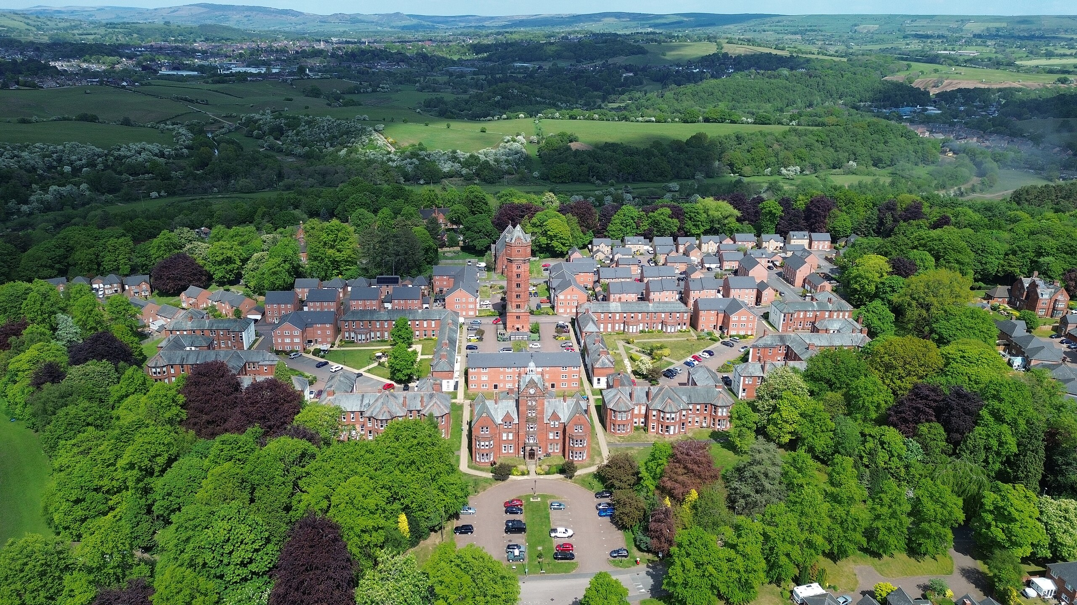
*

Slide 29
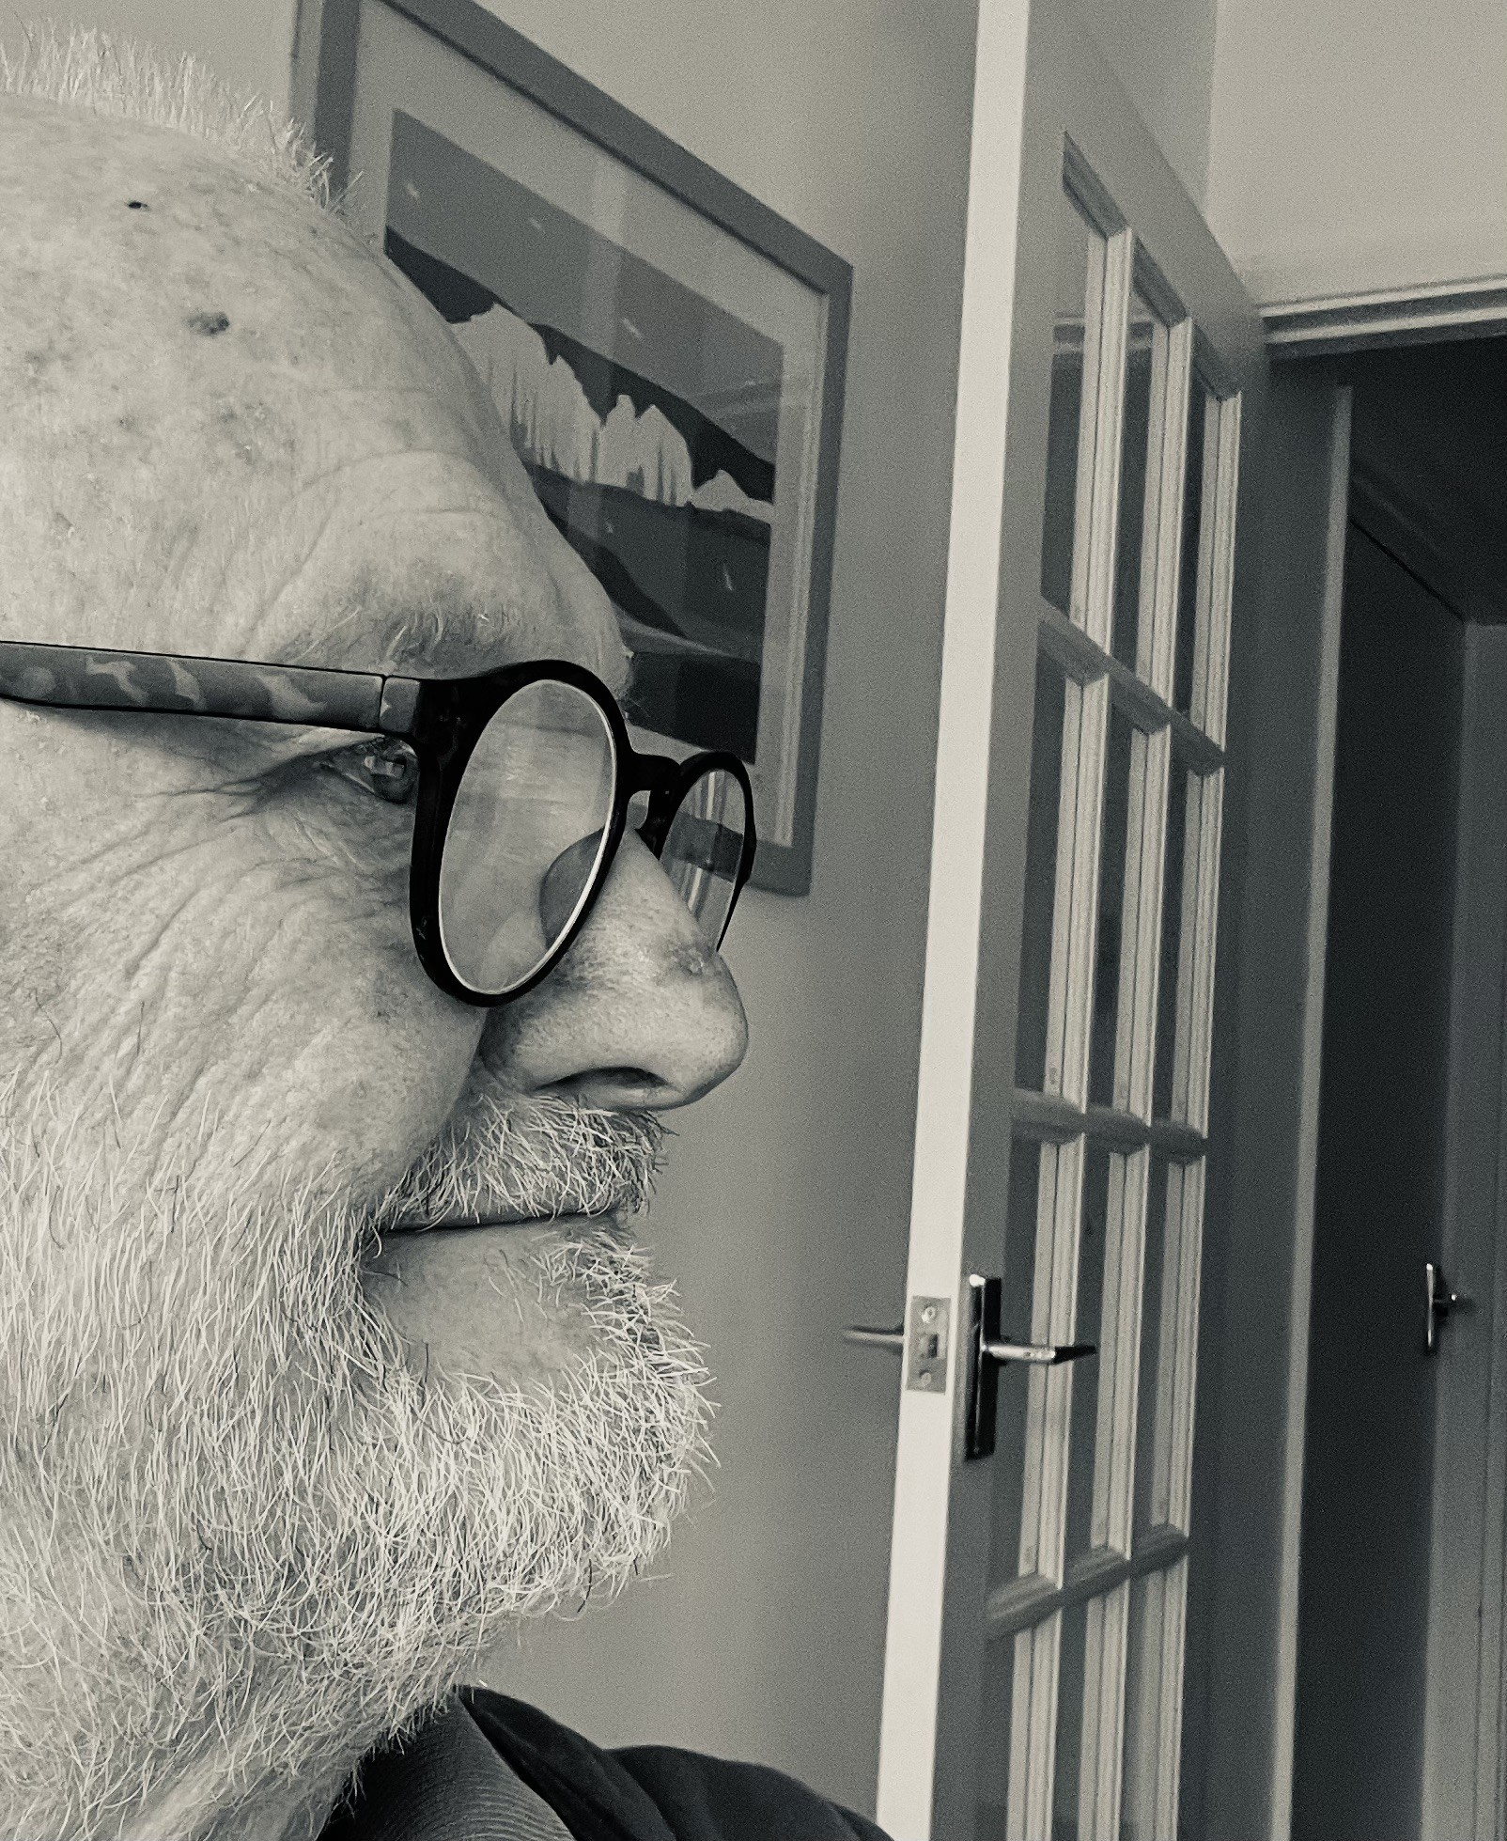
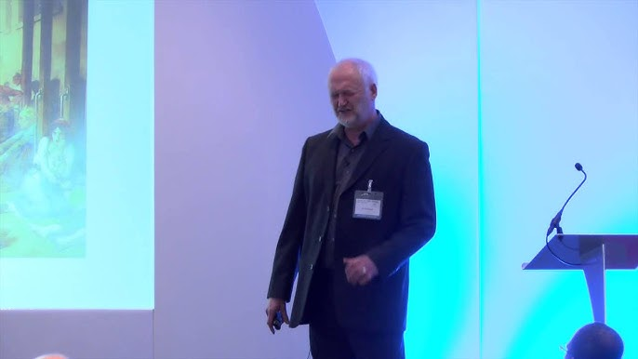
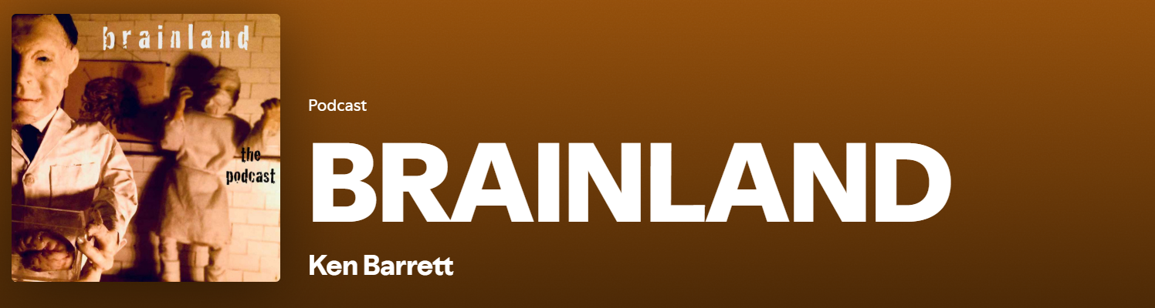
Ken Barrett. Rare sightings….

Slide 30
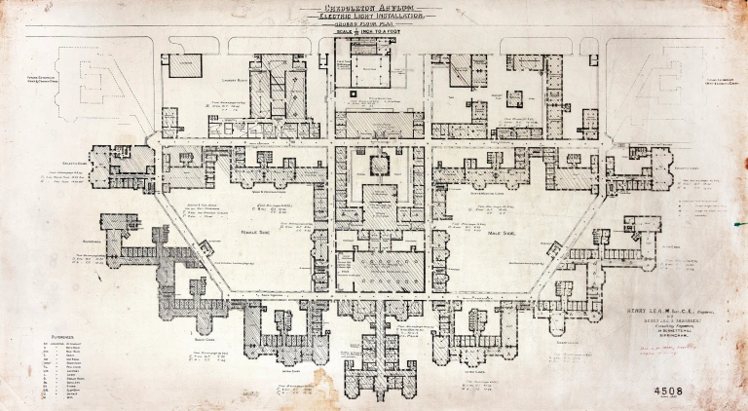
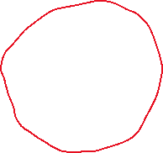
Cheddleton asylum…St. Edwards
Ward 14. Brain injury and HD.
Ward 13. Other early onset dementia
About 30 patients in the 1980’s
Notes:
Organic mental illness as “inconvenient truth”

Slide 31
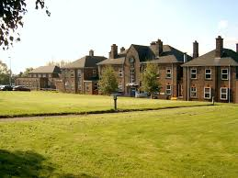
Haywood hospital, Burslem (taken from nurses home)

Slide 32
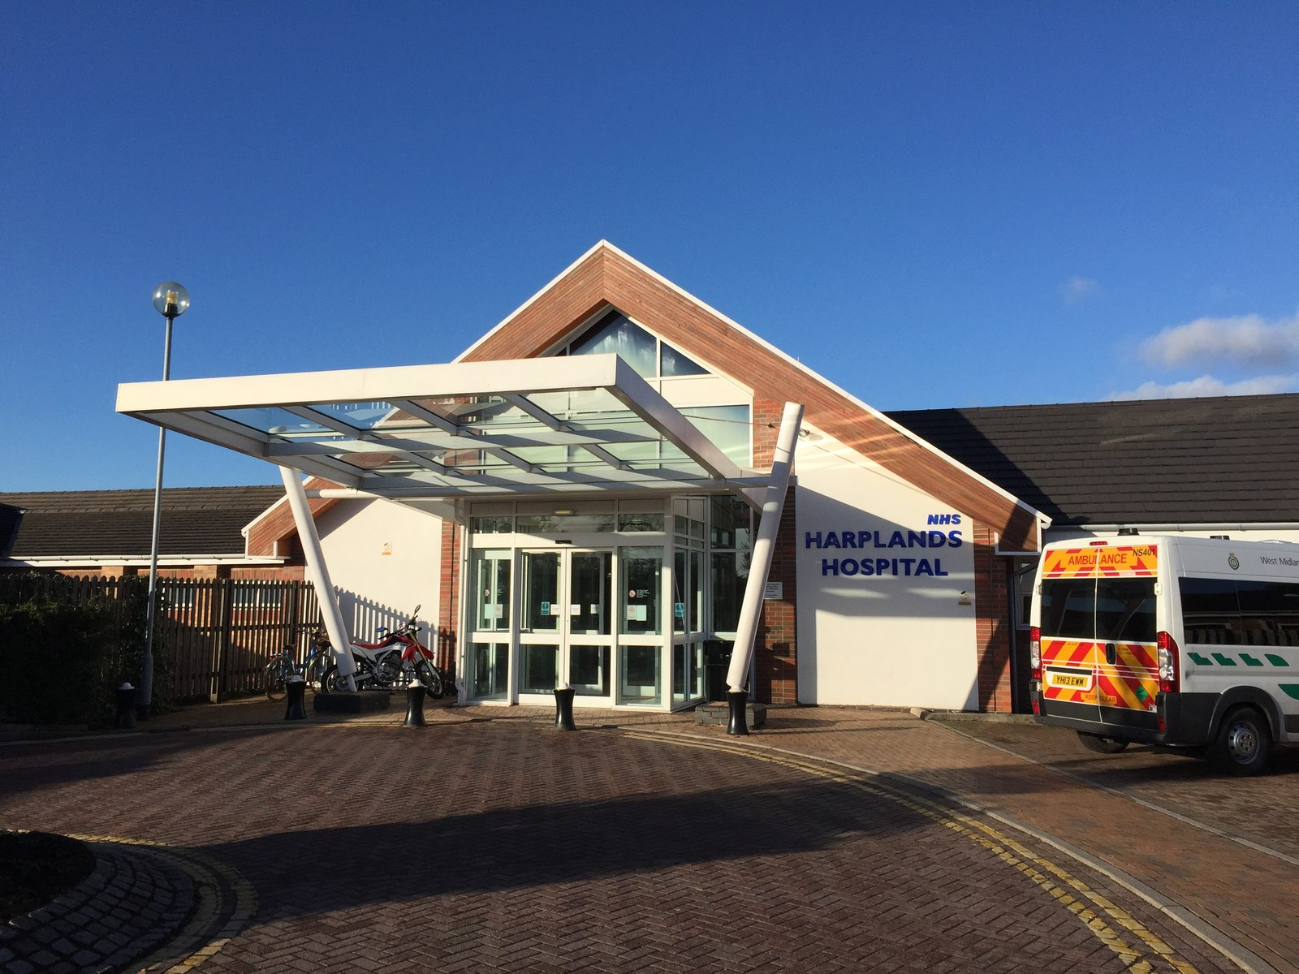
Ward 5 Neuropsychiatry

Slide 33
Summary
People with organic mental disorders have been excluded from mainstream mental health services over the last 30 years. (except in Stoke).
The private sector have picked up provision in a piecemeal fashion
This has led to harm to those people

Slide 34
So what do we do?
Remember this story!
Work with Mental health commissioners and providers to return equity of access to the “Lishman tribe”
Re-introduce the brain to the RMN curriculum.
Develop our role working alongside general psychiatry colleagues
FND? (that’s another lecture…..)

Slide 35
Thank you for listening.

Slide 36
