Slide 1
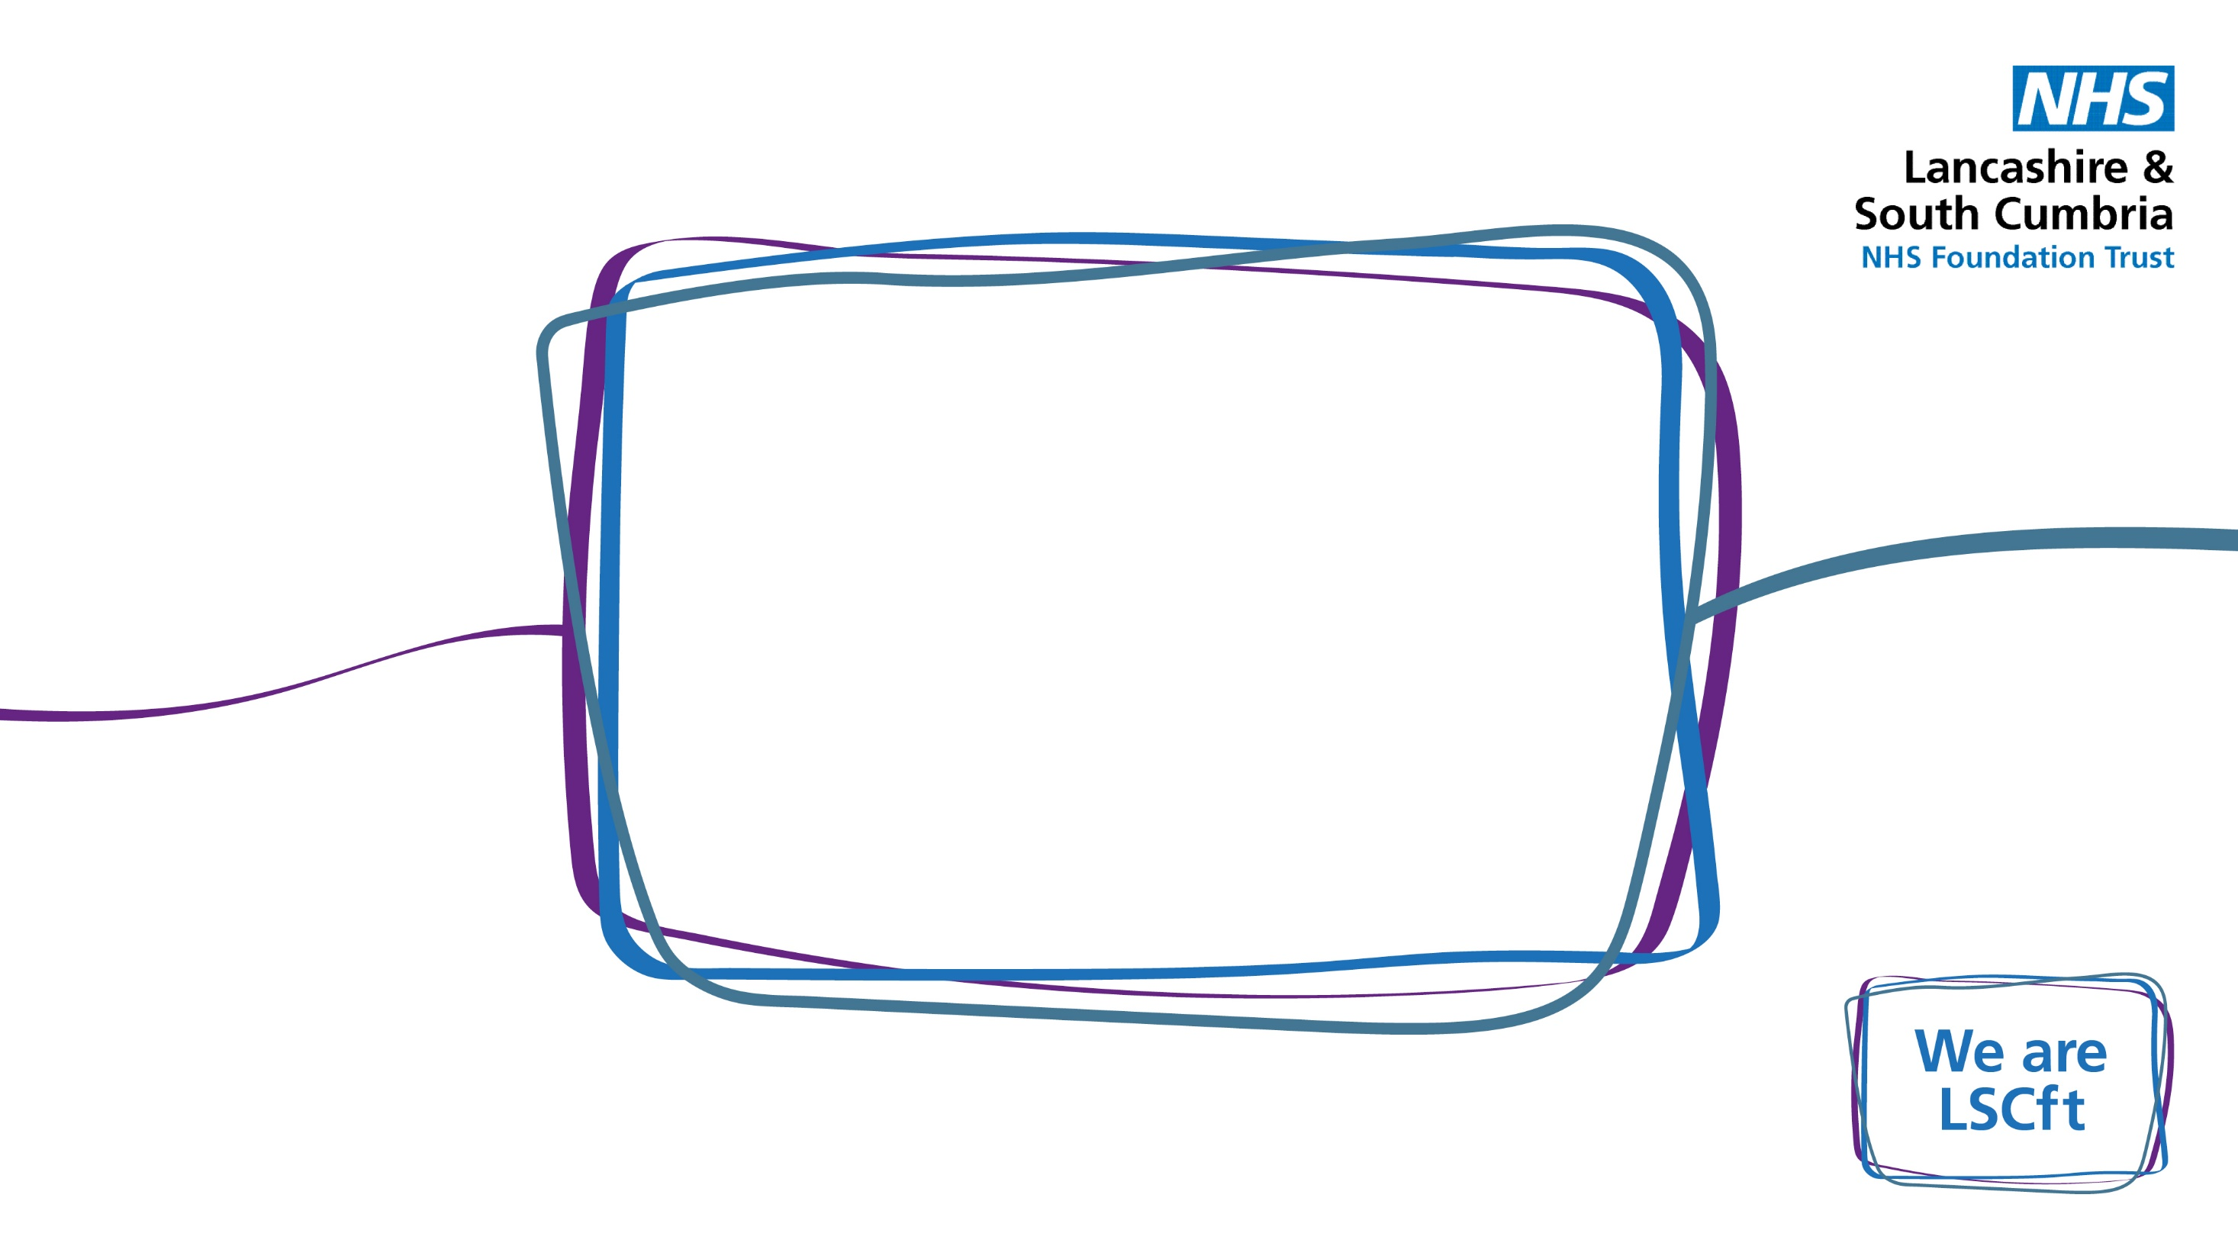

“Women are not small men”
Assessing and managing TBI in women
Dr Czarina Kirk Consultant Neuropsychiatrist ,
Vice Chair Neuropsychiatry Faculty

Slide 2

Women and ABI - A Few Statistics!
(Headway UK 19-20)
ED attendance approx. 1.4 million / year – approx. 90% mild TBI
TBI stats (England)
Approx 130,000 admissions per year
Men x 1.5 than women (>65 1:1)
Cf 05/06 – 19/20 – 28% increase in women being admitted – approx. 55,000 in 19/20
Peaks – <10 yrs and 21-50 (cf men)
(doesn’t include admissions for other brain injury eg tumour, encephalitis , stroke…)

Slide 3

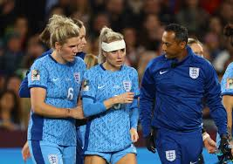
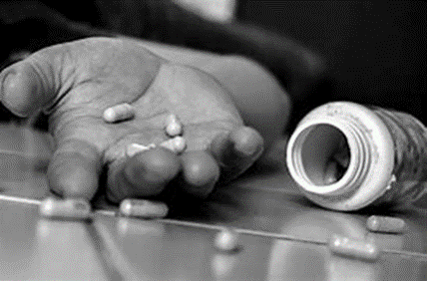
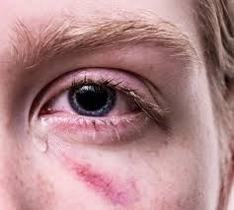
Why the increase?
Living longer? Falls commonest cause
Chronic health conditions
Driving 1975 29%; 2019 71%
Substance Use – drink less but more likely to be admitted due to harm
Sport – concussion – “Women are not small men” Concussion in women: New research under way into impact on female athletes - BBC Sport
Self harm – toxins, anoxia
Armed forces 1990 6% ; 2023 12%; 2030 30%Representation
of women in the Armed Forces (parliament.uk)
Domestic / Intimate partner violence
Brain injury and domestic abuse - Too many to count report (brainkind.org)

Slide 4

Impact of brain injury in Women
Atypical presentation – mild TBI can present with more severe symptoms or may not present at all.
Women have lower rates of direct transfers to trauma centres and intensive care after traumatic injuries. Adherence to guidelines for CT scans following TBI seems lower for women.
Life stage influenceTraumatic brain injury in women across lifespan - ScienceDirect
Increased incidence of mental illness – depression , anxiety, self harm, suicide
Criminality – women with TBI in prison – brain injury in same year as first offence; increased rates of alcohol and substance use; ACEs; traumaMaking-the-Link-Female-Offending-and-Brain-Injury.pdf (brainkind.org)
Vulnerability – exploitation; IPV
Barriers to rehab – care givers; accessibility; complexity – identified and hidden; stigma

Slide 5
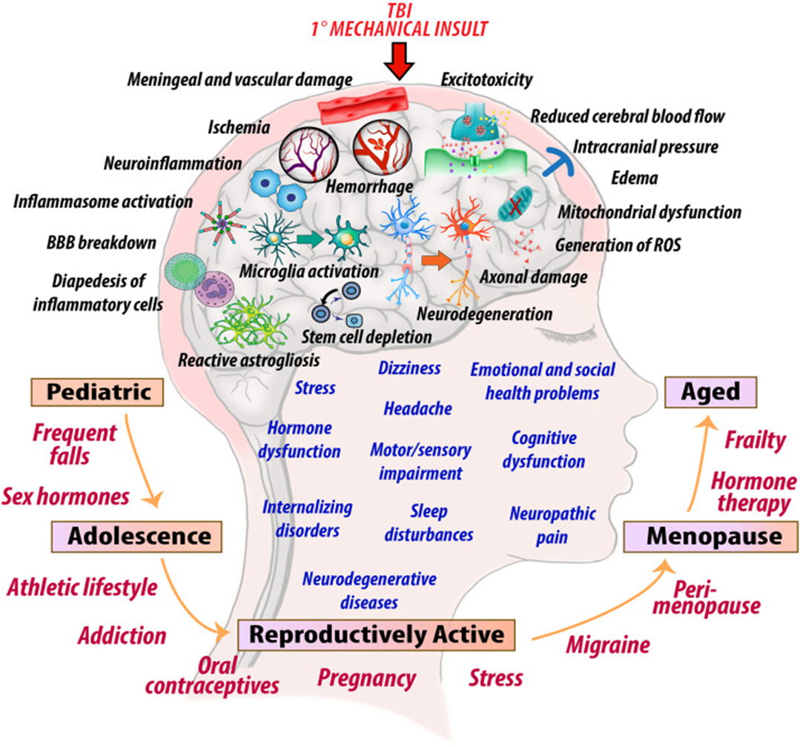

Slide 6
What is strangulation?
What is strangulation?
Obstruction of blood vessels and/ or airflow in the neck resulting in asphyxia.
Non-fatal strangulation
Section 75A(1)(a) SCA 2015 is the offence of non-fatal strangulation.
A History of NFS:Nancy Glass J Emerg Med 2008 35(3)
X 6 times risk of becoming a victim of attempted homicide
X 7 times risk of becoming a completed homicide

Slide 7
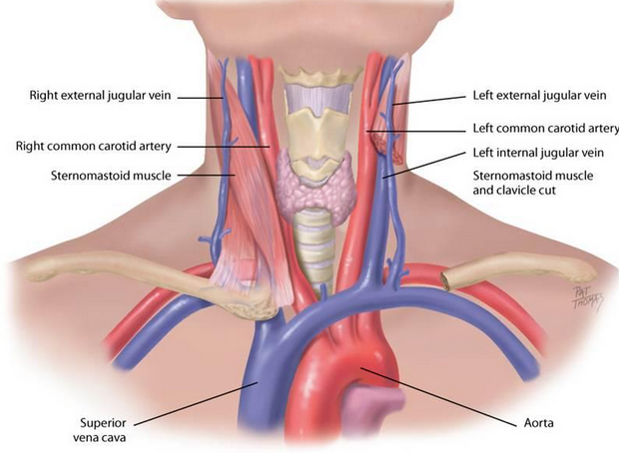


Jugular vein 4psi,
Carotid artery 11psi,
Trachea 34 psi.
80-100psi 20 psi
6.8 seconds
LOC
15 seconds Bladder incontinence
30 seconds Bowel incontinence
2-3 minutes Cell death
4-5 minutes Brain death

Slide 8

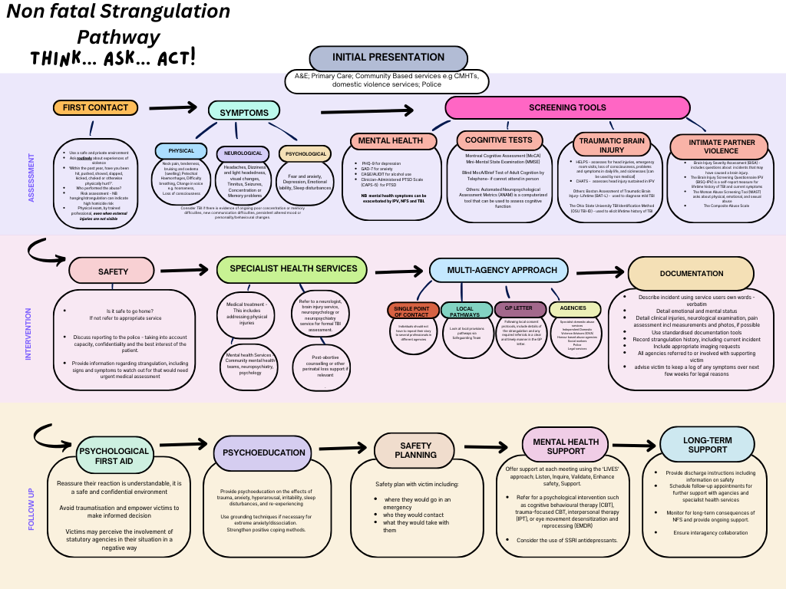

Slide 9
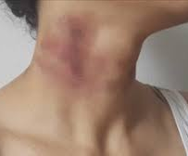
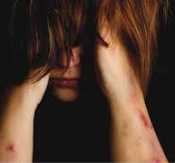

Case study
Domestic Violence; self harm; addiction; recidivism; children in care

Slide 10
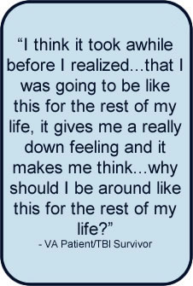
Brain Injury and Suicide
Large population-level studies have confirmed a 2x to 3x inflated risk of suicide following brain injury (Fann et al., 2002; Mackelprang et al., 2014; Fazel et al., 2014)
Up to 25% of people with brain injury think about suicide in the first year
This is even higher for adolescents (Marsden et al., 2018)
The increased risk is lifelong (Misono et al., 2008)
Association with early mood symptoms, premorbid mental illness, limited education, previous suicide attempts
Suicide associated with TBI has been the subject of numerous UK Coroner’s Reports.

Slide 11


Suicide and Self harm following brain injury
More severe the injury the higher the risk….but also repeated mild TBI can lead to mood and personality changes
Intimate partner violence
Childhood trauma – physical abuse, neglect, emotional
Contact sports
Violent assaults
Brain damage due to substance / alcohol misuse

Slide 12
Assessing Brain Injury in Women Step 1
ASK
1. Think safety first
2. Compassionate enquiry
3. Use of language
4. Screening tools
5. Documentation
6. Unintended consequences

Slide 13
Assessing Brain Injury in Women Step 2
UNDERSTAND
1. Safety
2. Formulation
3. Further assessment :Trauma – acute and long term ;cognitive impairment impact on problem solving/ insight/ decision making/ capacity ;Mental illness comorbidity; Neurological damage

Slide 14
Pre-injury factors
Brain Pathology
Social context
Cognitive difficulties
Emotional needs
Physical health
Behaviour / function

Slide 15
Formulation of needs:
BIOLOGICAL | PSYCHOLOGICAL | SOCIAL
Premorbid brain health Severity of injury Stage of life –eg puberty, pregnancy, menopause Location and Nature of injury – frontal lobe, limbic system Role of neuro-inflammation Complications – ICU, infections Epilepsy Sensory impairment Disability Pain Substance use | Fear Pre-morbid mental illness Memory Concentration and attention Decreased awareness of emotional state (uncoupling of cognition and emotion) Poor impulse control - disinhibition Poor social judgements, Reduced frustration tolerance Poor problem solving Inability to plan Concrete thinking PTSD, anxiety (social phobia) | Loss of function Loss of role Loss of relationships Social isolation Poverty Homelessness Domestic violence Crime Other legal issues – family courts

Slide 16
Interventions – STEP 3
ADAPTED INTERVENTIONS
1. Rehabilitation goals
2. Psychological first aid
3. Education about brain injury; long term consequences
4. Cognitive compensatory strategies
5. Safety planning
6.Physical health – pain relief, epilepsy, medication management
7. Multi-agency engagement

Slide 17



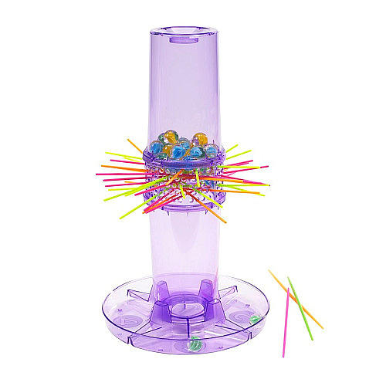
Case Study
Trauma informed
Assessment and formulation
Goal setting
positive behaviour support
safety planning
Neuro-cog rehab – education, compensatory aides, emotional coping, substance use

Slide 18
Rehabilitation interventions
Pre-injury factors
Brain Pathology
Social context
Cognitive difficulties
Emotional needs
Physical health
Functional consequences

Slide 19
Education and empowerment
Encourage
Encourage your client to see herself as the owner and gatekeeper of any information about her brain injury.
Help
Help her make a list of people she feels are safe to discuss her brain injury with, and those she does not.
Ensure
Ensure that doctors and professionals involved in her care understand the unique complexities that come with being a survivor of IPV, and the high degree of vigilance necessary to keep her information confidential.
Support
Support her in educating those around her about brain injury, and to combat any stigma that may arise.
Advocate
Help her to find advocates who can accompany her to court proceedings and child services meetings, and speak up if information about her brain injury is used against her. If possible, offer to be that advocate in her life.
Ask
Ask her if she needs accommodations such as information in writing, large print, or more time to respond to questions
Resources
Ensure that resources for referral are present when a brain injury is disclosed

Slide 20

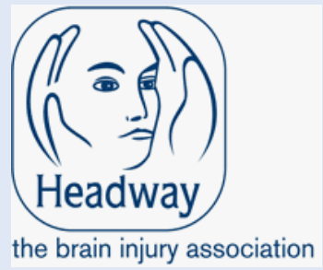
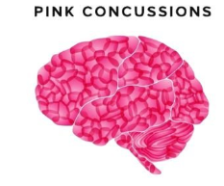
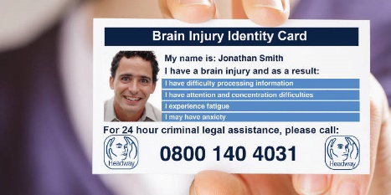

Resources:
Headway UK Headway - the brain injury association | Headway
Brainkind Brain Injury Charity and Rehabilitation - Brainkind | Brainkind
UKABIF United Kingdom Acquired Brain Injury Forum
PINK concussions Pink Concussions

Slide 21
Additional References
Cannon, L. M. et al. Examining trends in non‐fatal strangulation among sexual assault survivors seeking Sexual Assault Nurse Examiner care from 2002 to 2017. Int. J. Gynecol. Obstet. 149, 106–107 (2020).
Clarke, A. D. A. et al. Detecting a hidden pandemic: The current state and future direction of screening and assessment tools for intimate partner violence-related brain injury. Neurosci. Biobehav. Rev. 167, 105912 (2024).
Donaldson, A. E. et al. An exploration of frontline health professional’s current understanding of non-fatal strangulation. J. Adv. Nurs. 80, 5090–5101 (2024).
Foley, A. Strangulation: Know the Symptoms, Save a Life. J. Emerg. Nurs. 41, 89–90 (2015).
Herbenick, D. et al. #ChokeMeDaddy: A Content Analysis of Memes Related to Choking/Strangulation During Sex. Arch. Sex. Behav. 52, 1299–1315 (2023).
Sharman, L. S., Fitzgerald, R. & Douglas, H. Medical evidence assisting non-fatal strangulation prosecution: a scoping review. BMJ Open 13, e072077 (2023).
Raskin, S. A. et al. Traumatic brain injury screening and neuropsychological functioning in women who experience intimate partner violence. Clin. Neuropsychol. 38, 354–376 (2024).
Donaldson, A. E., Hurren, E., Harvey, C., Baldwin, A. & Solomon, B. Front‐line health professionals’ recognition and responses to nonfatal strangulation events: An integrative review. J. Adv. Nurs. 79, 1290–1302 (2023).
Muir, K. J. et al. Neuropsychological and Balance Symptoms of Abused Women Who Have Experienced Intimate Partner Violence-Related Strangulation: A Feasibility and Acceptability Study. Neurotrauma Rep. 3, 491–500 (2022).

Slide 22
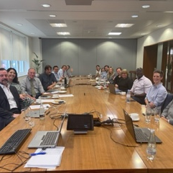
Thank you!
With thanks to Neuropsychiatry Faculty NFS working Group : Dr Matt Rowett, Dr Ana Miorelli, Dr Trudi Okello, Dr Czarina Kirk

Slide 23
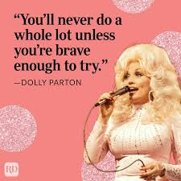
Last word goes to ...
Czarina.kirk@lscft.nhs.uk

