Slide 1
Supporting women with brain injury in the criminal justice system
BIL@brainkind.org
Complex Lives Research was funded by Ministry of Justice Wales
BIL service is funded by MOJ Wales and Health and Justice (NHS England)
Dr Annmarie Burns
Consultant Clinical Neuropsychologist
Annmarie.burns@brainkind.org
Notes:
0

Slide 2

Some context
Justice involved women are recognised as some of the most vulnerable and disadvantaged women in society
Histories of adverse childhood events, domestic abuse, exploitation, financial insecurity, poor mental health, substance use and homelessness
Complex interactions between these issues often means women are passed between services
Viewed as complex, challenging, difficult to treat
Notes:
.

Slide 3
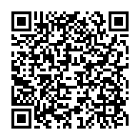

Making the link
2016-2018 HMP Drake Hall
Launched a pilot of the brain injury linkworker (BIL) service
Providing identification and neuropsychological rehabilitation of women with history of BI
  Staff training
  1:1 support
Resulted in the report: Making the Link (Brainkind, 2019)
Making-the-Link-Female-Offending-and-Brain-Injury.pdf

Slide 4

Making the Link: Key Findings
64%
62%
History indicative of BI
Reported they sustained their BI as a result of domestic abuse
33%
47%
Sustained their brain injury before their first offence
Had been to a HMP prison 5 or more times

Slide 5

Brainkind Research: Complex Lives 2024
Understand how women with brain injury in the CJS are currently supported
Understand if, and how, professionals in the CJS in Wales currently seek to identify brain injury
Explore the prevalence of brain injury in justice involved women in Wales, UK
Notes:
70 justice involved women

Slide 6
Complex lives: Methodology
Engaging with women:
70 participants all justice involved Welsh women
Brain injury Screening Index (BISI); Rivermead Post-Concussion Symptoms Questionnaire; PHQ-4; The Trauma Screening Questionnaire; Dimension of Anger Reactions.
Semi-structured interviews with the women focused on their experiences of the CJS and of seeking help for health and social issues
Engaging with Professionals:
72 professionals from the Welsh CJS took completed an online survey asking about knowledge of brain injury and how they support women
19 professionals participated in semi-structured interviews to explore the issues raised in the questionnaire in more detail
Notes:
Many from rural disadvantatged communities
Population of wales is 3.2 million
Ethnicity of our population was representative of the women, but it is not a diverse population

Slide 7
Key Findings: Justice involved women
80%
of participants screened positive on the BISI
92%
had experienced a serious blow to the head
78%
reported being held in a way they could not breathe
82%
self-reported 2 or more mental health conditions
68%
had made an attempt to take their own life
Notes:
With over 75% of females in prison reporting a head injury, almost 90% were accounted for by DA (McMillan et al., 2021).
NFS stat – include when presenting that 51% of women reported an associated LOC

Slide 8
Key Findings: Professionals
86%
would like to increase BI knowledge with training
90%
thought clear referral pathways would make a difference
72%
advice on having conversations about BI

Slide 9
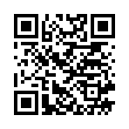
Complex lives: conclusions
Consistent with past research, a high proportion of the justice involved participants had a history suggestive of brain injury
Participants had experienced multiple disadvantages in life: childhood adversity, financial insecurity, domestic abuse, insecure housing, and described multiple physical and mental health conditions
Professionals communicated a commitment to supporting women with brain injury, but reported lack of knowledge and skills
Notes:
Interestingly, they had very good levels of education. Most had achieved GCSEs and stayed in full time education until 18 years unlike the male CJS
But few had transferred these skills to the workplace. Very few had jobs or had ever worked.

Slide 10

Women, brain injury and CJS
Significant number of women are likely to be struggling with consequences of undiagnosed brain injuries
Presenting with emotional difficulties or behaviours which challenge
High risk of their difficulties being mistattributed
Without brain injury being identified they are unlikely to be accessing the correct support
Without specialist support
  May experience increased financial vulnerability and social isolation
  Struggle to engage in rehabilitation programmes necessary to reduce recidivism
Notes:
E.g., not adhering to licence conditions being viewed as defiant and non-compliant rather than a consequence of memory difficulties.
Not responding to questions or instructions promptly being viewed as rude or disrespectful rather than slowed information processing
Females with BI have been found to have longer recovery times and worse outcomes for “mild” BIs (Maas et al., 2022)
92% of females in prison with a BI reported significantly worse mental health and substance misuse than males with a BI and individuals without a BI (McMillan et a., 2021; Blaya et al., 2022).

Slide 11
Brain Injury Linkworker Service
  The BIL service has been developed to:
  Meet the needs of the people we support
  Work within constraints of prison and probation services
  Be affordable and sustainable
  Fit with the requirements of commissioners
  Integrate with existing systems in prison and probation
  Effectively assess, manage and communicate risk

Slide 12
Current BIL Service
IDENTIFY
ASSESS
DISCHARGE
PRE-RELEASE SUPPORT
INTERVENTIONS

Slide 13
Support learners to understand the range of diverse deficits and impairments that are caused by brain injury and their impact on daily functioning
Provide tools to support practitioners to change one’s everyday approach to overcome and reduce the impact of neuro-disability on engagement
Ensure practitioners understand the importance of identifying and supporting those with neurodiverse conditions in the criminal justice system
ASK
UNDERSTAND
Support learners to understand the range of diverse deficits and impairments that are caused by brain injury and their impact on daily functioning
Provide tools to support practitioners to change one’s everyday approach to overcome and reduce the impact of neuro-disability on engagement
ADAPT
Notes:
Accessed via justice.gov mandatory training portal

Slide 14

Case example: Mya
Woman in her 40s in a female prison
In custody for a serious violent offence
History of significant domestic abuse and exploitation
Long history of substance misuse (drugs and alcohol)
Experienced brain injury in road traffic accident
Placed in custody straight from hospital, no post acute neuro-rehabilitation

Slide 15
Mya
Presenting Issues
Multiple incidents (“negative behaviours”) a week
Frequent loss of prison privileges
Conflicts with prison officers and peers
Described by staff as “disruptive”, “difficult” and “challenging”
Assessment
Limited understanding of her brain injury
Slow information processing and impaired memory
Poor emotional regulation and inability to manage impulsivity
Low self esteem, she felt “disrespected” and “disliked”

Slide 16
Mya
Intervention
Psychoeducation regarding her brain injury and its consequences
Shared formulation developed
Liaison with wing officers to support them in their communication with her
Communication book co-created with Mya
Developed strategies relating to her slow information processing and memory difficulties
Outcomes
Communication between Mya and prison staff improved
Staff less likely to misattribute her behaviour, instead understanding it in the context of BI
Prior to intervention an average of 3 incidents a week, at discharge no incidents for 8 weeks
Mya reported feeling “less disrespected” and “calm”
Notes:
Strength is in the combination of personal strategies and support form staff

Slide 17
Summary
Women with brain injury are presenting with behaviours which challenge the CJS
The behaviours are often misunderstood and misattributed
Women with ABI often struggle to engage with life in custody
Professionals are open to supporting women with BI but need guidance and resources
There is a clear need for neuropsychological expertise in the CJS
Adaptations/interventions should be evidence based but do not need to be complex: “Every interaction is rehab”
Notes:
Only once we start providing accessible support services to women with brain injury in the CJS, will we start to properly address the health and social inequalities that justice involved women face and have an opportunity to break the cycle of reoffending

Slide 18
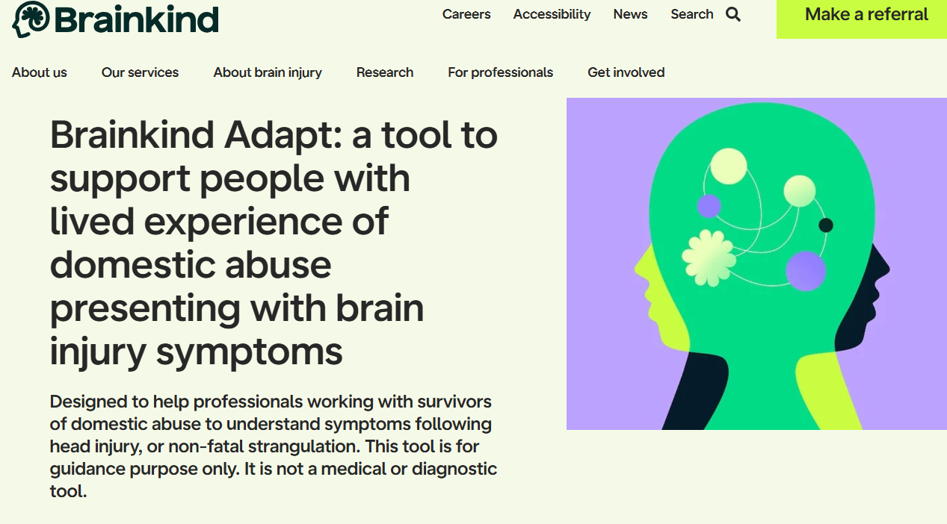
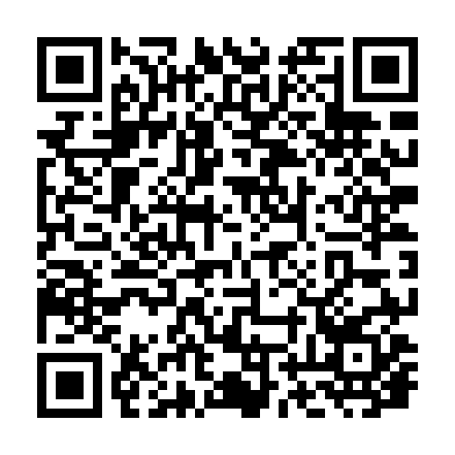
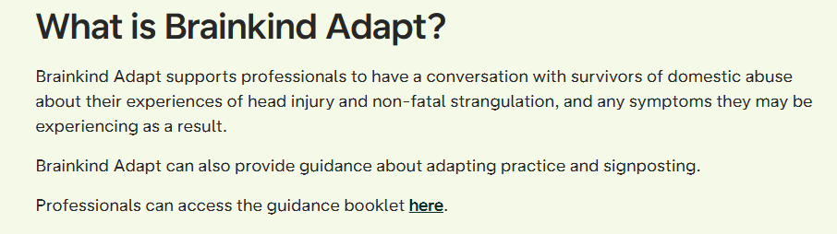

Slide 19
References
Chan, V., Estrella, M. J., Syed, S., Lopez, A., Hilderman, C. G., Colantonio, A., et al. (2023). Rehabilitation among individuals with traumatic brain injury who intersect with the criminal justice system: A scoping review. Frontiers in Neurology, 13, 1052294. https://doi.org/10.3389/fneur.2022.1052294 pubmed.ncbi.nlm.nih.gov
De Geus EQ, Milders MV, Van Horn JE, Jonker FA, Fassaert T, Hutten JC, Kuipers F, Grimbergen C, Noordermeer SD. Acquired brain injury and interventions in the offender population: a systematic review. Frontiers in psychiatry. 2021 May 7;12:658328.
Hunter, S., Kois, L. E., Peck, A. T., Elbogen, E. B., & LaDuke, C. (2023). The prevalence of traumatic brain injury (TBI) among people impacted by the criminal legal system: An updated meta-analysis and subgroup analyses. Law and human behavior, 47(5), 539.
Karr, Justin E., and T. K. Logan. "Post-Concussion symptoms in women with head injury due to intimate partner violence." Journal of neurotrauma 41, no. 3-4 (2024): 447-463.
Lattimore, P. K., Richardson, N. J., Ferguson, P. L., & Pickelsimer, E. E. (2022). The association of traumatic brain injury, post-traumatic stress disorder, and criminal recidivism. Health & Justice, 10(1), 7.
Maas, A. I., Menon, D. K., Manley, G. T., Abrams, M., Åkerlund, C., Andelic, N., ... & Zemek, R. (2022). Traumatic brain injury: progress and challenges in prevention, clinical care, and research. The Lancet Neurology, 21(11), 1004-1060.

Slide 20
References
Makovec Knight, J., Hannon, O., Spitz, G., Astridge, A., Copas, C., Duarte Martins, B., ... & Ponsford, J. (2025). Brain Injury Within Intimate Partner Violence: What Are the Cognitive Effects?. Journal of Neurotrauma.
Matheson, F. I., McLuhan, A., Riccardi, J. S., Kirby, A., & McMillan, T. M. (2024). Implementing interventions for women and youth with traumatic brain injury at transition from custodial settings: A call to action. Neuropsychiatric disease and treatment, 1169-1177.
McMillan, T. M., Aslam, H., Crowe, E., Seddon, E., & Barry, S. J. (2021). Associations between significant head injury and persisting disability and violent crime in women in prison in Scotland, UK: a cross-sectional study. The Lancet Psychiatry, 8(6), 512-520.
Pitman I, Haddlesey C, Ramos SD, Oddy M, Fortescue D. The association between neuropsychological performance and self-reported traumatic brain injury in a sample of adult male prisoners in the UK. Neuropsychol Rehabil. (2015) 25:763–79.
Williams, W., Chitsabesan, P., Fazel, S., McMillan, T., Hughes, N., Parsonage, M., & Tonks, J. (2018). Traumatic brain injury: a potential cause of violent crime?. The Lancet Psychiatry, 5(10)

