Slide 1

“Understanding MRI brain scans: What clinicians need to know’’
Presented by:
Dr.Habeba Mostafa, MD, FRCR, MSc, MBA, MBBCh
Assist.Lecturer of Neuroradiology-Cairo University, Locum neuroradiology consultant, UHNM

Slide 2
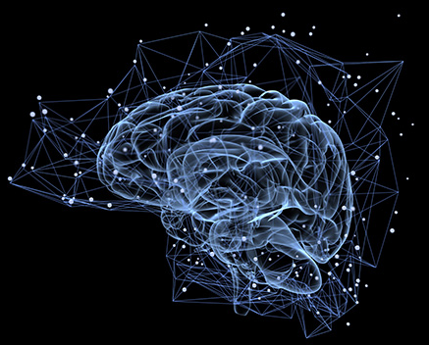
Objectives
What is the role of CT and MRI brain in diagnosis of dementia.
Qualitative & quantitative MR measures and scores.
Case based approach to dementia diagnosis.
Test your knowledge.

Slide 3
1.Resetting expectations: what is the rule of CT and MRI structural imaging in diagnosis of neurodegenerative conditions according to NICE guidelines.

Slide 4
What does CT brain diagnose?
Suspect the diagnosis of iNPH.
Predict the risk vascular dementia.
Rule out major acute emergencies and major organic causes of dementia.
All of the above.

Slide 5
What does MR brain diagnose?
Diagnose Alzheimer
Diagnose FTD
Diagnose Parkinson disease
Diagnose parkinson plus syndromes
Diagnose iNPH
Diagnose vascular dementia.
Rule out other organic causes of dementia
All of the above.
G+ the rest falls to the protocol, clinical data, and expertise.

Slide 6

Clinical context
https://jenniferbarney.substack.com/p/help-me-help-you

Slide 7
What does the correct MRI brain dementia protocol diagnose?
Suspect Alzheimer/aMCI
Suspect FTD
Suspect Parkinson disease
Diagnose some parkinson plus syndromes
Diagnose iNPH if we have the correct dataset
Predict the risk vascular dementia.
Rule out other organic causes of dementia
All of the above in presence of appropriate clinical data.

Slide 8
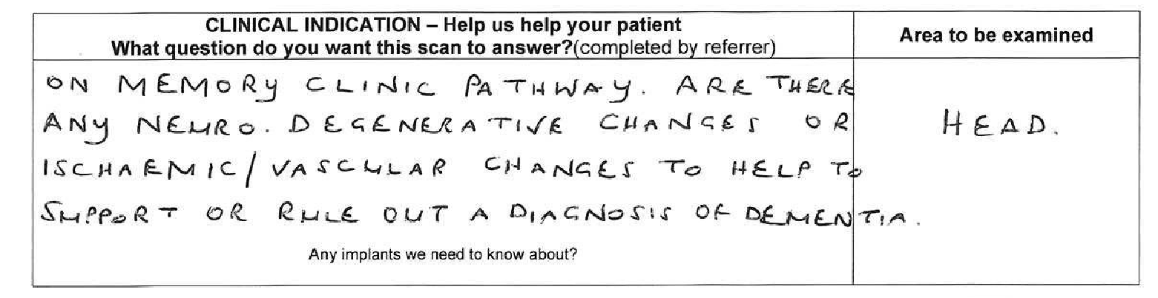
Clinical context: What we usually get

Slide 9
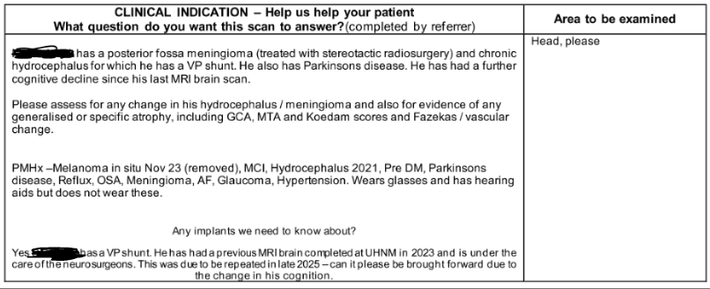
Clinical context: What we rarely get

Slide 10
What is minimum clinical data required
Is there language dysfunction.
Is there motor dysfunction and type/distribution.
Is there behavioral changes? Apathy or aggression.
Is there rapid cognitive decline.
Other specific symptoms? Visuospathial disorder?
What is your differential on clinical basis?

Slide 11
What are the minimum sequences for MRI brain dementia protocol diagnose?
Axial SWI not GRE: amyloid angiopathy and PD
DWI: Crutzfeldt Jacob disease among many others
At least 1 3D dataset, usually T1: Multipurpose particularly PSP diagnosis
At least one 2D coronal Dataset (FALIR/T2): mesial temporal structures and scoring purposes.
At least one axial coronal Dataset (FALIR/T2): small artery disease, encephalitis, inter-septal distance among others

Slide 12
I1.Scoring and qualitative measures of dementia.

Slide 13
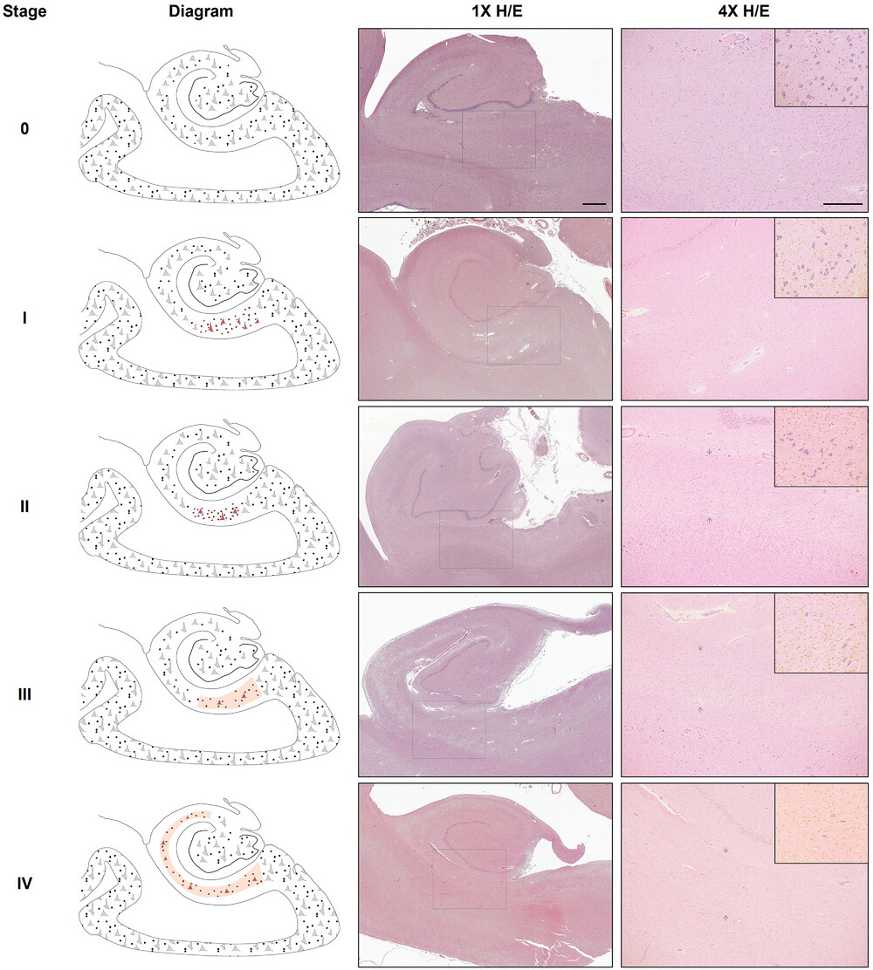
Mesio-temporal region: MTA & ERICA scoring
https://alz-journals.onlinelibrary.wiley.com/doi/10.1002/alz.12942

Slide 14
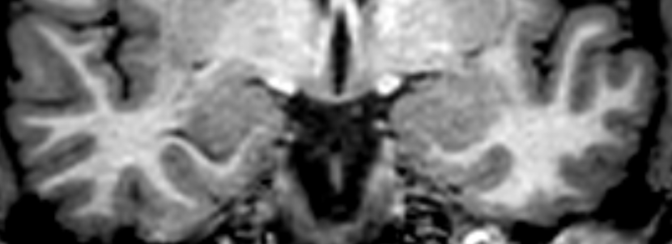
Normal mesio-temporal region checklist: amygdala, entorhinal cortex, collateral sulcus

Slide 15
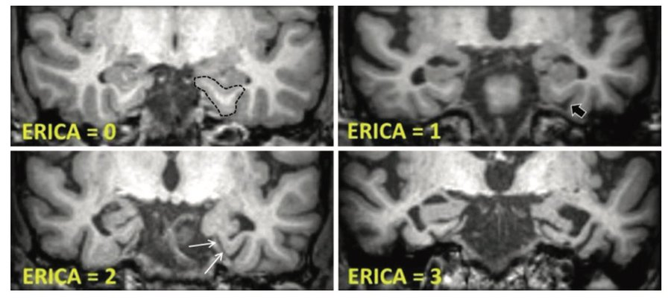
ERICA score: An ERICA score of 2 or greater achieved a higher diagnostic accuracy (91%) than the MTA score (74%), with a sensitivity of 83% versus 57% and a specificity of 98% versus 92% in discriminating dementia caused by AD from SCD (P < .001). The ERICA score was correlated with amyloid β 42/40 ratio (ρ = −0.54, P < .001) and with cerebrospinal fluid tau (ρ = 0.35, P = .001) and p-tau (ρ = 0.31, P = .004). In multivariable linear regression analysis, ERICA was associated with verbal learning and recall (β = −.40 and −.41), nonverbal recall (β = −.28), and cued recall (β = −.41, P ≤ .002 for all).
https://pubs.rsna.org/doi/abs/10.1148/radiol.2018171888?journalCode=radiology

Slide 16
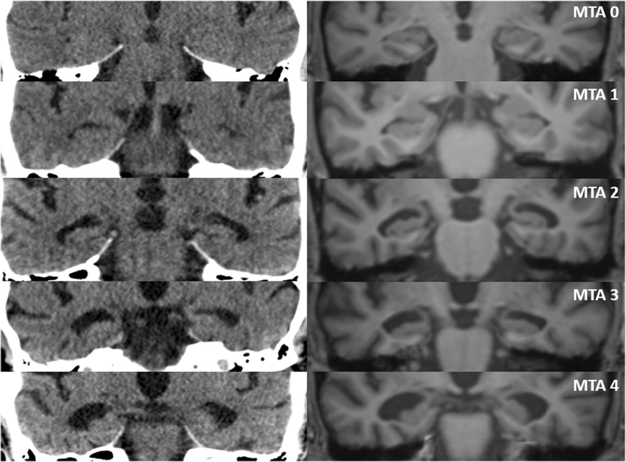
Mesio-temporal region: MTA scoring
http://dx.doi.org/10.1007/s00330-021-08177-1

Slide 17
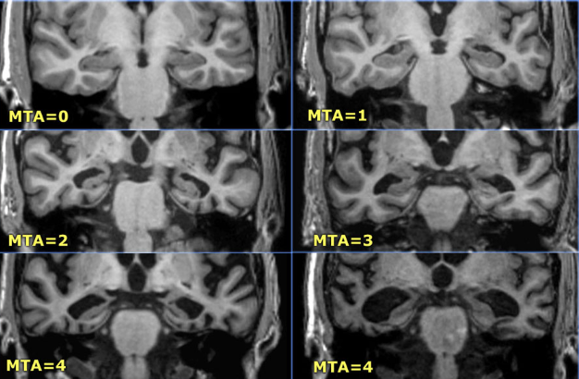
Mesio-temporal region: MTA scoring
< 75 years: score 2 or more is abnormal.
> 75 years: score 3 or more is abnormal.
https://radiologyassistant.nl/neuroradiology/dementia/role-of-mri

Slide 18
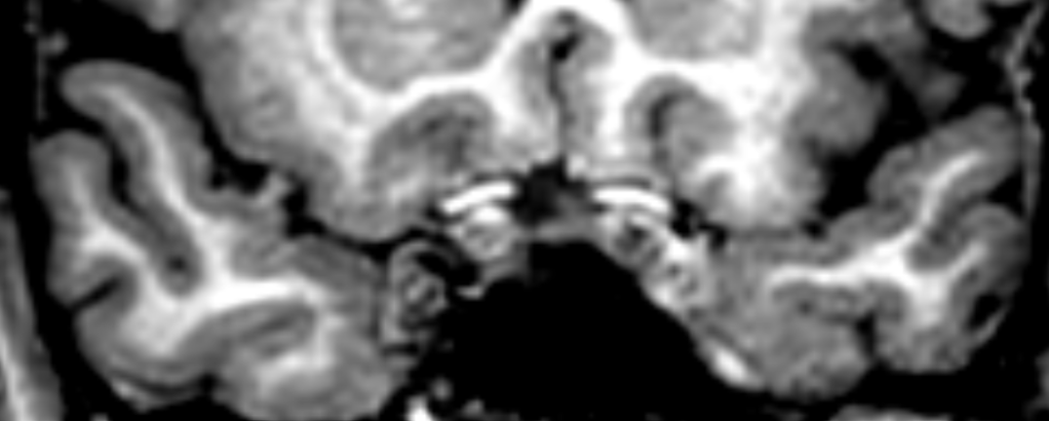
Normal mesio-temporal region checklist: temporal pole

Slide 19
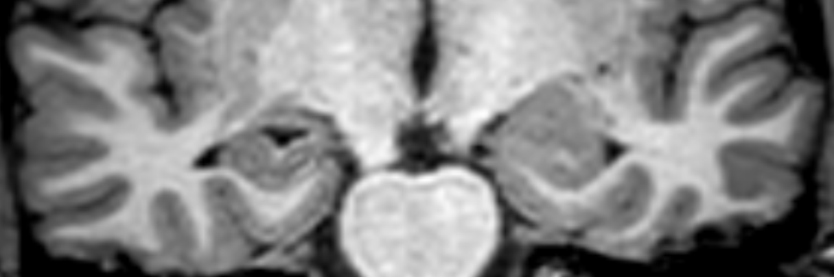
Normal mesio-temporal region checklist: hippocampi T temporal horns

Slide 20
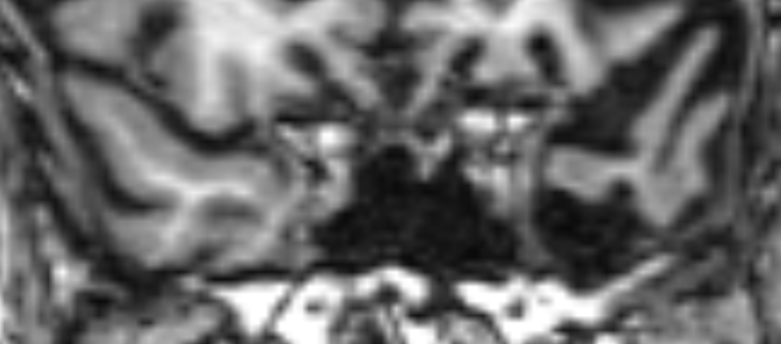
Abnormal mesio-temporal region: left temporal polar atrophy >>> semantic dementia

Slide 21
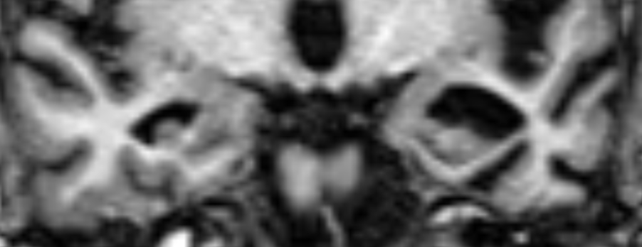
Abnormal mesio-temporal region: left amygdala, hippocampus, entorhinal cortical atrophy and widened collateral sulcus -arrow- >>> semantic dementia

Slide 22
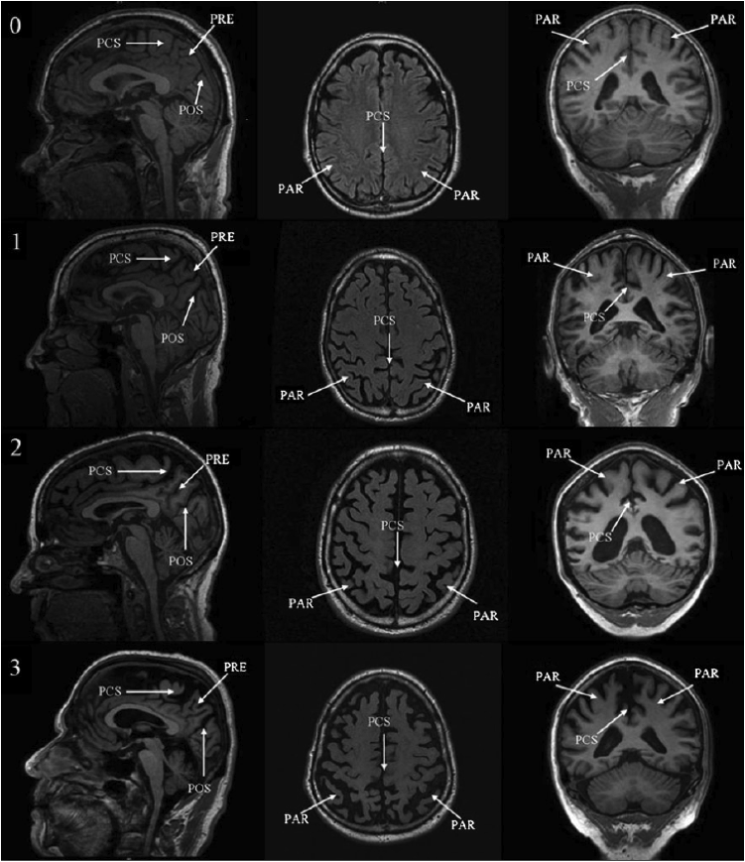
Precuneus atrophy, is it specific?? KOEDAM score??
https://epos.myesr.org/posterimage/esr/ecr2014/121817/mediagallery/538294

Slide 23
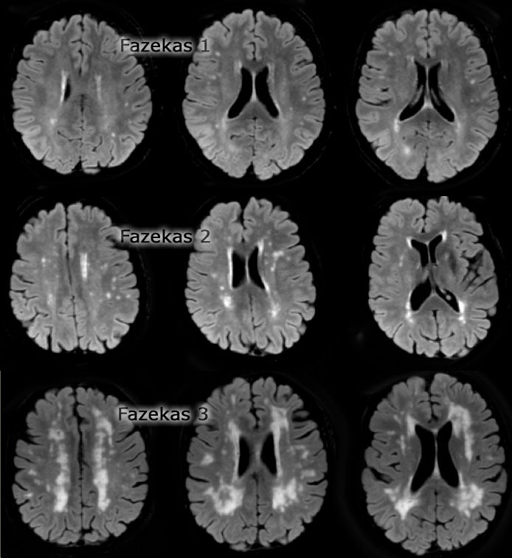
The Fazekas score??
2 & 3 are high risk not diagnostic of vascular dementia

Slide 24
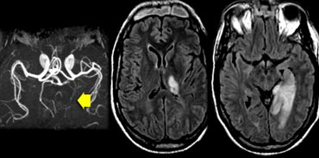
The strategic infarctions
https://radiologyassistant.nl/neuroradiology/dementia/role-of-mri

Slide 25
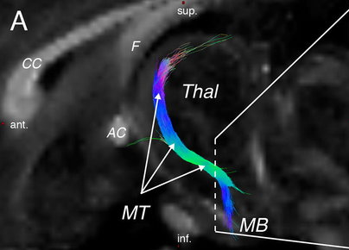
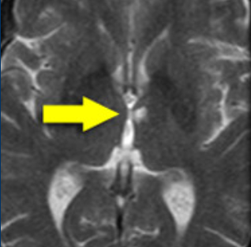
The strategic infarctions
https://radiologyassistant.nl/neuroradiology/dementia/role-of-mri

Slide 26
What is the diagnosis in this case
MTA score=2
Kodem score: 2
GCA score= 1
Fazekas 1 to 2

Slide 27

What Movie is this?
https://x.com/cinemabravoph/status/1756830475899769228

Slide 28
Let go of the scores
and
direct your attention to regional atrophy and its correlation in functional disorder

Slide 29
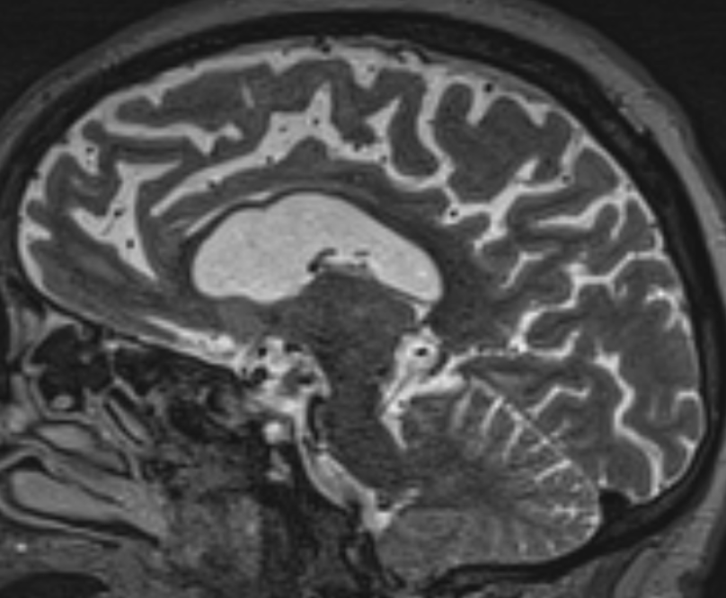
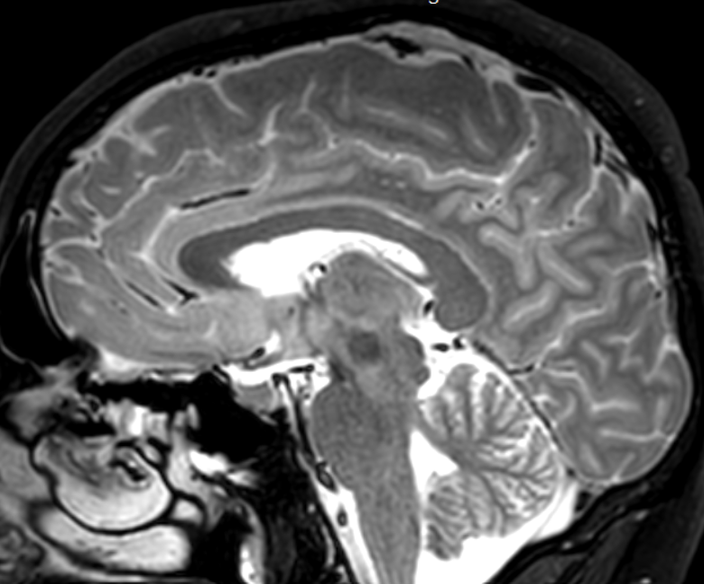
Regional atrophy: medial frontal and anterior callosal atrophy
FTD-PSP
Normal

Slide 30
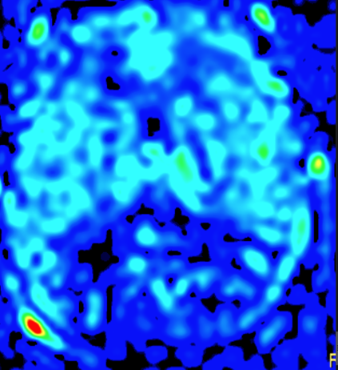
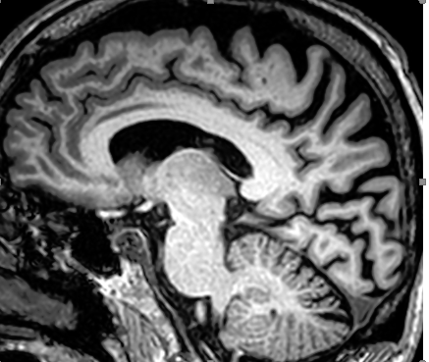
Regional atrophy: posterior cortical region??
Posterior cortical atrophy
FTD
FTD
Occipital hypoperfusion in 3D-PCASL MR ASL

Slide 31
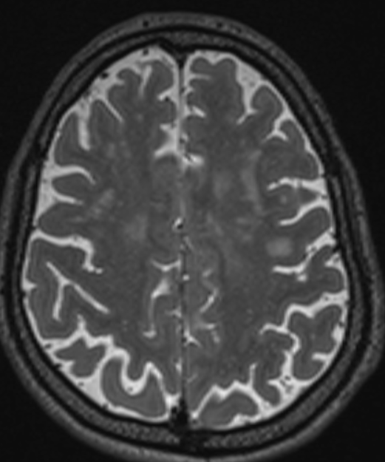
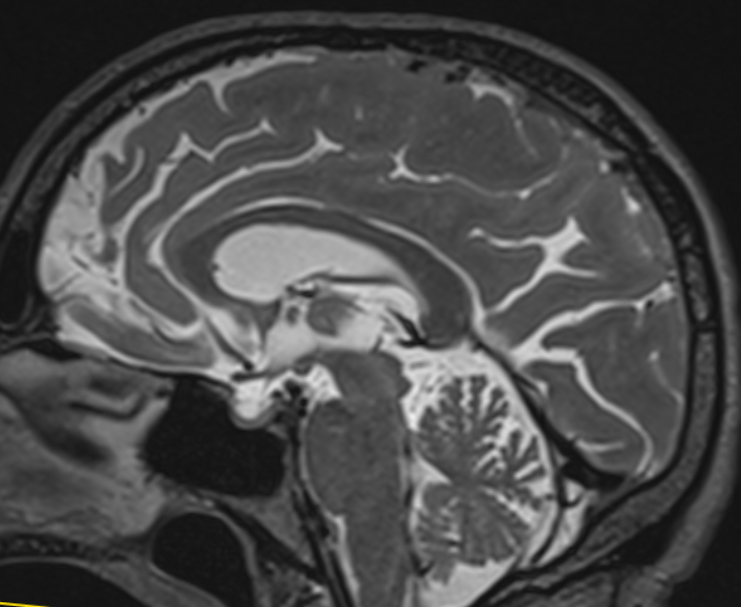
Regional atrophy: lateral parietal regions and precuneus-disorders of execution
AD-Notice the lateral parietal atrophy
AD
AD

Slide 32
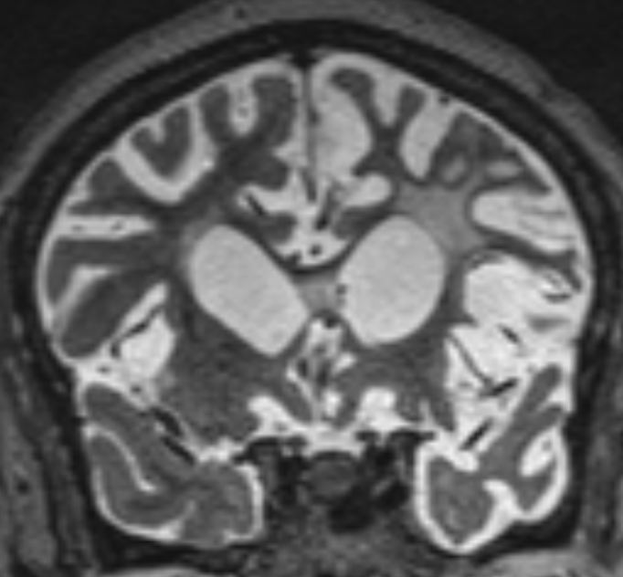
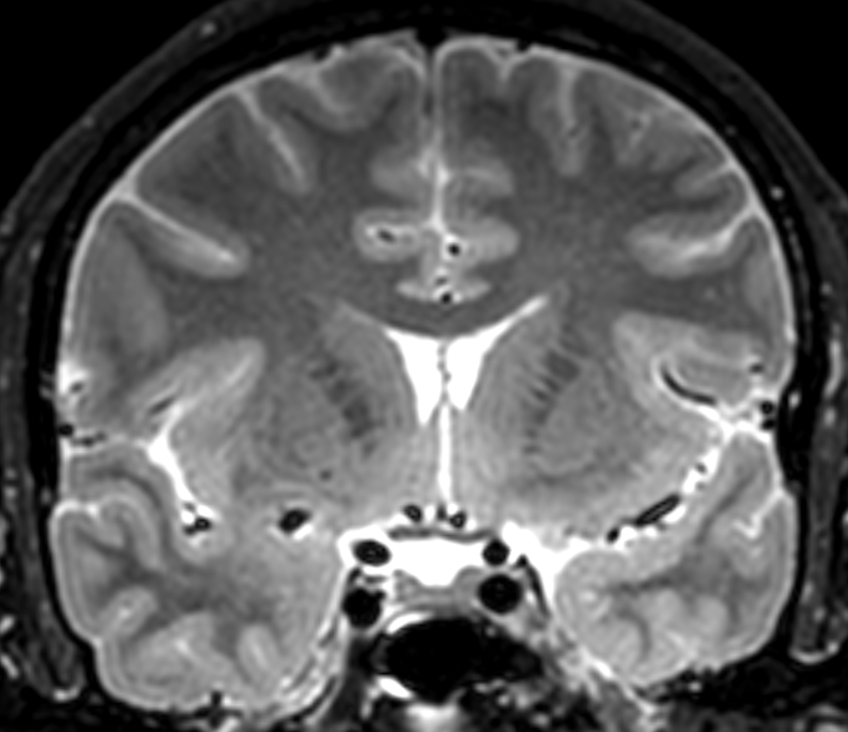
Regional atrophy: Fronto-opercular and temporal polar- Language variant FTD
FTD
Normal

Slide 33
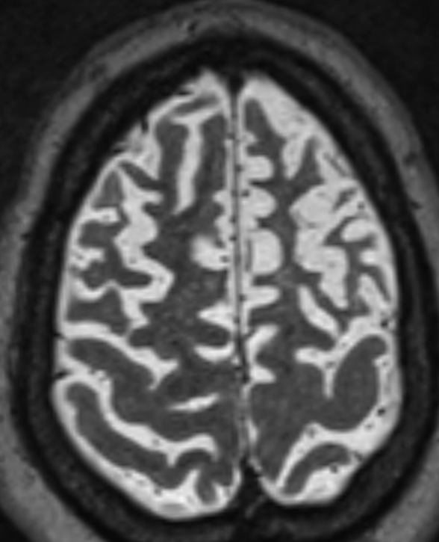
Regional atrophy: Dorsolateral prefrontal cortex: disorders of behavior and language
FTD

Slide 34
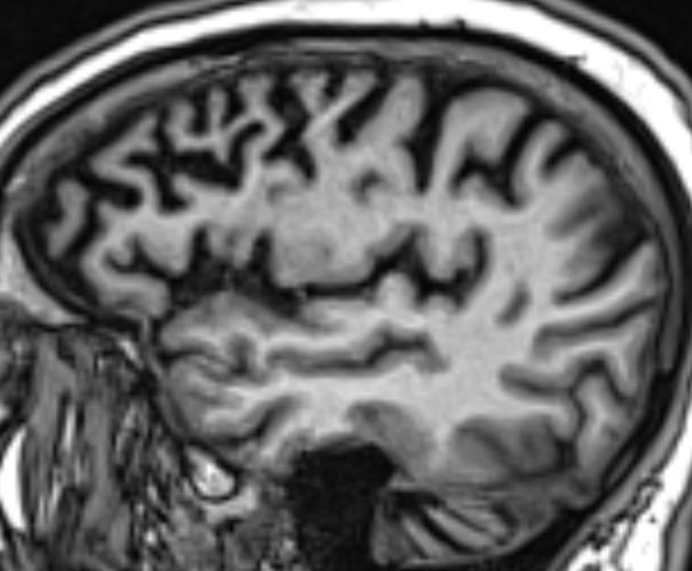
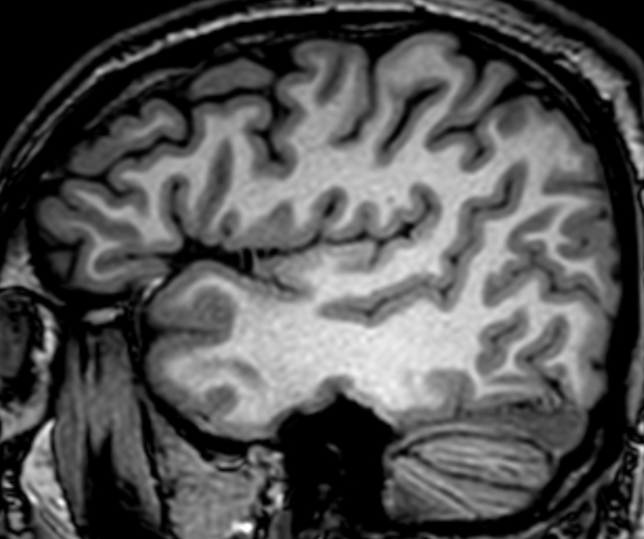
Regional atrophy: Dorsolateral prefrontal cortex: disorders of behavior and language
FTD
Normal

Slide 35
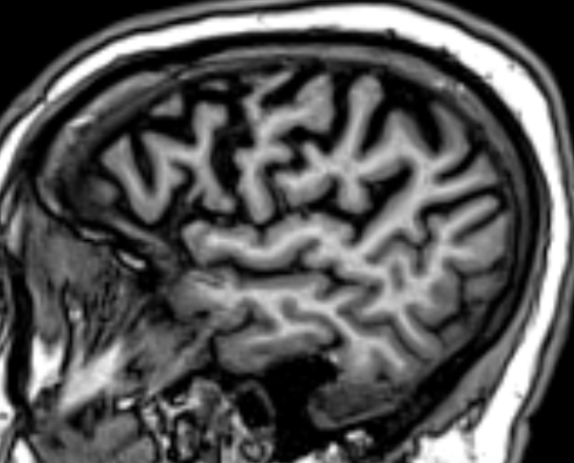
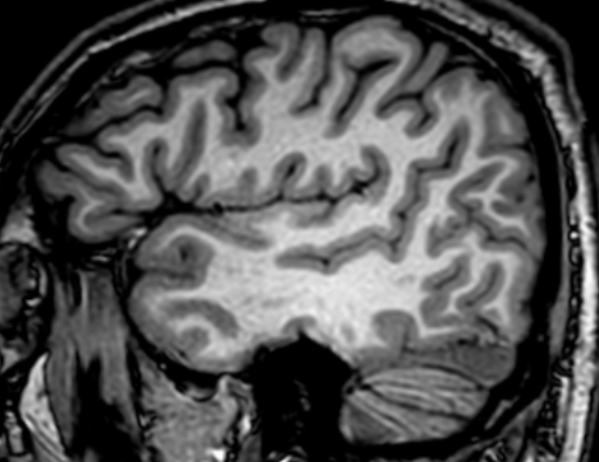
Regional atrophy: Dorsolateral prefrontal cortex: disorders of behavior and language
FTD
Normal

Slide 36
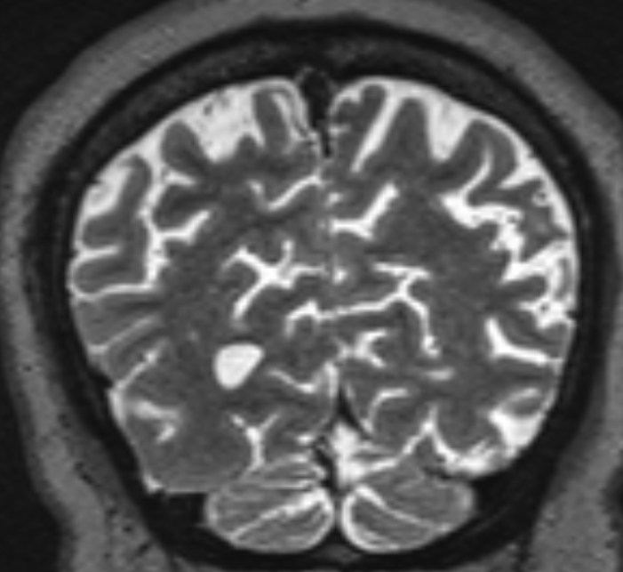
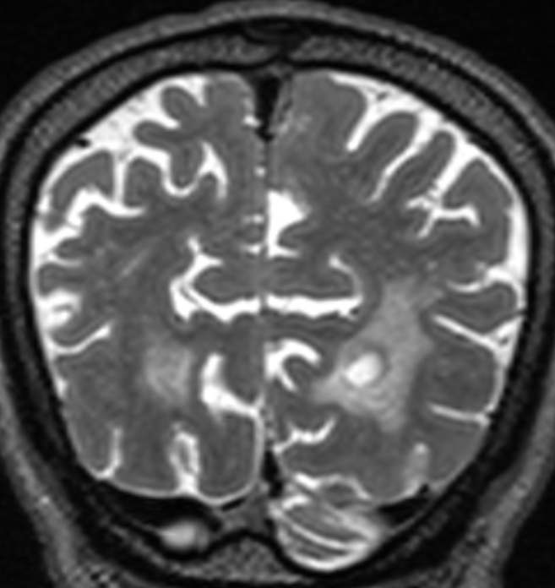
Is parietal structural atrophy specific??
FTD
AD

Slide 37
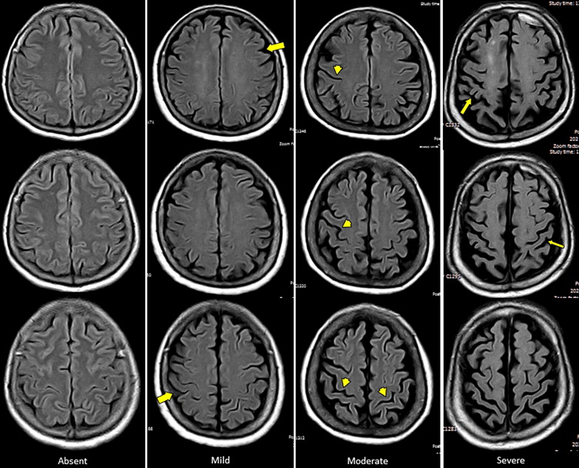
Cortical atrophy : GCA score
https://www.sciencedirect.com/science/article/abs/pii/S0167494314001770

Slide 38
1ii.Quantitative MR measures

Slide 39
3. Quantitative MR measures:
Measures for 1ry PD/2ry PD syndromes
Measures for iNPH
R2* for PD syndromes and other metal deposition related neurodegenerative conditions
Measures for AD & aMCI

Slide 40
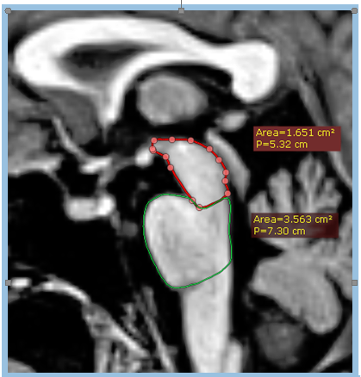
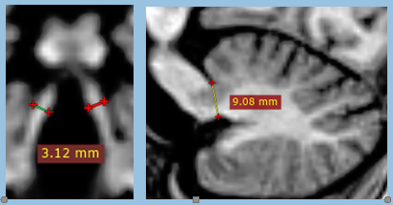
MR parkinson index (MRPI=[Pons/midbrain area]x[MCP/MCP thickness in cm]) for PSP>13.5
brainstem measures should be taken at exact midsagittal plane and SCP should be measured at the exact quadrigeminal plate plane

Slide 41
MR parkinson index (MRPI) for PSP>13.5
Meta-regression showed the association of the magnet field strength with heterogeneity. Studies using 3 T MRI showed significantly higher sensitivity (100%) and specificity (100%) than those of studies using 1.5 T MRI (sensitivity of 98% and specificity of 97%) (p < 0.01). Thus, the MRPI could accurately differentiate PSP from PD and support the implementation of appropriate management strategies for patients with PSP.
Diagnostic Performance of the Magnetic Resonance Parkinsonism Index in Differentiating Progressive Supranuclear Palsy from Parkinson’s Disease: An Updated Systematic Review and Meta-Analysis - PMC
https://doi.org/10.3390/diagnostics12010012

Slide 42
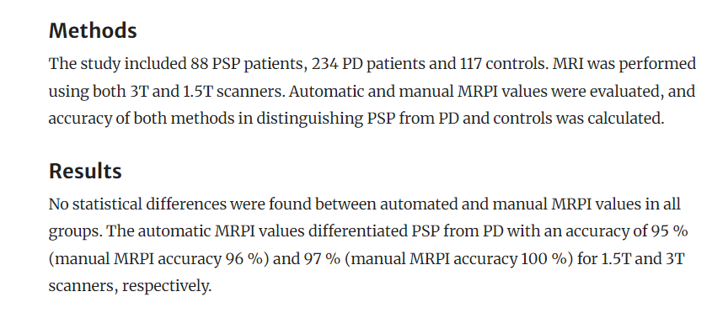
1I-MR parkinson index (MRPI) for PSP: MRI
Magnetic Resonance Parkinsonism Index: diagnostic accuracy of a fully automated algorithm in comparison with the manual measurement in a large Italian multicentre study in patients with progressive supranuclear palsy | European Radiology
https://doi.org/10.3390/diagnostics12010012

Slide 43
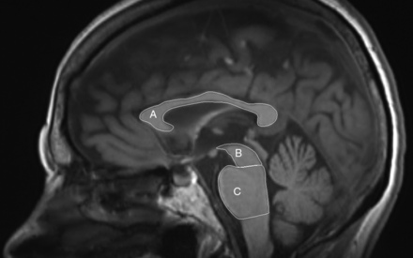
Corpus callosum atrophy
‘CC subsection analysis indicated a posteroanterior CC atrophy gradient in CBD, with relative preservation of the CC1 segment (prefrontal cortex). PSP, on the other hand, had more pronounced anterior CC atrophy.’
MRI Planimetry and Magnetic Resonance Parkinsonism Index in the Differential Diagnosis of Patients with Parkinsonism | American Journal of Neuroradiology
DOI: https://doi.org/10.3174/ajnr.A5618

Slide 44
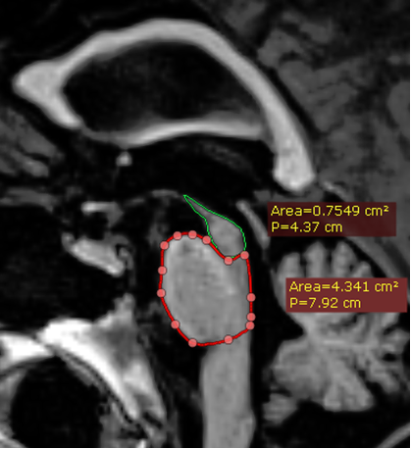
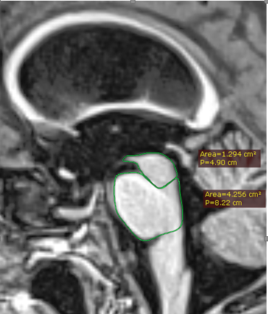
PSP vs CBD: callosal atrophy pattern:
MRPI=19.3 : 20.9
MRPI=11.78
PSP
CBD
Notes:
3964045 - 3165154

Slide 45
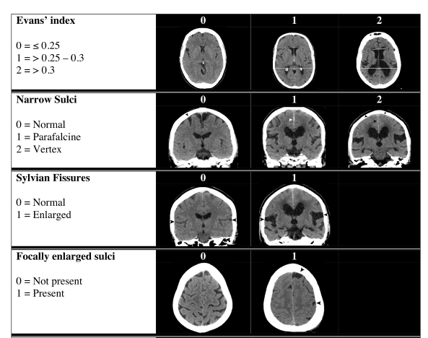
1II-RADscale for the iNPH
https://doi.org/10.1371/journal.pone.0232275

Slide 46
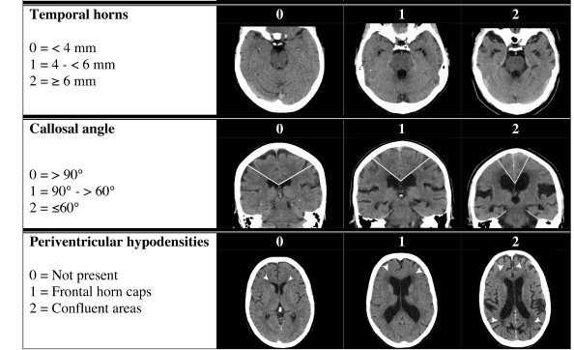
1II-RADscale for the iNPH
https://doi.org/10.1371/journal.pone.0232275

Slide 47
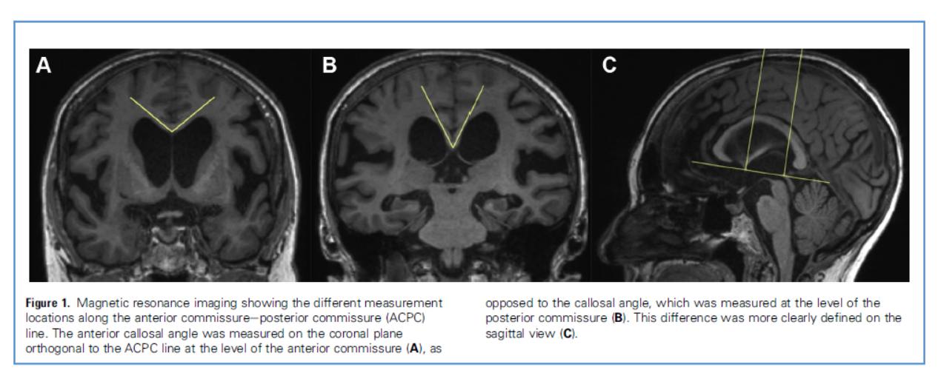
1II-Anterior callosal angle for the iNPH
https://doi.org/10.1016/j.wneu.2020.04.085

Slide 48
1II-Anterior callosal angle (ACA)for the iNPH
Mantovani et al. (2020):
''Baseline ACA was significantly correlated with preoperative fall risk, gait, and balance impairment assessed with Tinetti POMA scale. Additionally, baseline ACA differentiated patients who experienced improvement at Tinetti POMA scale after surgery.''
https://doi.org/10.1007/s00701-020-04699-7

Slide 49
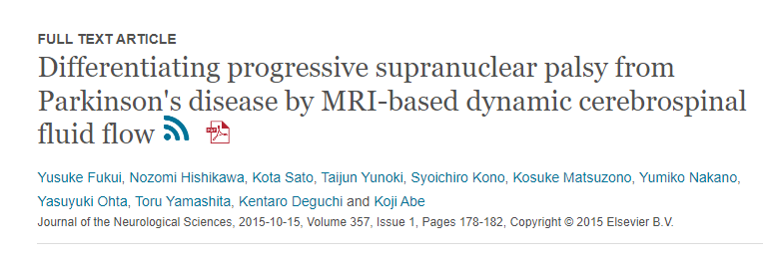
MR CSF flowmetry: Aqueduct area & CSF velocity
https://doi.org/10.1016/j.jns.2015.07.026
Differentiating progressive supranuclear palsy from Parkinson's disease by MRI-based dynamic cerebrospinal fluid flow - ClinicalKey

Slide 50
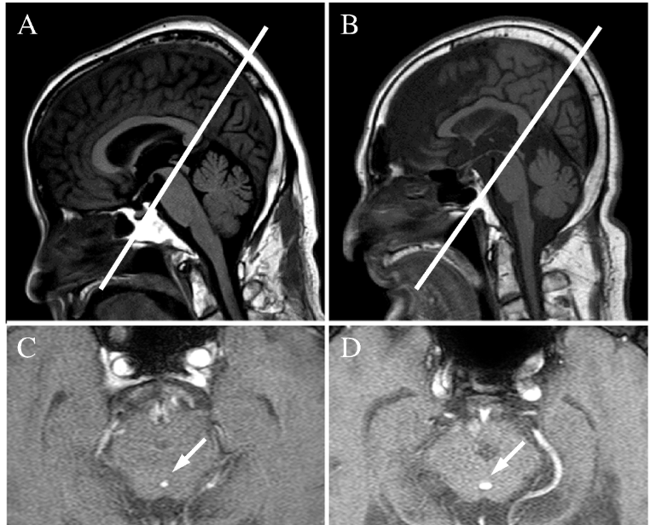
MR CSF flowmetry: Aqueduct area & CSF velocity
1ry parkinson
PSP
https://doi.org/10.1016/j.jns.2015.07.026

Slide 51
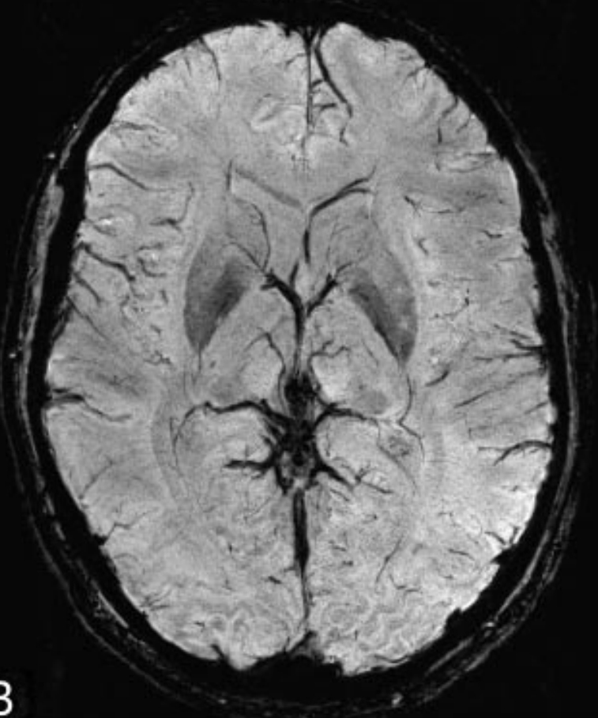
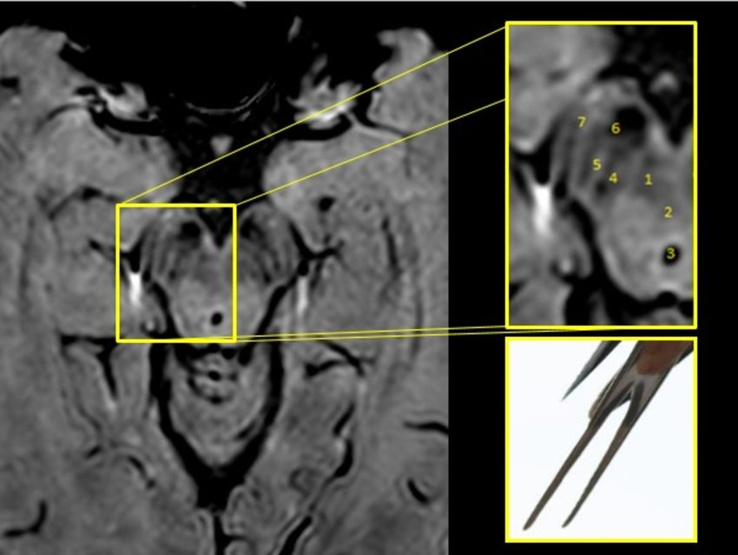
Quantification of iron deposition into the subcortical gray matter

Slide 52
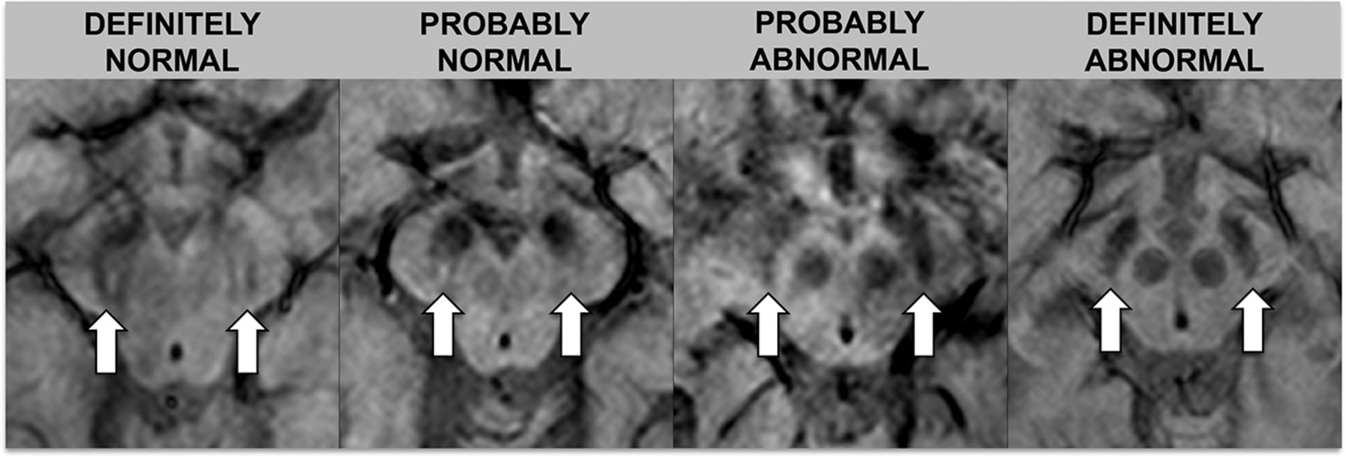
1I-SWI swallow tail sign: Lewy’s body dementia, PD, others
MRI of the Swallow Tail Sign: A Useful Marker in the Diagnosis of Lewy Body Dementia? | American Journal of Neuroradiology

Slide 53
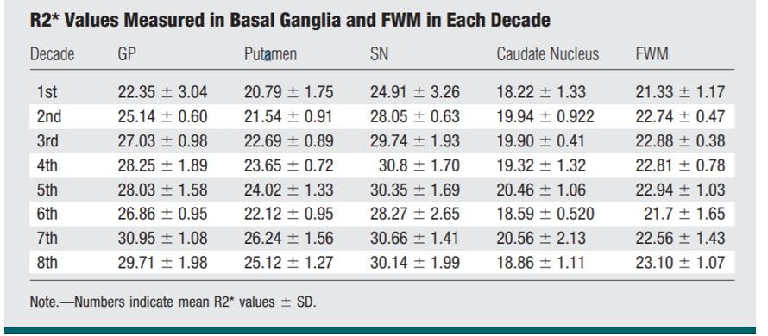
Quantification of iron deposition into the subcortical gray matter: normal values for each decade of age
https://doi.org/10.1148/radiol.2522081399

Slide 54
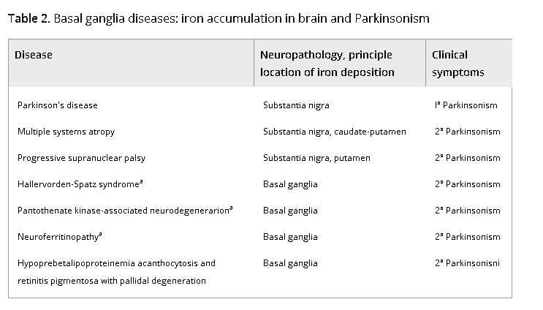
Quantification of iron deposition into the subcortical gray matter
https://onlinelibrary.wiley.com/doi/full/10.1002/jmri.21563

Slide 55
1V-R2* metal quantification for neurodegenerative conditions.
“In receiver operating characteristic (ROC) analyses, the putamen has been consistently demonstrated to have the highest area under the curve (AUC) values (~0.8–0.9) in differentiating MSA-p from PSP and PD (34, 45, 46, 58, 59, 63). Furthermore, the red nucleus and globus pallidus are the two most valuable nuclei in the diagnosis of PSP”
Brain Iron Accumulation in Atypical Parkinsonian Syndromes: in vivo MRI Evidences for Distinctive Patterns - PMC

Slide 56
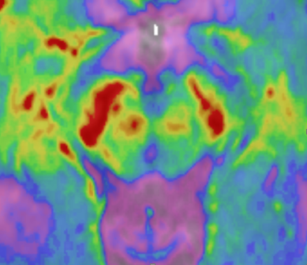

Quantification of iron deposition into the subcortical gray matter: R>L substantia nigra and red nucleus as well as right globus pallidus

Slide 57

Cortical band sign..CBD, ALS, PLS… among others

Slide 58

Amyloid angiopathy: 25% positive on SWI
Notes:
3804232

Slide 59

Interseptal distance (ISD): CT or MRI, measures should be taken at the exact AC-PC plane
Association of imaging abnormalities of the subcallosal septal area with Alzheimer's disease and mild cognitive impairment - Clinical Radiology

Slide 60

Interseptal distance (ISD): CT or MRI
Association of imaging abnormalities of the subcallosal septal area with Alzheimer's disease and mild cognitive impairment - Clinical Radiology

Slide 61

Interseptal distance (ISD): CT or MRI
Association of imaging abnormalities of the subcallosal septal area with Alzheimer's disease and mild cognitive impairment - Clinical Radiology

Slide 62

Interseptal distance (ISD): CT or MRI
Association of imaging abnormalities of the subcallosal septal area with Alzheimer's disease and mild cognitive impairment - Clinical Radiology

Slide 63
3. Case based approach to dementia diagnosis.

Slide 64
1-Dementia diagnosis ground rules:
A-Ruling out organic causes
B-Ruling out double pathologies
c-Follow up is a key while piecing your findings together

Slide 65

Case 1

Slide 66

Case 1

Slide 67

Case 1

Slide 68


Case 2

Slide 69

Case 3

Slide 70
Case 3

Slide 71

Case 3

Slide 72

Case 3

Slide 73

Case 3

Slide 74

Case 4

Slide 75

Case 4

Slide 76

Case 4

Slide 77



Case 4

Slide 78

Case 4

Slide 79

Case 4

Slide 80



Dementia: ruling out organic causes radiation-induced cerebral vasculopathy

Slide 81

Case 5

Slide 82

Case 6
https://doi.org/10.1017/cjn.2023.306

Slide 83
Case 6 PSP ?? Other pathologies??
https://doi.org/10.1017/cjn.2023.306

Slide 84

Follow up is a tool to diagnosis:MR Parkinson index (MRPI) of 6.2 (values <13.5 are either normal or MSA).

Slide 85
4. Test your knowledge

Slide 86


Case 1

Slide 87


Case 1

Slide 88
Dementia: iNPH

Slide 89


Case 2
Notes:
G72380

Slide 90


Case 2

Slide 91
Dementia: AD

Slide 92
***Compare case 1 (iNPH) to 2 (AD)
iNPH
AD

Slide 93
Take home message
Radiology output is as good as the requested protocol and provided clinical context.
Scores is helpful but regional atrophy is diagnostic.

Slide 94


Slide 95
References
Aquino, D., Bizzi, A., Grisoli, M., Garavaglia, B., Bruzzone, M. G., Nardocci, N., ... & Chiapparini, L. (2009). Age-related iron deposition in the basal ganglia: quantitative analysis in healthy subjects. Radiology, 252(1), 165-172.‏
Bi, B., Che, D., & Bai, Y. (2022). Neural network of bipolar disorder: Toward integration of neuroimaging and neurocircuit-based treatment strategies. In Translational Psychiatry (Vol. 12, Issue 1, pp. 1–12). Springer Nature. https://doi.org/10.1038/s41398-022-01917-x
Fukui Y, Hishikawa N, Sato K, Yunoki T, Kono S, Matsuzono K, Nakano Y, Ohta Y, Yamashita T, Deguchi K, Abe K. Differentiating progressive supranuclear palsy from Parkinson's disease by MRI-based dynamic cerebrospinal fluid flow. J Neurol Sci. 2015 Oct 15;357(1-2):178-82. doi: 10.1016/j.jns.2015.07.026. Epub 2015 Jul 21. PMID: 26227830.
Gan, C. L., O'Sullivan, M. J., Metzler-Baddeley, C., & Halpin, S. (2017). Association of imaging abnormalities of the subcallosal septal area with Alzheimer's disease and mild cognitive impairment. Clinical Radiology, 72(11), 915-922.‏
Kim S, Suh CH, Shim WH, Kim SJ. Diagnostic Performance of the Magnetic Resonance Parkinsonism Index in Differentiating Progressive Supranuclear Palsy from Parkinson's Disease: An Updated Systematic Review and Meta-Analysis. Diagnostics (Basel). 2021 Dec 22;12(1):12. doi: 10.3390/diagnostics12010012. PMID: 35054178; PMCID: PMC8774886.

Slide 96
References
Kockum K, Virhammar J, Riklund K, Söderström L, Larsson EM, Laurell K. Diagnostic accuracy of the iNPH Radscale in idiopathic normal pressure hydrocephalus. PLoS One. 2020 Apr 24;15(4):e0232275. doi: 10.1371/journal.pone.0232275. PMID: 32330190; PMCID: PMC7182203.
Mantovani P, Giannini G, Milletti D, Cevoli S, Valsecchi N, Gramegna LL, Albini-Riccioli L, Sturiale C, Cortelli P, Lanzino G, Elder BD, Palandri G; PRO-HYDRO Study Group. Anterior callosal angle correlates with gait impairment and fall risk in iNPH patients. Acta Neurochir (Wien). 2021 Mar;163(3):759-766. doi: 10.1007/s00701-020-04699-7. Epub 2021 Jan 12. PMID: 33438062.V.C. Constantinides, G.P. Paraskevas, G.
Velonakis, P. Toulas, E. Stamboulis, E. Kapaki. MRI Planimetry and Magnetic Resonance Parkinsonism Index in the Differential Diagnosis of Patients with Parkinsonism American Journal of Neuroradiology Jun 2018, 39 (6) 1047-1051; DOI: 10.3174/ajnr.A5618

Slide 97



