Slide 1




How Can Technology Help Neuropsychiatry Patients?
Digital Interventions for Traumatic Brain Injury and Beyond
A Comprehensive Review for Health Professionals
Dr Matthew Rowett
25 November, 2025
Notes:
"Good afternoon, everyone. It's a pleasure to be here with you, particularly among colleagues working at the intersection of neurology and mental health. I'm Dr. Matthew Rowett, and today we’re looking into a topic that is rapidly reshaping our field: How Can Technology Help Neuropsychiatry Patients?
This presentation is a comprehensive review, focusing not just on the 'what,' but the 'how' and 'why' digital interventions are essential for the future, particularly in managing the complex, chronic challenges associated with Traumatic Brain Injury and Acquired Brain Injury (TBI/ABI). Our goal is to move beyond the novelty of technology and discuss practical, evidence-based integration into UK Neuropsychiatry services."

Slide 2












Introduction
Digital technology is transforming mental healthcare, particularly in the field of neuropsychiatry, which deals with cognitive, emotional, and behavioural disorders resulting from neurological injuries.
Focus on TBI
Traumatic/Acquired Brain Injury (TBI/ABI)
Neurological conditions causing cognitive, emotional, and behavioral disorders
These conditions often lead to long-term distress and require continuous, accessible, and personalised support—areas where digital platforms can make a significant difference.
Clinical Challenges
Ongoing cognitive deficits, emotional dysregulation, and family burden
Digital Solutions
The Transformative Potential
Targeted, accessible, and continuous support for patients and families
Bridge geographical and logistical barriers to care
Provide continuous assessment and monitoring
Enable personalised, adaptive interventions
Page 2 | How Can Technology Help Neuropsychiatry Patients?
Notes:
"The narrative of mental healthcare is being rewritten by digital technology, and in neuropsychiatry—where cognitive, emotional, and behavioural disorders are intrinsically linked to neurological injury—this transformation is perhaps most critical.
Our patients often require support for decades. This support must be continuous, accessible, and highly personalised. Traditional, face-to-face models, particularly across the often-wide geographical spread of UK specialist centres, face significant logistical and workforce challenges.
Digital technology offers a transformative potential to bridge these barriers, provide continuous assessment and monitoring far beyond the clinic walls, and enable personalised, adaptive interventions.
Our specific focus today will be on TBI/ABI. We know the clinical challenges: persistent cognitive deficits, emotional dysregulation, and a profound burden on families. Digital solutions are the targeted, accessible tools we need to provide truly continuous support for both the patient and their family unit."

Slide 3

















Understanding Neuropsychiatry and TBI
Neuropsychiatry
TBI Pathophysiology
Resulting Challenges
The intersection of neurology and psychiatry focused on:
Traumatic brain injury involves:
Cognitive
Memory, attention, executive function
Primary injury mechanisms
Cognitive, emotional, and behavioral disorders
Secondary pathological processes
Emotional
Resulting from neurological injuries
Network disruptions in brain function
Mood regulation, emotional control
Including TBI and stroke
Behavioral
Social interactions, daily activities
These conditions often lead to long-term distress and require continuous, accessible, and personalised support.
Page 3 | How Can Technology Help Neuropsychiatry Patients?
Notes:
"Before looking at the solutions, let's briefly confirm our framework. Neuropsychiatry is fundamentally about the intersection of neurology and psychiatry. We address the cognitive, emotional, and behavioural changes resulting from neurological injuries like TBI and stroke.
When we discuss TBI, we're talking about complex pathophysiology—primary injury mechanisms, secondary pathological processes, and widespread network disruptions. This is not a static condition.
The resulting challenges are multifaceted:
Cognitive: Affecting memory, attention, and crucially, executive function—the very skills needed for daily life.
Emotional: Including mood regulation and emotional control.
Behavioral: Impacting social interactions and the ability to perform activities of daily living.
Understanding this complexity drives our need for adaptive, technologically supported interventions."

Slide 4


















The Burden of TBI
Long-term Complications & Burden
What is TBI/ABI?
Traumatic/Acquired Brain Injury (TBI/ABI) refers to damage to the brain caused by external physical force (traumatic) or due to disease, oxygen deprivation, or other non-external factors (acquired).
Cognitive Impacts
Emotional & Behavioral
Functional & Social
Memory deficits
Activities of daily living (ADL) challenges
Conditions include: Traumatic brain injury (TBI), stroke, and other neurological injuries
Executive function difficulties
Emotional dysregulation
Personality changes
Social role limitations
Attention impairments
Psychiatric comorbidities
Family burden
Healthcare Challenges
Support Requirements
Need for continuous, long-term support
Continuous monitoring
Accessible interventions
Personalised care
Geographic barriers to specialised care
Workforce distribution challenges
Page 4 | How Can Technology Help Neuropsychiatry Patients?
Notes:
"Traumatic and Acquired Brain Injury represents brain damage either from external force or non-external factors like stroke or oxygen deprivation. The burden on our healthcare system is significant, but more importantly, the burden on the patient and their family is immense.
Our system currently struggles with: the need for continuous, long-term support; the geographic barriers to specialist neuropsychiatric rehabilitation; and the inevitable workforce distribution challenges across the UK.
The long-term complications are chronic: memory deficits, executive dysfunction, emotional dysregulation, and secondary psychiatric comorbidities—all leading to significant challenges with Activities of Daily Living (ADL) and heavy family burden. Digital tools are perfectly positioned to meet this continuous monitoring and accessible intervention requirement."

Slide 5









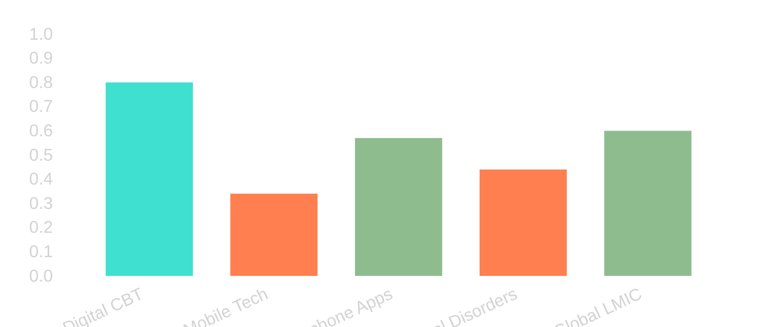





Evidence Base for Digital Mental Health Interventions
High-quality evidence from large-scale meta-analyses shows digital tools can produce clinical outcomes comparable to traditional care, establishing a foundation before TBI-specific applications.
Digital CBT Efficacy
Meta-analysis of 64 RCTs showed digital CBT for depression and anxiety is equivalent to face-to-face therapy.
ES: 0.80 Strong aggregate effect
NNT: 2.34 Treatment needed number
Mobile Technology Impact
Effect Size Comparison
Meta-analysis of 25 clinical trials (N=8,843) showed mobile technology enhances psychological interventions.
ES: 0.34
ES: 0.57
ES: 0.44
Overall effect
Smartphone apps
Psychological disorders
Global Applicability
Systematic review in low/middle income countries showed moderate effect (Hedges' g 0.60) with high-quality evidence.
Effect size (ES) of digital interventions vs. traditional therapy
Effective for MDD, GAD, panic disorder
Page 5 | How Can Technology Help Neuropsychiatry Patients?
Notes:
(The Foundation of Efficacy)
"The digital age in mental health is no longer a pilot project; it is grounded in robust, high-quality evidence. Large-scale meta-analyses confirm that digital tools produce clinical outcomes comparable to traditional care.
A key meta-analysis of 64 RCTs on digital Cognitive Behavioural Therapy (CBT) showed equivalence to face-to-face therapy with a strong effect size (ES: 0.80) and a very low Number Needed to Treat (NNT: 2.34). That is a powerful clinical validation.
Furthermore, mobile technology, specifically smartphone apps, has been shown to enhance psychological interventions. This evidence base extends beyond high-income countries; a systematic review across Low and Middle-Income Countries (LMICs) showed moderate, high-quality effects, demonstrating the global applicability and robustness of these tools for conditions like MDD and GAD.
This tells us: digital is not a compromise; it is a validated alternative."

Slide 6



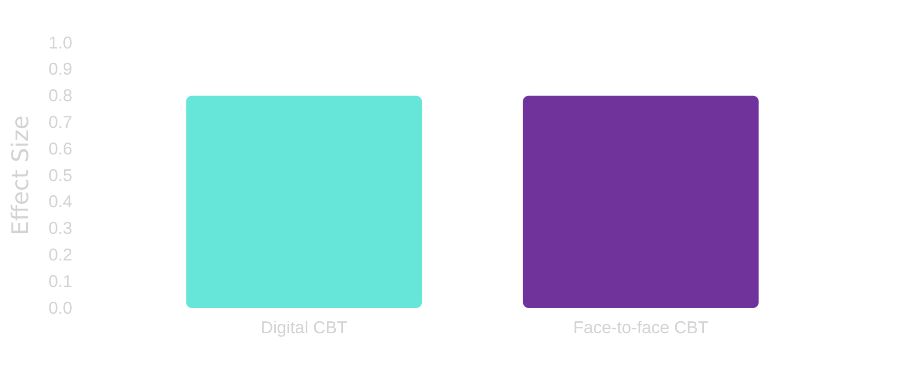











Equivalence to Traditional Therapies
Meta-Analysis Findings
Effect Size Comparison
Meta-analysis of 64 RCTs showed digital CBT produces effects comparable to face-to-face therapy
Strong aggregate effect size (0.80) indicates clinically significant results
Low treatment-needed number (NNT = 2.34) suggests high effectiveness
Key Clinical Applications
Real-World Implications
Digital CBT shows effectiveness for:
Rural Access
Timely Intervention
Addresses workforce distribution challenges in remote areas
Overcomes waiting lists for mental health services
MDD
GAD
Panic Disorder
Page 6 | How Can Technology Help Neuropsychiatry Patients?
Notes:
(Digital CBT as a Valid Treatment)
"To be clear on the equivalence: the collective data, particularly from the 64 RCTs, shows digital CBT is statistically comparable to traditional face-to-face delivery.
What does this mean for our day-to-day practice in the UK?
Rural Access: For specialist neuropsychiatric care, which can be difficult to access in remote areas, digital delivery immediately addresses workforce and geographic challenges.
Timely Intervention: By offering highly scalable, automated, or semi-automated programs, we can significantly overcome waiting lists for essential mental health services for TBI patients."

Slide 7



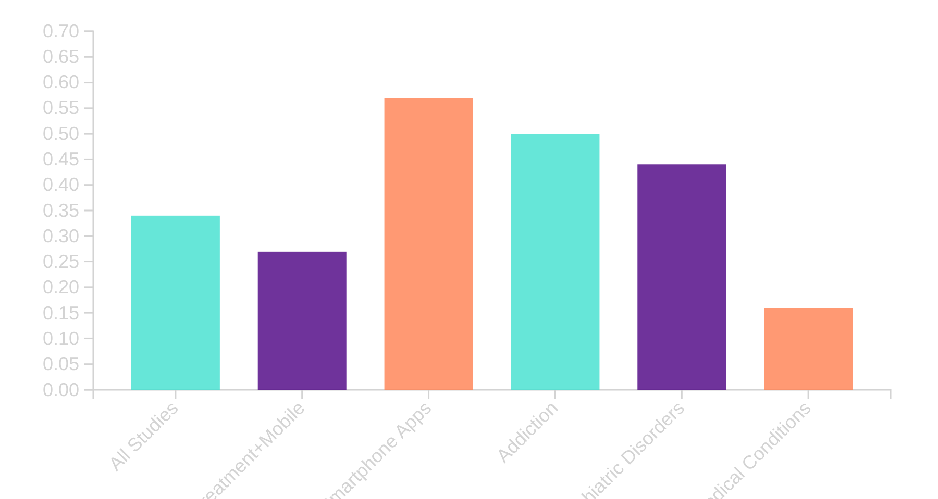





Mobile Technology Impact
Research Evidence
Effect Sizes by Intervention Type
Meta-analysis of 25 clinical trials (N=8843 participants)
Smartphone applications showed largest effect (ES = 0.57)
Significant heterogeneity between studies (Q=125.15, p<.0001)
Concerns about publication bias (fail-safe N=60)
Clinical Implications
Mobile technology enhances psychological therapies and behavioral interventions, with particular effectiveness for:
Effect sizes (ES) represent the magnitude of additional benefit provided by mobile technology interventions:
Addiction (ES = 0.50)
- Small effect: ES = 0.20 | - Medium effect: ES = 0.50 | - Large effect: ES = 0.80
Psychiatric disorders (ES = 0.44)
Page 7 | How Can Technology Help Neuropsychiatry Patients?
Notes:
(Focus on Smartphone Apps)
"When we dissect the digital tools, mobile technology stands out. A meta-analysis of 25 trials showed that smartphone applications demonstrated the largest effect size (ES = 0.57). This falls into the medium-to-large category based on Cohen's guidelines.
The clinical implications are profound: mobile tech enhances standard psychological and behavioural interventions, showing effectiveness particularly in addiction (ES = 0.50) and psychiatric disorders (ES = 0.44)—conditions highly prevalent post-TBI. This portability and accessibility are crucial for patients with functional and mobility challenges."

Slide 8














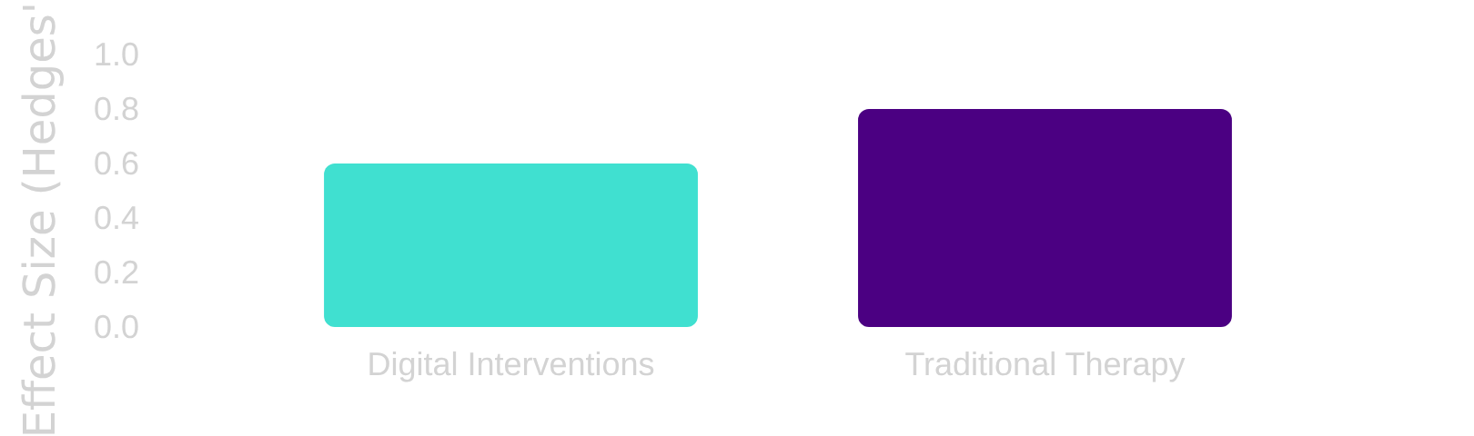
Global Applicability
Evidence from LMICs
Contextual Factors
Systematic reviews and meta-analyses show digital psych interventions are effective in low and middle-income countries
Significant heterogeneity between studies (I = 74%) indicates effectiveness varies by:
Background Factors
Combined effect size of Hedges' g 0.60 (Fu et al., 2020)
Socioeconomic conditions, healthcare infrastructure, cultural context
High quality evidence (GRADE ratings)
Digital Tool Nature
Platform type, complexity, language, accessibility features
Implementation Strategies
Effect Size Comparison
Delivery method, adaptation for local context, integration with existing services
Page 8 | How Can Technology Help Neuropsychiatry Patients?
Notes:
(Relevance to UK Health Equity)
"The evidence from LMICs, with an effect size of Hedges' g 0.60, reinforces the adaptability of these interventions. However, the data also reveals significant heterogeneity (I² = 74%).
This heterogeneity isn't a red flag; it's a vital reminder that effectiveness varies based on contextual factors. We must tailor:
Digital Tool Nature: Platform type, complexity, language.
Implementation Strategies: How the tool is delivered and integrated with existing UK services.
The lesson for us is that simply providing the tool isn't enough; we must adapt it for the patient's socioeconomic, cultural, and healthcare infrastructure context."

Slide 9













Digital Applications in TBI Management
Digital platforms are transforming TBI management by providing targeted, accessible support to address the unique challenges this condition presents.
Cognitive Deficits
Emotional Dysregulation
Family Stress
Remotely delivered cognitive rehabilitation
Online psychological interventions
Family-centered online interventions
Mobile-based mood monitoring
Digital caregiver support programs
Digital cognitive assessment tools
Technology-assisted family communication
Digital peer support communities
Personalised cognitive training programs
Digital CBT has shown equivalent effectiveness to face-to-face therapy for depression and anxiety.
Research shows digital family interventions can reduce psychological distress for caregivers.
Studies show digital cognitive interventions produce moderate effects on cognitive function (SMD=0.59).
Key advantage: Digital technologies help overcome geographical and logistical barriers, making specialised TBI support more accessible to diverse patient populations.
Page 9 | How Can Technology Help Neuropsychiatry Patients?
Notes:
(Targeted Interventions)
"Digital interventions are not just for general mental health; they are being specifically adapted for the core deficits of TBI.
Cognitive Deficits: We're seeing effective remotely delivered cognitive rehabilitation and digital assessment tools, yielding a moderate effect size (SMD=0.59).
Emotional Dysregulation: Online psychological interventions and mobile-based mood monitoring are providing accessible support.
Family Stress: Crucially, family-centered online interventions are proving effective in reducing the psychological distress of caregivers—addressing the significant 'family burden' we noted earlier.
The key remains: overcoming geographical and logistical barriers to deliver sustained, specialist care."

Slide 10















Therapeutic Interventions for TBI
Digital Therapeutic Programs
Online Family Problem Solving (OFPS) Intervention
Digital platforms provide structured therapeutic interventions directly to patients and families, overcoming geographical and logistical barriers.
Carey et al. (2008) - Randomised clinical trial with 40 families
Key Benefits
Intervention Components
Direct delivery to patients and families
Therapist video conferences
Internet-based resources
Overcoming geographical barriers
Structured therapeutic approaches
Key Outcomes
Significant Improvements
Technology Use
Technology Adoption Factors
Parents in OFPS group showed greater improvements in depression, anxiety, and overall psychological distress
Parents who frequently used technology at home missed fewer sessions (avg. 7.64 vs. 16.33)
A study by Munsell et al. (2020) found that:
Elderly patients (51-70 years) showed higher engagement
Missed Sessions by Technology Usage
Rural patients completed more sessions (11.54 more)
Younger urban patients showed lower engagement
Page 10 | How Can Technology Help Neuropsychiatry Patients?
Notes:
(Structured Programs and Engagement)
"Structured Digital Therapeutic Programs are essential. The 2008 Online Family Problem Solving (OFPS) Intervention study by Carey et al. showed real clinical improvements: parents experienced greater reductions in depression, anxiety, and distress. Critically, technology users at home missed fewer sessions.
This leads us to key research on Technology Adoption Factors (Munsell et al., 2020). The data gives us an important insight: engagement is not uniform.
Older patients (51-70 years) showed higher engagement.
Rural patients completed significantly more sessions.
Younger urban patients showed lower engagement.
This challenges the assumption that digital uptake is driven solely by youth, suggesting that need and lack of alternative access are powerful motivators."

Slide 11



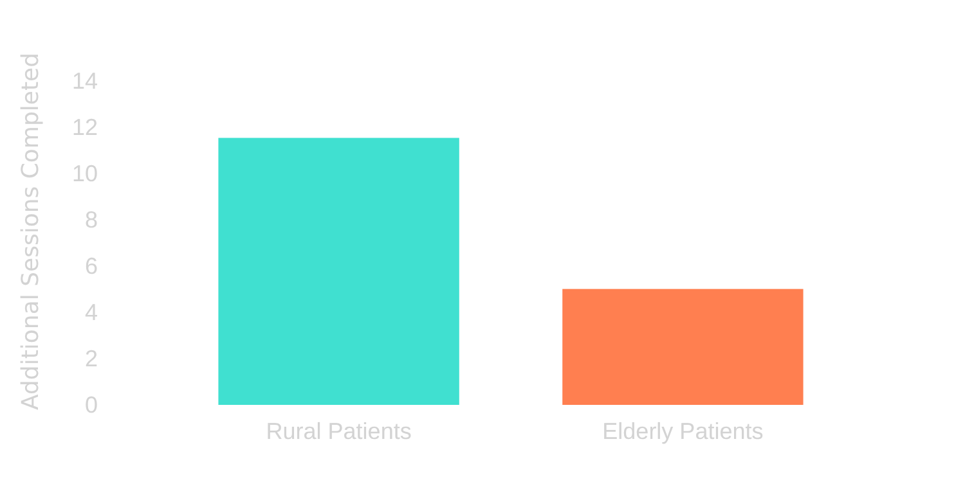










Technology Adoption Factors
Key Factors Affecting Adoption
Session Completion Analysis
Baseline Technology Comfort
Comparing session completion rates between patient groups
Previous technology use at home significantly predicts treatment engagement
Geographic Location
Rural patients show higher engagement with home digital therapies
Age Demographics
Older patients (51-70 years) demonstrate greater treatment adherence
Rural patients completed 11.54 more sessions (p=.001)
Elderly patients (51-70) completed 5.01 more sessions (p=.04)
Surprising Insight: Rural and elderly patients show higher engagement with home digital therapies than younger urban patients
Page 11 | How Can Technology Help Neuropsychiatry Patients?
Notes:
(The Surprising Insight)
"Let's dwell on these adoption factors, as they are crucial for implementation in UK services. When selecting patients for digital pathways, we must consider:
Baseline Technology Comfort: A key predictor of adherence.
Geographic Location: Rural patients, who often face longer travel times to specialist clinics, show higher engagement (11.54 more sessions completed).
Age: Older patients (51-70 years) show higher treatment adherence (5.01 more sessions completed).
The Surprising Insight is that the 'digital divide' might cut differently in clinical settings—where the patient is motivated by the clinical benefit and the logistical convenience. This should inform our patient selection and service design."

Slide 12








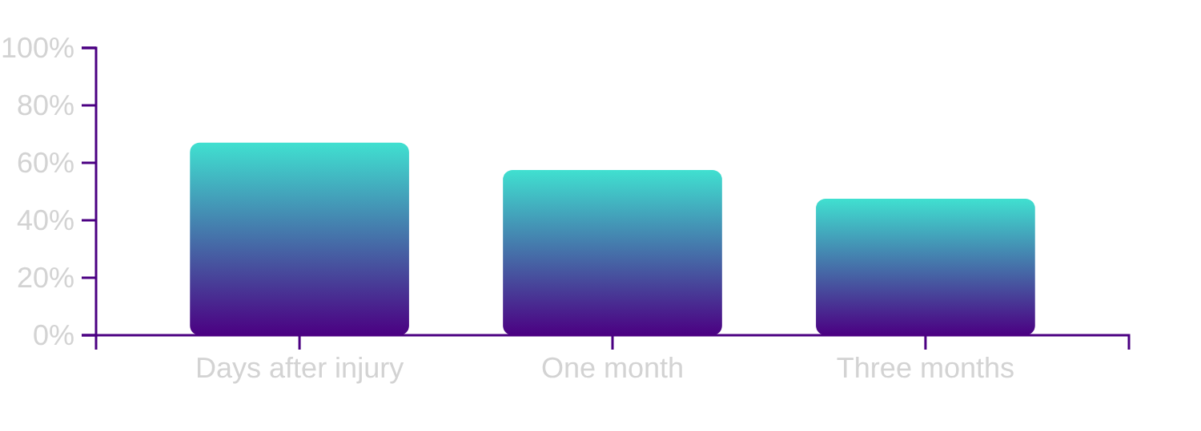





Digital Assessment and Remote Monitoring
Digital Neuropsychological Assessment
Remote Monitoring for TBI
Electronic surveys for mTBI follow-up show practical utility in identifying patients with persistent symptoms.
Tablet-based d-NPA shows high feasibility with 94% completion rate for ABI patients
Key challenge: Traditional paper norms don't apply to digital format
Follow-up Completion Rates
34% of healthy controls scored below 10th percentile on digital versions
Implementation Challenges
Normative Data
Need for new, validated norms specific to digital format
Population Differences
Digital format may affect performance across different demographics
Page 12 | How Can Technology Help Neuropsychiatry Patients?
Notes:
(Validating Digital Tools)
"Moving from intervention to assessment, the shift to digital neuropsychological assessment (d-NPA) is happening. Tablet-based d-NPA shows excellent completion rates (94% for ABI patients), offering efficiency.
However, a major clinical challenge emerges: normative data. Traditional paper norms do not reliably translate. One study showed 34% of healthy controls scored below the 10th percentile on digital versions. This necessitates:
Developing new, validated norms specific to the digital format.
Understanding population differences in digital performance.
For Remote Monitoring, electronic surveys are showing practical utility in mTBI follow-up, identifying patients with persistent symptoms early, which is vital for timely intervention."

Slide 13




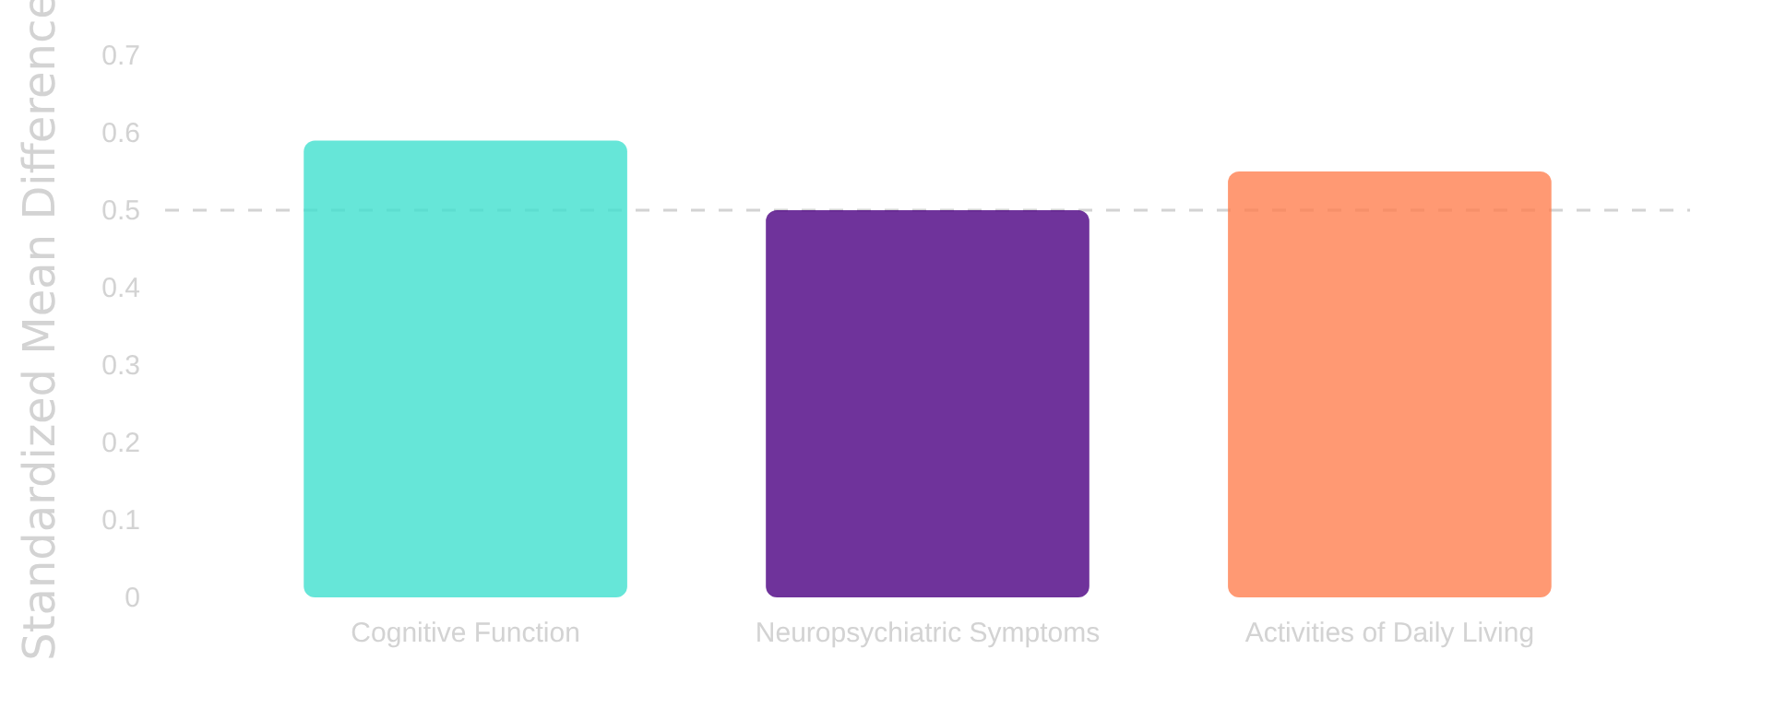






Digital Cognitive Interventions
Key Findings
Effect Sizes (Standardised Mean Difference)
A systematic review and meta-analysis (Chi et al., 2025) showed that digital cognitive interventions:
Produced moderate but significant improvements in cognitive function (SMD=0.59)
Reduced neuropsychiatric symptoms (depression, anxiety)
Enhanced activities of daily living (ADL)
Cognitive Function
0.59
Neuropsychiatric Symptoms
0.50
Activities of Daily Living
0.55
Particular Promise
Moderate effect size
Moderate effect size
Moderate effect size
Virtual Reality-Based Cognitive Interventions (VR-CI)
Effect sizes interpreted using Cohen's guidelines: <0.2 (small), 0.2-0.5 (moderate), >0.5 (large)
Showed promise in the study, offering immersive and engaging treatment environments
Page 13 | How Can Technology Help Neuropsychiatry Patients?
Notes:
(Evidence for Function)
"Chi et al.'s 2025 systematic review confirms the value of digital cognitive interventions. They produced:
Moderate but significant improvements in cognitive function (SMD=0.59).
Reduction in neuropsychiatric symptoms (SMD=0.50).
Enhancement of Activities of Daily Living (ADL) (SMD=0.55).
Crucially, these are clinically meaningful effects. And among the various interventions, Virtual Reality-Based Cognitive Interventions (VR-CI) showed particular promise, offering immersive and engaging environments—a clear step beyond traditional pen-and-paper tasks."

Slide 14












Virtual Reality Applications
VR-Based Cognitive Interventions
Outcomes & Potential
Key Findings
Future Directions
Virtual reality technology offers immersive environments for cognitive rehabilitation and enhancement in TBI patients.
Significant improvements in cognitive function (SMD=0.59)
Personalised VR environments for individual needs
Reduced neuropsychiatric symptoms (depression, anxiety)
Integration with neurofeedback systems
Theoretical Basis
Immersive environments for targeted cognitive training
Remote monitoring and home-based rehabilitation
Enhanced activities of daily living (ADL)
Adaptive difficulty levels based on performance
Social interaction opportunities for communication skills
Research Status
Chi et al. (2025) conducted a high-quality systematic review and meta-analysis on digital cognitive interventions for TBI patients, finding VR-CI showed particular promise among various interventions.
Page 14 | How Can Technology Help Neuropsychiatry Patients?
Notes:
(Next-Generation Rehabilitation)
"VR provides highly immersive environments for cognitive rehabilitation. The theoretical basis is sound: it allows for targeted cognitive training, adaptive difficulty levels, and the simulation of real-world scenarios that are difficult to replicate in the clinic.
The research status, as highlighted by Chi et al. (2025), is promising. The future involves personalised VR environments, integrating with technologies like neurofeedback, and delivering complex rehabilitation directly into the patient’s home.
We must start piloting and evaluating these technologies now to prepare for their clinical maturity."

Slide 15


















Stakeholder Priorities in TBI Technology
Key Stakeholder Groups & Priorities
Research Methodology
Simblett et al. (2025) conducted a cohort study during the COVID-19 pandemic to identify key priorities for ABI technology research.
Service Users
Caregivers
Healthcare Professionals
Inclusive Approach
Invited service users, caregivers, and healthcare professionals to participate in priority setting
Focus on symptom management
Support for family burden
Efficient assessment tools
Preference for user-friendly interfaces
Education about TBI and recovery
Consensus Framework
Remote monitoring capabilities
Established a framework that combines future technological developments with needs explicitly identified by stakeholders
Desire for personalised interventions
Respite and remote monitoring tools
Integration with existing workflows
Benefits of Stakeholder-Informed Development
The framework developed by Simblett et al. ensures that future technological innovations are aligned with the actual needs of patients, caregivers, and clinical providers, maximising the potential for successful implementation and adoption.
Enhances clinical relevance of technological solutions
Improves adoption potential among target users
Ensures resources are directed toward most needed applications
Page 15 | How Can Technology Help Neuropsychiatry Patients?
Notes:
(A Patient-Centred Approach)
"For any digital implementation to succeed, it must be relevant to the people who use it. The Simblett et al. (2025) cohort study highlighted the importance of an inclusive approach, inviting service users, caregivers, and clinicians to define research priorities.
What did they find?
Service Users prioritise symptom management and user-friendly interfaces.
Caregivers seek support for family burden and education.
Healthcare Professionals prioritise efficient assessment and integration with existing workflows.
Successful implementation requires meeting all three needs. If the tool is clinically sound but doesn't fit the patient's life or the clinician's workflow, it will fail."

Slide 16



















Challenges in Implementation
Despite the potential of digital technologies in neuropsychiatry, several barriers must be addressed to ensure effective implementation, particularly for TBI patients.
Patient Adaptation Needs
Integration with Existing Systems
TBI patients may have specific cognitive and physical limitations that affect technology adoption and use. Baseline technology comfortness appears to be a key moderator of treatment response and adherence.
Seamless integration of digital tools with existing clinical workflows and electronic health records presents technical and organisational challenges that must be overcome.
Privacy and Security Concerns
Rural/Remote Settings
TBI patients may have heightened privacy concerns related to their condition. Ensuring data security and confidentiality while maintaining user-friendly access is crucial.
While digital interventions can help bridge geographical barriers, implementation in rural and remote settings presents unique challenges related to infrastructure, connectivity, and support systems.
Technical Support and Maintenance
Ongoing technical support and system maintenance are essential for sustained implementation success, particularly for vulnerable patient populations like those with TBI.
Cognitive Limitations
Many TBI patients experience cognitive impairments that may affect their ability to engage with complex digital interfaces. Simplification and personalisation of technologies are often required.
Page 16 | How Can Technology Help Neuropsychiatry Patients?
Notes:
(Addressing the Roadblocks)
"The road to integrating these effective digital interventions into our services, particularly within the NHS, has clear obstacles.
Our primary challenges are often rooted in the patient population itself. Patient Adaptation Needs are significant. TBI patients may have cognitive, perceptual, or physical limitations that affect their ability to adopt new technology. We know that baseline technology comfort is a key moderator of success, and complexity is the enemy of engagement here.
Second, for those serving vast areas, Rural and Remote Settings present unique operational problems related to infrastructure, connectivity, and the ability to provide in-person support when required.
Third, the very nature of the injury—Cognitive Limitations—means many patients will struggle with complex digital interfaces, demanding simplification and personalization.
Finally, we face major hurdles in Integration with Existing Systems. Technical and organizational alignment for seamless data flow with clinical workflows and our NHS Electronic Health Records (EHRs) is non-negotiable for safety and efficiency. This also includes addressing profound Privacy and Security Concerns, especially for a vulnerable population where capacity and consent can be complex."

Slide 17





















Accessibility Considerations
Digital Divide Issues
Strategies for Equitable Access
Infrastructure Barriers
Ensuring equitable access to digital interventions requires addressing multiple dimensions of the digital divide, particularly for vulnerable TBI patient populations.
Limited broadband internet access in rural and remote areas
Device Accessibility
Not all TBI patients have access to smartphones or computers
Technology Adaptation
Support Systems
Digital Literacy
• Voice-activated interfaces
• Caregiver-assisted access
Varying levels of technology comfort and digital skills
• Simplified user interfaces
• Peer support programs
• Adaptive display settings
• Technical support teams
Cognitive Limitations
Some TBI patients may have cognitive impairments affecting technology use
Infrastructure Solutions
Inclusive Design
• Community technology centers
• User-centered design process
• Mobile broadband units
• Accessibility standards compliance
• Low-bandwidth application versions
• Continuous user testing
Page 17 | How Can Technology Help Neuropsychiatry Patients?
Notes:
(Strategies for Equitable Access)
"This leads directly to the question of equity and the Digital Divide Issues. Accessibility is paramount. We cannot simply offer a digital tool and assume equal access. We must consider:
Infrastructure barriers, like limited broadband availability, particularly in rural UK settings.
Device accessibility—not all patients have the latest smartphones or tablets.
Digital literacy, which varies widely across demographics.
To ensure Equitable Access, our strategies must be proactive:
Technology Adaptation: Think voice-activated interfaces, highly simplified UIs, and adaptive display settings to bypass physical or cognitive impairments.
Support Systems: Utilizing caregiver-assisted access, peer support programs, and providing dedicated technical support teams.
Infrastructure Solutions: Exploring community technology centers or ensuring low-bandwidth versions of applications are available.
Inclusive Design: We must use a user-centered design process, ensuring our tools comply with accessibility standards and are continuously tested with TBI users."

Slide 18
























Clinical Integration Strategies
Practical approaches for integrating digital tools into clinical workflows for TBI management
Workflow Integration
Implementation Approach
Technical Considerations
Integrate digital tools as supplements to, not replacements for, traditional care
Start with small pilot programs to test digital interventions
Ensure digital tools are compatible with existing electronic health records
Scale successful interventions across clinical sites
Address accessibility needs of diverse patient populations
Implement digital assessments as part of routine clinical evaluations
Address implementation challenges identified in research
Use remote monitoring to identify patients who need additional support
Key Success Factors
Stakeholder Engagement
Outcome Measurement
Clinical Leadership
Patient Engagement
Technical Support
Define clear outcome measures for digital interventions
Involve patients and families in the selection process for digital tools
Collect feedback from patients and providers on usability
Train healthcare providers on digital tools before implementation
Page 18 | How Can Technology Help Neuropsychiatry Patients?
Notes:
(Making it Work in the NHS)
"Moving digital pilots to standard, reimbursable practice requires deliberate strategies. We must focus on Workflow Integration. Digital tools should act as supplements to traditional care, enhancing rather than replacing the clinical relationship. This means implementing digital assessments into routine evaluations and using remote monitoring to flag patients who need immediate clinical attention, efficiently triaging our limited specialist resources.
Stakeholder Engagement is crucial. Train healthcare providers before implementation and involve patients and families in the selection process to ensure buy-in.
Our implementation approach should be cautious: start with small pilot programs and only scale successful, evidence-based interventions.
Ultimately, our Key Success Factors hinge on clinical leadership championing the change, high patient engagement due to relevance, and robust technical support to maintain the system's reliability."

Slide 19









Future Research Directions
Key research priorities to advance digital technology applications for TBI patients:
Need for Larger Trials
Standardised Outcome Measures
Replication studies with larger sample sizes to confirm current findings, especially for specific populations like TBI patients.
Development of consistent outcome measures to facilitate comparison across studies and meta-analyses.
Global Implementation Studies
Innovative Technology Integration
Research on effective implementation strategies for low-resource settings, where traditional mental health services may be limited.
Evaluation of emerging technologies like virtual reality and AI-assisted interventions for TBI rehabilitation.
Key Challenge
Significant heterogeneity (I²=74%) in intervention effectiveness across studies highlights the need for more standardised approaches and contextual factors in future research.
Page 19 | How Can Technology Help Neuropsychiatry Patients?
Notes:
(The Research Agenda)
"To solidify this field, the research agenda must address current limitations. We desperately need Larger Trials—replication studies with increased sample sizes to confirm the initial promise, particularly in TBI cohorts.
We require Standardised Outcome Measures. The current heterogeneity in intervention effectiveness (I²=74%) makes cross-study comparisons difficult. Consistent, validated outcome measures are essential for robust evaluation.
We also need Global Implementation Studies focusing on the practical strategies that work in low-resource settings, offering lessons for high-resource environments facing similar workforce or access challenges.
And finally, we must continue the Innovative Technology Integration, rigorously evaluating emerging tools like advanced VR and AI-assisted interventions for TBI rehabilitation."

Slide 20










Emerging Technologies
The future of digital neuropsychiatry lies in these promising innovations that are poised to transform TBI care:
AI-driven Personalisation
Neuroimaging Integration
Predictive Analytics
Adaptive interventions that evolve with patient needs
Non-invasive brain monitoring technologies
Early identification of patients at risk for poor outcomes
Real-time symptom monitoring and feedback
Portable EEG and fNIRS devices for clinical use
Real-time monitoring of recovery trajectories
Automated cognitive support based on performance
AI analysis of brain imaging data for injury patterns
Resource optimisation through outcome prediction
*Future potential not yet fully realised in TBI care
*Requires further validation for routine clinical application
*Requires large-scale validation in diverse TBI populations
These technologies converge to create a new paradigm of precision neuropsychiatry, moving toward personalised care based on individual patient data.
Page 20 | How Can Technology Help Neuropsychiatry Patients?
Notes:
(The Precision Neuropsychiatry Pipeline)
"The future is rapidly converging towards Precision Neuropsychiatry. We are seeing three exciting streams of technology emerge:
AI-driven Personalization: Adaptive interventions that evolve with the patient's real-time needs, providing automated cognitive support and symptom monitoring. This is the goal of fully personalized digital therapy.
Neuroimaging Integration: The development of non-invasive, portable monitoring technologies, such as at-home EEG and fNIRS devices, coupled with AI analysis of brain imaging data.
Predictive Analytics: Using large datasets to identify patients at risk for poor outcomes early, allowing for real-time adjustments to treatment and resource optimization.
These technologies promise to deliver care that is timely, specific, and data-driven."

Slide 21













Ethical Considerations
Digital technology use in neuropsychiatry presents unique ethical challenges, particularly when working with TBI patients who may have vulnerable cognitive profiles.
Privacy Concerns
Data Security
Cognitive impairments in TBI patients may affect ability to understand privacy implications
Protecting sensitive neurological and psychological data
Secure data storage and transmission protocols for clinical use
Need for specialised consent processes for vulnerable populations
Informed Consent
Vulnerability & Equity
Adapted consent processes for cognitive limitations
Ensuring equitable access to digital interventions
Ongoing consent discussions as technology evolves
Protecting against exploitation of cognitive vulnerabilities
Critical consideration: TBI patients may have impaired decision-making capacity, communication abilities, and understanding of technology risks, requiring specialised ethical oversight.
Page 21 | How Can Technology Help Neuropsychiatry Patients?
Notes:
(Protecting Our Vulnerable Population)
"As clinicians, we must always anchor technology use in ethics. With vulnerable TBI patients, this is especially critical.
Privacy Concerns are magnified; cognitive impairments may affect a patient's ability to fully grasp privacy implications, demanding specialized consent processes. Data Security is paramount—protecting sensitive neurological and psychological data via secure storage and transmission protocols.
We must address Informed Consent by adapting our processes for cognitive limitations and ensuring ongoing, iterative consent discussions as the technology and risks evolve.
Ultimately, we must protect against the Vulnerability and Equity risks, ensuring equitable access and safeguarding against exploitation. We must never forget that TBI patients may have impaired decision-making capacity; our adoption of technology must therefore be guided by the highest ethical standards of beneficence and autonomy."

Slide 22














Best Practices for Technology Selection
Guidelines for clinicians on evaluating and selecting appropriate digital tools for TBI patients
Patient-Centered Selection
Evidence-Based Selection
Implementation-Focused Selection
Assess baseline technology comfort and literacy
Review systematic reviews and meta-analyses
Consider rural/urban implementation contexts
Consider cognitive abilities and communication needs
Check GRADE ratings of evidence
Assess resource requirements and sustainability
Consider effect sizes (e.g., SMD values)
Evaluate physical limitations affecting device interaction
Evaluate integration with existing care pathways
Cross-Cutting Considerations
Stakeholder Priorities
Accessibility
Outcome Measurement
Include patients, caregivers, and clinicians in selection
Ensure tools are accessible to diverse populations
Select tools with valid and reliable assessment methods
Page 22 | How Can Technology Help Neuropsychiatry Patients?
Notes:
(A Structured Approach)
"To navigate the myriad of digital solutions, we recommend a structured approach to selection:
Patient-Centered: Start by assessing baseline technology comfort, literacy, cognitive abilities, and physical limitations. If the patient can't use it, it doesn't matter how good the evidence is.
Evidence-Based: Rigorously review systematic reviews, check GRADE ratings, and consider effect sizes (SMD values) specific to neuropsychiatric outcomes.
Implementation-Focused: Consider the context—rural versus urban—resource requirements, and sustainability. Can it integrate with your existing care pathway?
Our cross-cutting considerations are simple: involve all Stakeholders, ensure Accessibility, and define clear Outcome Measurement."

Slide 23

















Case Studies
Real-world implementations of technology-enhanced TBI care:
Online Family Problem-Solving Intervention
Digital Cognitive Intervention
TBI/ABI Patients
TBI Children's Families
Significant improvements in cognitive function (SMD=0.59)
Parents in OFPS group showed significant improvements in depression and anxiety
Reduced neurobehavioral symptoms and improved ADL performance
Technology users at home missed fewer sessions (7.64 vs 16.33 sessions)
Cognitive Benefits
VR-CI Applications
Improved Outcomes
Rural Implementation
Remote Monitoring Study
Digital Assessment Study
mTBI Follow-up
ABI Patients
67% participation rate at 3 days post-injury
94% completion rate for d-NPA
57.5% at 1 month, 47.5% at 3 months
Developed new norms for digital assessment
High Engagement
Digital Tracking
Feasibility
d-NPA Implementation
Key Insight: Digital interventions show promise across diverse settings, with technology adoption influencing engagement.
Page 23 | How Can Technology Help Neuropsychiatry Patients?
Notes:
(Translating Evidence to Practice)
"To reinforce the clinical utility, let’s quickly look at some case studies:
The Online Family Problem-Solving Intervention successfully helped TBI children's families, with parents showing significant improvements in depression and anxiety. A crucial implementation insight was that technology users at home missed significantly fewer sessions.
Digital Cognitive Interventions for TBI/ABI patients showed meaningful functional gains, with improvements in cognitive function (SMD=0.59) and enhanced ADL performance.
And finally, Remote Monitoring Studies for mTBI follow-up demonstrated the feasibility of high participation rates shortly after injury, providing crucial data for identifying those with persistent symptoms early.
The key insight is clear: Digital interventions show promise across diverse settings, and technology adoption is a critical driver of adherence and success."

Slide 24



















Conclusion and Recommendations
Recommendations for Healthcare Professionals
Key Findings
High-quality evidence confirms digital interventions are effective for common mental health conditions
Assess Technology Readiness
Integrate Digital Tools
Evaluate patients' baseline technology comfort levels as they influence treatment engagement
Incorporate evidence-based digital interventions into standard care pathways for TBI patients
Mobile technology enhances psychological therapies with medium to large effects
Effective implementation in low/middle-income countries
Remote Monitoring
Consider VR Interventions
Digital platforms provide structured therapeutic support for TBI patients
Implement digital assessment tools for continuous monitoring and early intervention
Explore virtual reality cognitive interventions for cognitive rehabilitation
VR-based cognitive interventions show particular promise for cognitive rehabilitation
Implementation Note: Success depends on matching technology to patient needs, ensuring accessibility, and addressing privacy concerns.
Page 24 | How Can Technology Help Neuropsychiatry Patients?
Notes:
(Final Takeaways and Call to Action)
"To conclude: the evidence is strong. High-quality digital interventions are effective, comparable to traditional care, and mobile technology and VR show particular promise for TBI. Crucially, adoption is often highest in underserved populations, directly addressing known service gaps.
My final Recommendations for Healthcare Professionals today are:
Assess Technology Readiness in your clinics.
Integrate Digital Tools by incorporating evidence-based interventions into your standard pathways.
Implement Remote Monitoring for continuous oversight and early intervention.
Explore VR Interventions for cognitive rehabilitation.
Remember: Success depends on matching the technology to the patient's unique needs, ensuring accessibility, and maintaining robust privacy and ethical standards."

Slide 25












Questions and Discussion
Let's discuss how technology can best serve neuropsychiatry patients
Share your experiences, challenges, and insights on implementing digital solutions for TBI and other neuropsychiatric conditions.
Continue the Conversation
Implementation Challenges
Accessibility
LinkedIn
What barriers have you encountered when implementing digital interventions?
How can we ensure equitable access to digital mental health resources?
www.linkedin.com/in/matthew-rowett
Blog
WWW.neuropsychtoday.blogspot.com/
Future Research
Ethical Considerations
What research priorities would you suggest for digital neuropsychiatry?
What ethical challenges arise with digital mental health interventions?
"Technology should serve to enhance, not replace, the human connection in care."
Page 25 | How Can Technology Help Neuropsychiatry Patients?
Notes:
(Opening the Floor)
"Thank you. Before we close, let’s remember the closing quote: 'Technology should serve to enhance, not replace, the human connection in care.'
I now want to open the floor for a brief discussion. I’d be very interested to hear your experiences, particularly any barriers you have encountered in implementing digital solutions within your own UK Neuropsychiatry services.
What Implementation Challenges have you faced?
How can we better ensure Equitable Access?
What Future Research priorities would you suggest?
What Ethical Considerations arise in your day-to-day work?
Let's start the conversation about how technology can best serve our patients."

