Slide 1
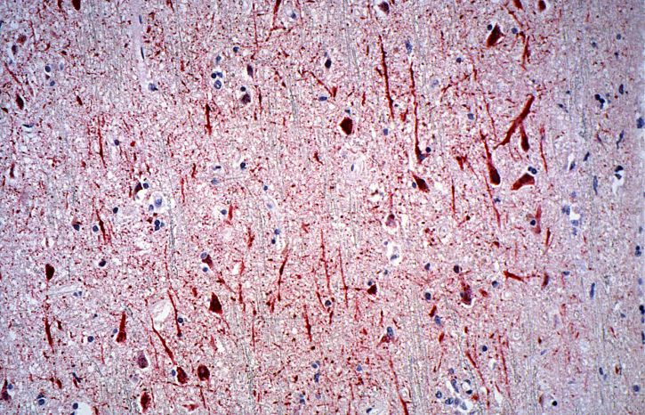
Neurological Assessment for non-neurologists
8th Neuropsychiatry Conference
Stoke on Trent - 25th November 2025
Dr. Michela Simoni
Consultant Neurologist - Royal Stoke Hospital
UHNM – Stoke on Trent

Slide 2
Aim of this workshop:
Offer an overview of a basic neurological assessment
Show a neurologist’s approach to common presenting symptoms
- Basics of neurological assessment
- A few presenting symptoms
- Cases for discussion
- Closure
Plan:

Slide 3
Possible Non-Neurology Audience
Psychiatrists
Psychologists
Geriatricians
General Physicians
Radiologists
Trainees in above specialties, and medical students
Specialist nurses
Physiotherapists
Occupational Therapists

Slide 4
What do you think is the most important part of the neurological assessment?
The History-taking
The neurological examination
The tests: “neurologists always request MRI and Spinal Fluid, no matter what…”
Or … else?

Slide 5
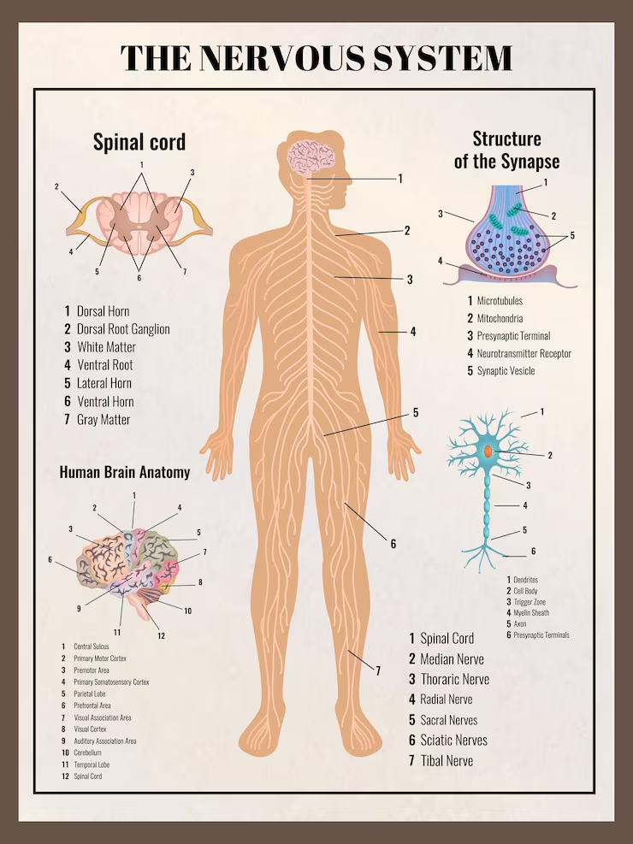
What do Neurologists do?
They evaluate and manage conditions of the central and peripheral nervous system.

Slide 6

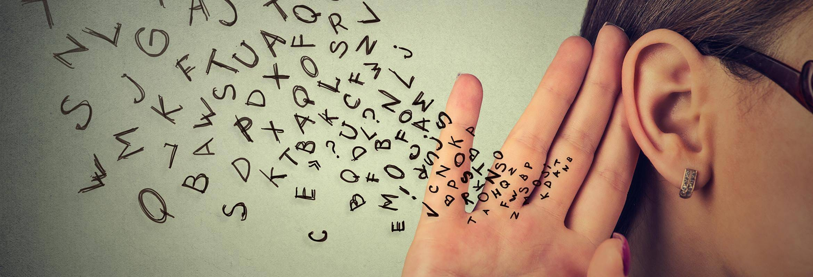
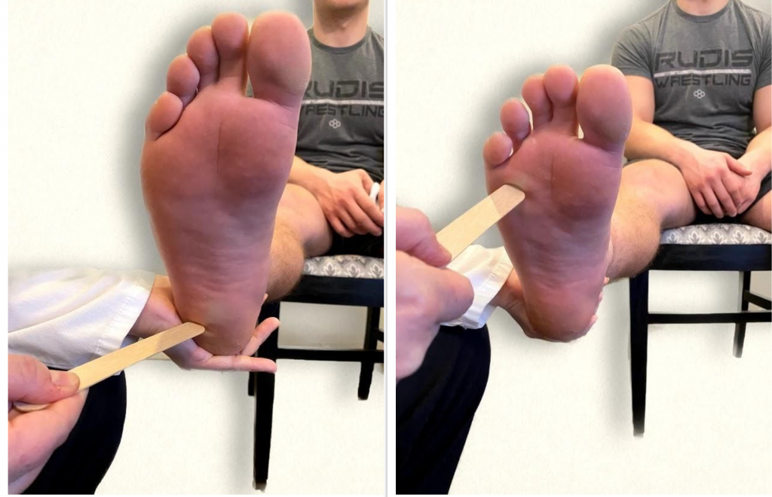
My Approach: Look, Listen, Examine

Slide 7

Look:
How patients get up from the chair and start walking
Gait – legs and arms movements, stance, speed
Any involuntary movements
Facial expression and eye contact
Etc…

Slide 8

Listen: pay attention to cues
Voice
Speech (speed, articulation, tone, prosody)
Vocal tics or other involuntary sounds (i.e sighs)
Language (grammar, syntax, “empty talking”…)

Slide 9
Listen: history taking
From the patient, and if possible, from a third party
Questions about present complaint:
Weakness or sensory loss, swallowing difficulties, double vision or loss of vision
Headaches and pain
Dizziness and falls
Black-outs and seizures
Cognitive difficulties or behavioural changes
Tremor or other involuntary movements

Slide 10
Listen: history taking 2
Time and type of onset: i.e. “thunderclap” headache, sudden loss of power or sensation in one limb, versus gradual onset of headache or deficits
Tempo: acute, chronic, progressive, relapsing-remitting, etc…
Persistence
Triggers and relieving factors
Association with other symptoms: sleep or urinary problems, weight loss/gain, etc…
Medications - tried or ongoing
Other medical conditions - past or present
Recreational habits and drugs (including alcohol)
Family history
Look for the “unspoken clues” and tailor questions “as you go”

Slide 11

Examine
The physical examination is driven by the history and symptoms
Basic Assessment:
Gait and balance
Cranial nerves, visual fields and optic discs
Muscle tone and power, muscle bulk and spontaneous twitches
Superficial and deep sensation
Coordination
Tendon reflexes and plantar responses
More specific signs:
Bradykinesia, Dysdiadochokinesia, Dyspraxia, Astereognosis, Agraphesthesia, Frontal release signs etc…

Slide 12
Examination: think about anatomy and pathways
Pyramidal signs – weakness, sensory loss/levels, spasticity, extensor plantar responses or abnormally brisk tendon reflexes (TRs)
Parkinsonian signs – tremor, rigidity, bradykinesia
Cerebellar signs - ataxia, dysmetria, intention tremor, nystagmus, dysdiadochokinesia, hypotonia, dysarthria
Peripheral signs – loss of TRs, fasciculations, weakness and loss of sensation in dermatomal patterns, fatigability

Slide 13
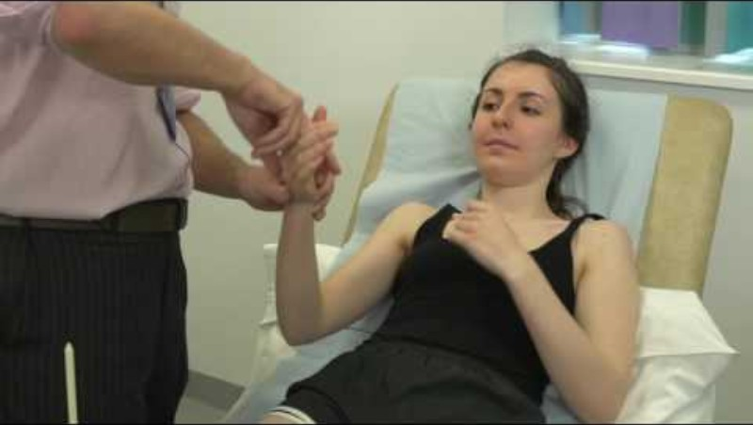
Brief Neurological Exam
https://www.youtube.com/watch?v=q56WgXvn0iU

Slide 14
Examination – cognitive functions
Cognitive tests (i.e MMSE, MoCA, or ACE III), and other tests for language or frontal functions require longer assessment-time.
During a “standard” neurological assessment, a few items (date and place orientation questions, clock-drawing, 3 words recall) may be sufficient.

Slide 15
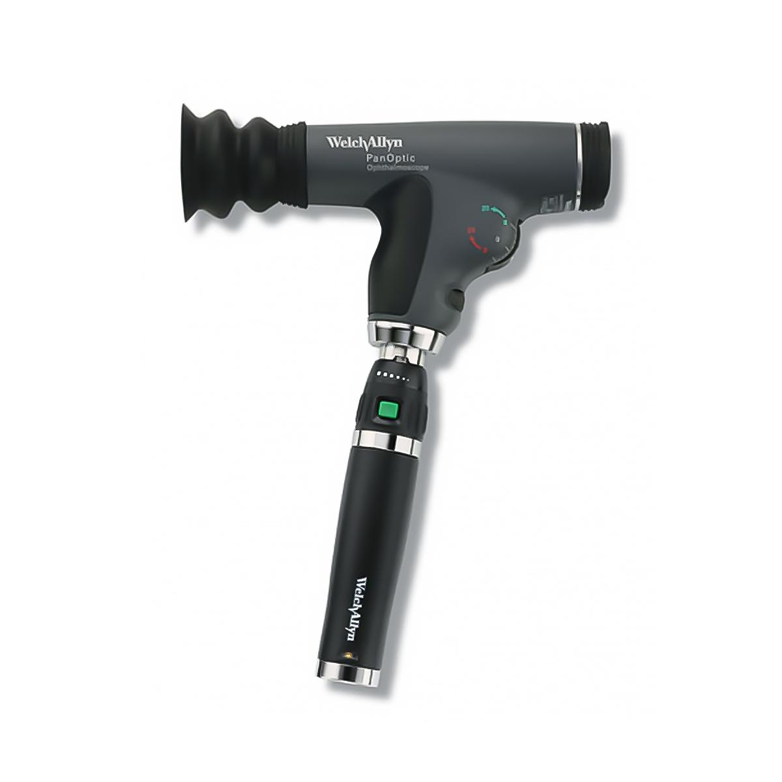
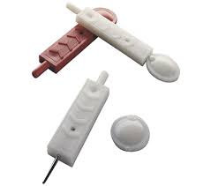
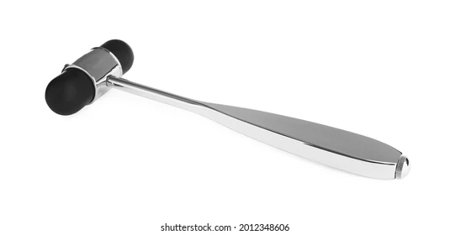
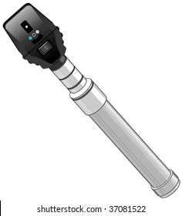

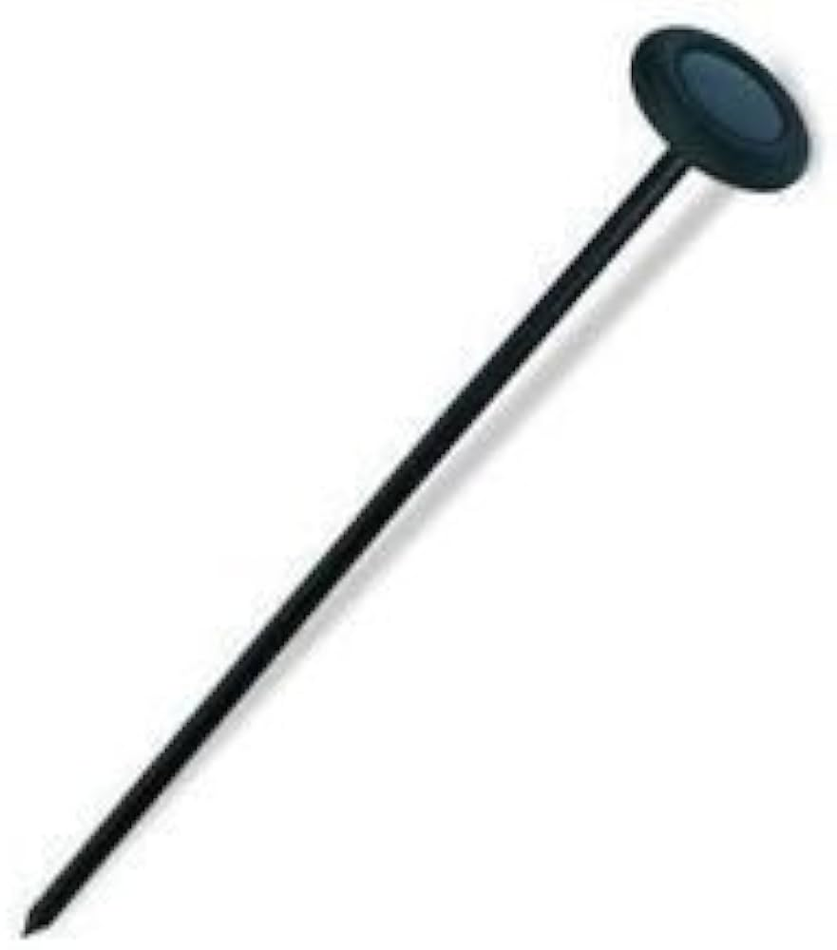
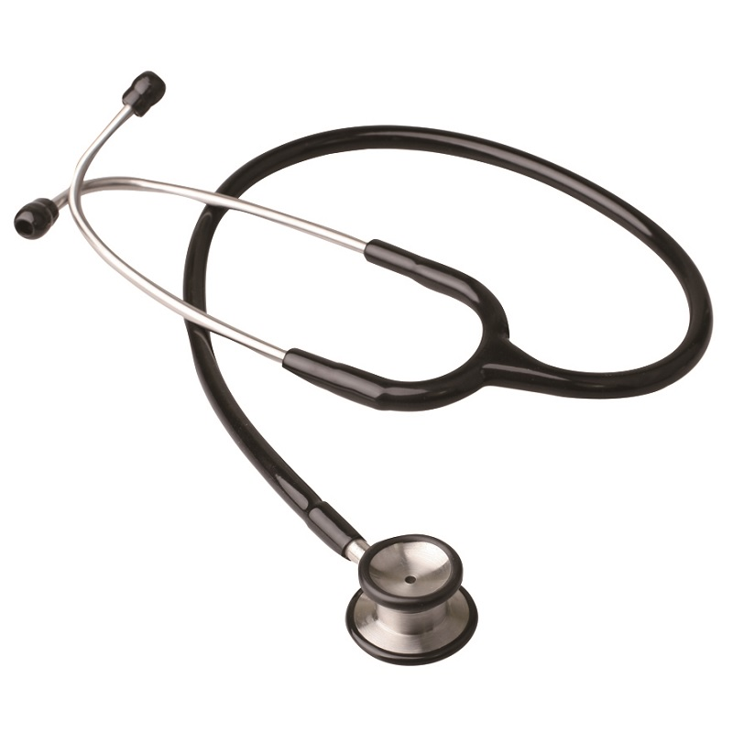
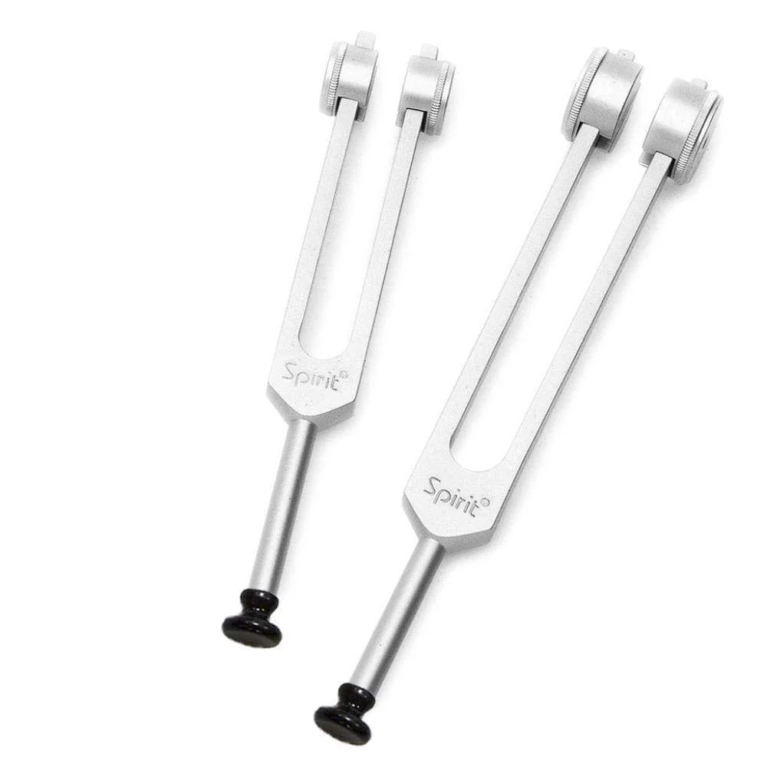
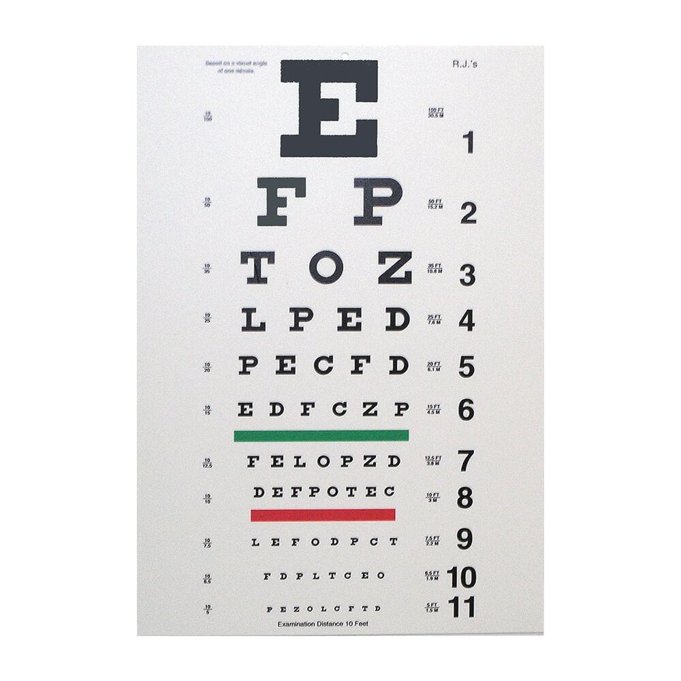
The Neurologist’s tools – to complement eyes, ears, and hands

Slide 16
The Neurologist’s tests
Blood tests, including genetic tests
CT head – acute setting
MRI brain
MRI spine
CSF Opening and closing pressure, xanthochromia, proteins, glucose, cells, micro-organisms, PCR, OligoClonalBands (OCBs), Antibodies, Markers of neuro-degeneration, RT-QuIC, etc… Remember to always take blood at same time, to compare glucose and OCBs
EEG
NCS and EMG
SSEP/VEPs
Nuclear Medicine tests: PET, DaT, SPECT
Tissue biopsy (nerve, muscle, meninges, brain)

Slide 17

Symptom presentation: Headache
Time of onset
Type of onset
Acute
Thunderclap (1 min)
Slowly progressive
Severity (1-10 scale)
Localisation
Unilateral/bilateral
Occipital/frontal/temporal
Quality of pain
Throbbing
Stabbing
Pressure/squeezing
Associated symptoms?
Loss of vision or hearing
Positive visual phenomena
Tinnitus
Nausea/vomiting
Photophobia/phonophobia
Lacrimation
Facial pain
Neck pain or stiffness
Confusion
Fever or systemic illness
Collapse
Postural?
Specific time of the day?

Slide 18
Symptom presentation: Headache 2
Not to miss on examination:
Fundoscopy – Optic discs swelling
Visual Fields - defects
Any power or sensory deficit, or acute cognitive problem (encephalopathy)
Scalp tenderness
Temporal arteries pulsation and tortuosity
Aim:
Identify secondary headaches
Treat primary headaches

Slide 19
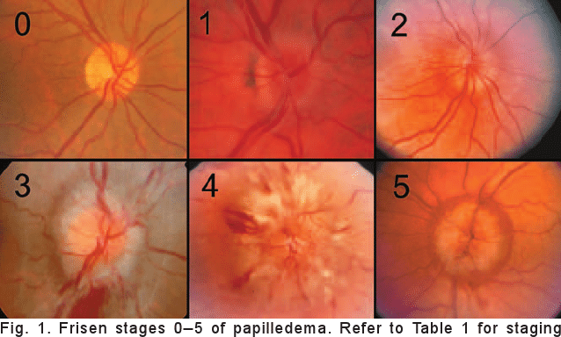
Optic Discs Swelling: Frisen’s scale
0 Normal disk with blurring of nasal and temporal disk; the cup is maintained, and there is no obstruction of retinal vessels.
1 C-shaped blurring of the superior, nasal, and inferior disk borders; the temporal margin is usually normal.
2 360-degree elevation of the disk margin.
3 Entire disk elevation with partial obscuration of one or more retinal vessels at the disk margin.
4 Complete obliteration of the cup and complete obscuration of at least some vessels on the surface of the disk. Small, dilated telangiectatic capillaries may be seen on the disk.
5 Dome-shaped disk appearance, with all retinal vessels obscured

Slide 20
Symptom presentation: “Blackouts” (loss of consciousness)
Time of onset (years, days?)
Frequency
Warning symptoms or signs
Triggers
Description (from third party):
Autonomic features
Eyes
Versive movements
Tonic or/and clonic movements
Tongue biting
Loss of bladder control
Recovery time
Seizures vs. Syncope
Consider:
postural hypotension,
functional seizures

Slide 21
Symptom presentation: the “Shakes”
… is it tremor?
In differential: Chorea, Tics, Myoclonus and other less frequent hyperkinetic movement disorders

Slide 22
Symptom presentation: Tremor
Duration
Localisation (hands/head/legs/chin/tongue/voice)
Lateralisation
Rest/Action/Postural/Intention
Amplitude and frequency
Response to alcohol
Ask about: postural symptoms, swallowing, urinary function, sleep
Consider: Medications
Family history
Thyroid status

Slide 23
Tremor…plus?
On examination look also for:
Dystonia
Cerebellar signs/ Ataxia
Bradykinesia
Rigidity
Change in voice and speech
Abnormalities in eye movements

Slide 24
Common types of Tremor
Essential Tremor:
Hands, Arms, Head, Voice
Bilateral
Action-tremor
High frequency (6-12 Hz)
May improve with alcohol intake
Parkinsonian tremor:
Hands (pill-rolling), arms, legs, mouth/chin
Unilateral at first
Resting tremor
4-6 Hz, medium amplitude
Usually associated with other parkinsonian signs
Dystonic Tremor:
Head, arms, legs, voice
In patients with dystonia
Often irregular and jerky
Usually postural and kinetic tremor
Cerebellar Tremor:
Intention tremor of hands/arms
6-8 Hz, variable amplitude
Usually associated with other cerebellar signs

Slide 25
Symptom presentation: Gait problems and Falls
Parkinsonian? Ataxic? Dyspraxic? Spastic?
Balance assessment
Think about:
Sensory /proprioceptive loss in peripheral neuropathy (ie diabetes)
Parkinson’s & Parkinsonian syndromes
Cerebro-Vascular disease (chronic white matter changes and previous strokes)
Normal Pressure Hydrocephalus
Myelopathy
Etc…

Slide 26
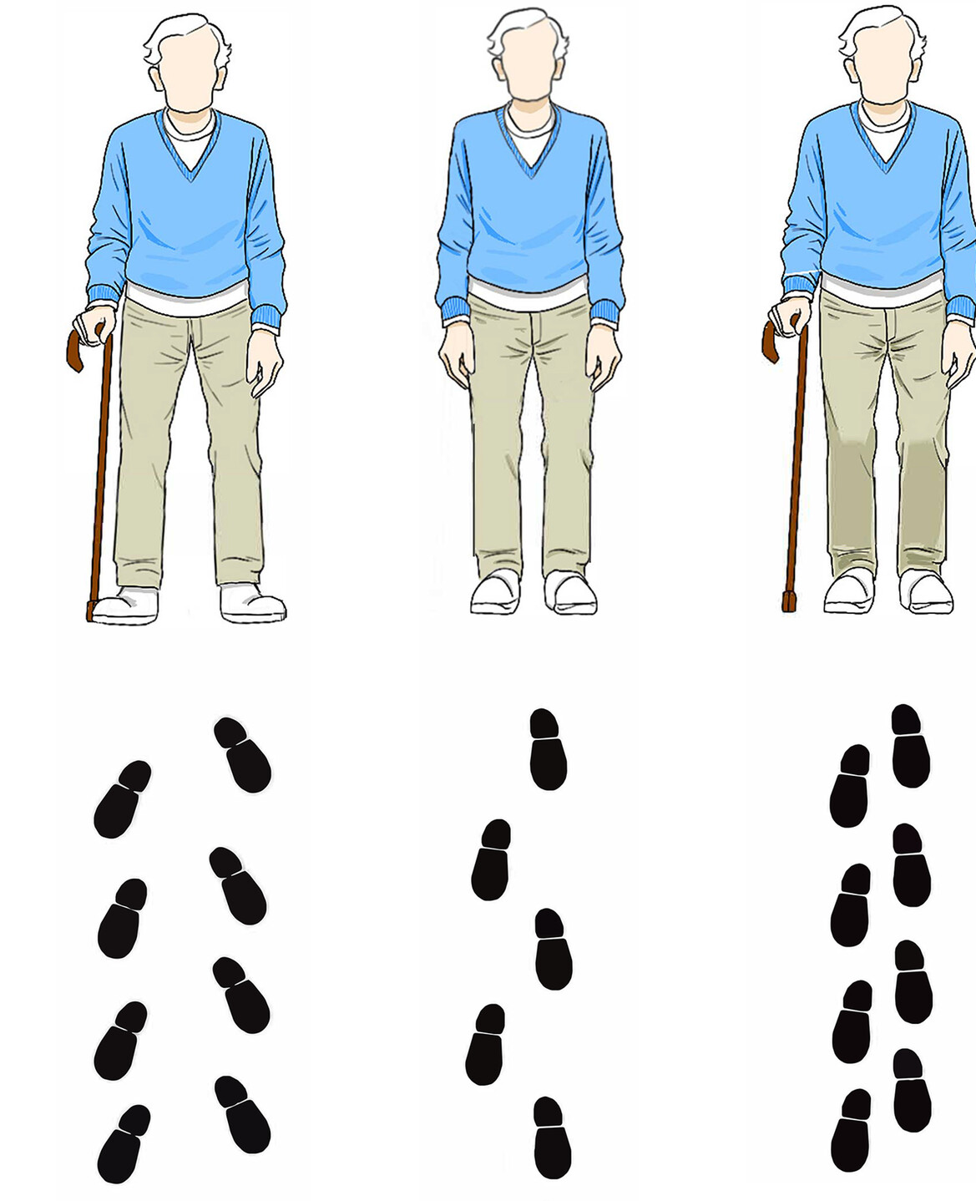
Gait:
Base
Steps length and height
Arms movements
Position of upper body
Coordination/balance

Slide 27
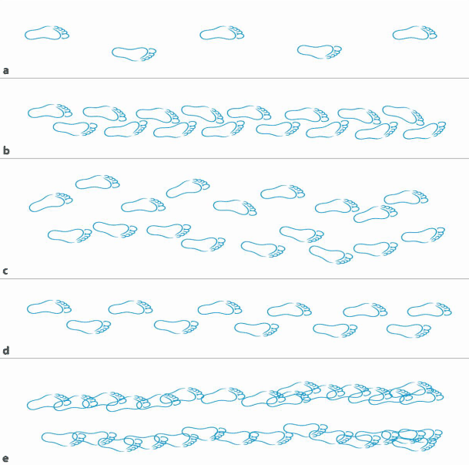
Gait
Spastic Gait
Ataxic Gait
Parkinsonian Gait
Frontal Gait

Slide 28

And now…all together, please!
A few interactive cases

Slide 29
Case 1 - tremor
67 y-o lady
Problem: Tremor. Please advise on whether this could be Parkinson’s.

Slide 30
Case 1 - history
Tremor started years ago, in childhood. Does not stop her from using hands in daily activities. Both hands affected. Possibly better with alcohol.
No difficulties walking, swallowing, sleeping, or with urinary functions.
PMH: Hypertension, osteoarthritis, hypothyroidism.
DH: Ramipril 5 mg/day, L-Thyroxine 75 mcg/day
SH: Retired cleaner. Non-smoker, alcohol in moderation.
FH: Tremor in brother, father, paternal grandmother, paternal aunt

Slide 31
Case 1 - examination
Preserved facial expression. Normal speech. No cranial nerves deficits. Nodding head tremor: “yes-yes”. Normal voice.
Bilateral hands tremor, worse on left. Predominantly action tremor. High frequency, small amplitude. No dystonia.
Normal muscle tone. Normal power, sensation, and coordination of 4 limbs. No bradykinesia. Normal gait, with preserved arms swinging. Negative pull test.

Slide 32
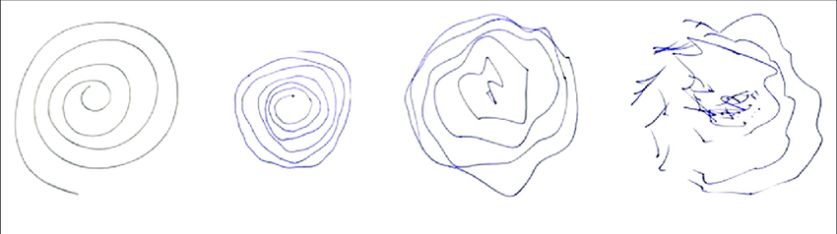
Case 1 – spiral drawing

Slide 33
Case 1
Diagnosis?
Essential Tremor
Any tests needed?
No, not in this case
Treatment?
Symptomatic. Beta-blockers or anti-epileptic medications (primidone, topiramate, gabapentin, clonazepam). Possibility of surgery or US-thalamotomy in resistant cases associated with significant disability.

Slide 34
Case 2 - Headache
31 y-o man
Problem: sudden onset of headache, associated with vomiting and photophobia
GP refers to ED

Slide 35
Case 2 – History & Examination
HPC: Headache started while sitting at his desk, in work, 8 hours ago.
Pain reached maximum intensity (10/10) within 1 minute. Felt as if he had been hit on the back of the head with a hammer
Headache is still present, improved with painkillers (8/10).
Vomited several times, could not tolerate light
Vision was blurred
PMH: Infrequent (2-3 /year) Migraine with visual aura. Asthma
DH: Inhalers
SH: Architect. Social smoker. Alcohol at weekends. Used recreational cocaine 2 weeks ago.
FH: Maternal uncle had intracerebral haemorrhage.
Examination: severe photophobia, but no obvious swelling of optic discs. No VFs deficits. No focal neurological deficits. No nuchal rigidity. Apyrexial.

Slide 36
Case 2
Impression?
Thunderclap headache (TCH)
Any tests needed?
YES.
Urgent CT head, and CSF for xanthochromia if CT head is normal
Management?
PRIMARY goal: to identify a potential cause for the TCH. If CT head shows blood, or CSF is positive for xanthochromia, urgent referral to NEUROSURGERY for management of Subarachnoid Haemorrhage. CT-angiogram and possibly DSA and treatment of aneurysm, if found, will follow.
If CT head and CSF normal, and symptoms resolving, this is likely to be a primary TCH. Treated with analgesia.
MRI brain with angiogram can be useful to identify possible dissection, pituitary abnormality, CVST, or RCVS in selected cases.

Slide 37
Case 2: conclusions
CT head: normal
CSF: xanthochromia negative, 2 WCC, Proteins 0.46, Glucose 3.4 (blood glucose = 6)
Headache improving with analgesia.
Diagnosis:
Primary thunderclap headache in patient with migraine.

Slide 38
Case 3 – Headache & Visual disturbances
GP referral to SDU:
27F presenting with 1 month history of headache, and 2 days intermittent visual disturbance
History
  Holocranial, throbbing headache
  Worse when lying flat, bending forwards and straining
  Transient loss of vision when bending forwards, lasting a few seconds
PMH
  PCOS- on metformin

Slide 39
Case 3 – Assessment & Management
Examination
  Bilateral grade 4 optic disc swelling
  Bilateral slight restriction of visual fields to confrontation
  BP 150/85, HR 85, BMI 45
Investigations
  CT head, CT venogram (normal)
  Lumbar puncture: opening pressure 54cmH2O, normal constituents
Diagnosis
  Idiopathic intracranial hypertension (IIH)
Management
  Urgent Ophthalmology assessment with OCT and Humphreys’ VFs
  Urgent CSF diversion if vision is at risk (Neurosurgery)
  Acetazolamide
  Weight loss

Slide 40
Case 4: gait issues and dizziness
GP referral: 48 y-o lady
Problem: dizziness - not vertigo
Examination: Normal apart wide base gait, and finger-nose test over-shooting. Blood pressure 174/106, pulse 74 normal.
Cause?

Slide 41
Case 4: History
Twelve months history of balance problems: she needs assistance now when having a shower, and she has had a few falls.
No problems with speech, swallowing, urinary function, memory or behaviour. She sleeps well.
PMH: Hypertension since age 30. Previous history of depression.
DH: Amlodipine and Candesartan
SH: used to work in a shop. Does not smoke, does not drink alcohol, does not take any recreational drugs.
FH: no neurological conditions

Slide 42
Case 4: Examination
Nystagmus towards the right side.
Normal eye movements, normal other cranial nerves and visual fields.
Subtle “scanned type” dysarthria - but no recent changes.
Gait ataxia, and unable to walk in tandem. Romberg negative.
Power and sensation preserved on four limbs.
Coordination reduced in both arms and legs.
Normal TRs
Plantar responses in flexion.

Slide 43
Case 4: Impressions?
Cerebellar ataxia
DDx:
Vascular
Inflammatory
Neuro-degenerative (MSAc)
Neoplastic and Paraneoplastic
Genetic

Slide 44
Case 4: review and tests
Progression of symptoms: Postural Instability
Urinary urgency
BP in clinic
Lying: 194/106 mmHg, 85 heart beats per minute
1 minute standing: 158/109,107 bpm
2½ minutes standing: 163/111,105 bpm

Slide 45
Case 4: tests
MRI brain – Cerebellar atrophy, pontine atrophy with “hot cross bun” sign, and “bright” cerebellar peduncles
CSF – Normal
Bloods – all normal, including vasculitis, paraneoplastic
Genetic tests – negative
CT TAP – no malignancy

Slide 46
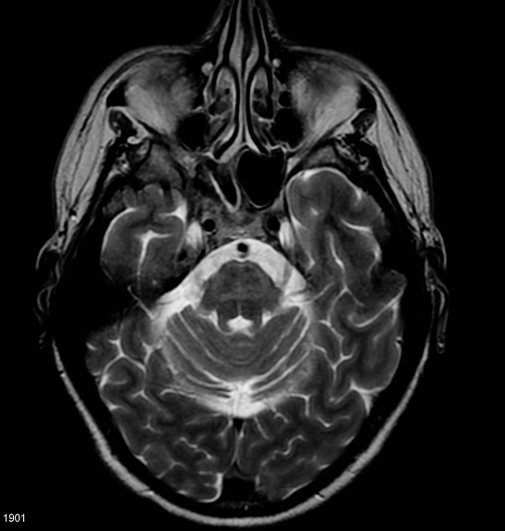
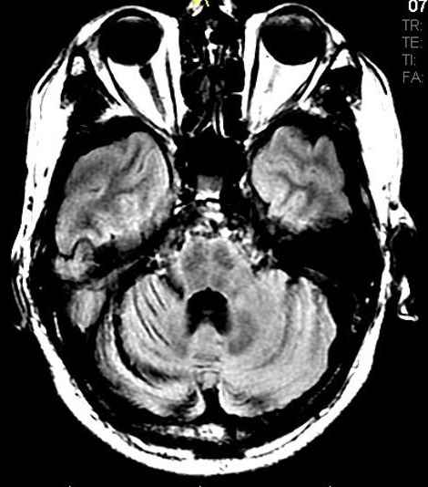
Case 4: brain MRI

Slide 47
Case 4: Diagnosis?
Diagnosis?
MSA-c – neurodegenerative disorder, alpha-synucleinopathy.
Treatment?
No specific treatment available. Individual symptoms are treated.
Management?
Supportive.
https://www.msatrust.org.uk/

Slide 48
Case 5: Blackout
20 y-o woman. GP referral to clinic. Blackout: seizure?
HPC:
Two months ago, while sitting, watching TV with her mother. Stopped talking and became vacant. Her breathing changed, she became rigid, her eyes rolled backward and she was unresponsive for a few minutes. She bit her tongue, but she was not incontinent of urine. She recovered in approximately 10 minutes. No identified triggers. Well ever since.
PMH: asthma. No h/o meningitis or febrile convulsions. Born at term, via C-Section.
DH: Nil
SH: not smoking, no alcohol, no recreational drugs.
FH: seizures in paternal grandmother and in one of her maternal aunts.
Neurological Examination: Normal

Slide 49
Case 5: Impressions & Management
Diagnosis?
Epileptic Seizure
Treatment?
No need for medications at this stage – one isolated seizure does not mean epilepsy.
Management?
EEG and MRI
Discuss with patient about risk of reoccurrence: advice on risk-avoidance.
Discussion about driving and DVLA

Slide 50
Case 5: Tests and Diagnosis
MRI brain with epilepsy protocol: normal
EEG: brief generalised bursts of low-amplitude irregular spike and wave activity, suggestive of Idiopathic Generalised Epilepsy
Final Diagnosis: Idiopathic Generalised Epilepsy
Management: Started on antiepileptic medication (lamotrigine)
Referred to epilepsy nurses for f/u

Slide 51
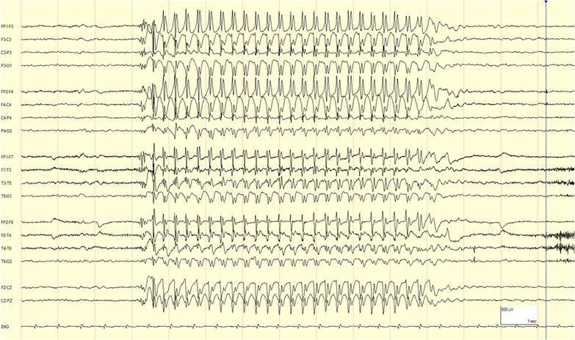
EEG: 3Hz generalised spike-wave activity (from ILAE website)

Slide 52
So: What do you think is the most important part of the neurological assessment?
History-taking has traditionally been considered the most important part of the neurological assessment. And it (probably) still is.
However, neurology has evolved greatly in the past few years: we do have more treatments, and we are more than ever relying on tests. How to reconcile history, examination findings, and tests results, is ultimately the most important skill for a neurologist.

Slide 53
Acknowledgments:
Many thanks to Dr. Charley Chance (Neurology Resident Doctor) for her contribution with case 3.
The clinical scenarios have been inspired by real cases - largely or completely modified.
The video, the pictures, and the radiological images have all been downloaded from the Internet.
References:
- Nicholl D, Hassan-Smith G. The brief Neurological Exam . Youtube
https://www.youtube.com/watch?v=q56WgXvn0iU
Pirker W, Katzenschlager R. Gait Disorders in Adults and the Elderly. A clinical guide. Wien Klin Wochenschr. 2016; 129. 10.1007/s00508-016-1096-4.
Schiffman JS, Scherokman B, Tang RA, Dorotheo U, Preto P, Varon J. Evaluation and treatment of papilledema in pregnancy. Comp Ophthalmol Update 7: 187-202, 2006
Sharma S, Pandey S. Approach to a Tremor patient. Ann Indian Acad Neurol 2016;19:433‑443
ILAE International League Against Epilepsy – https://www.epilepsydiagnosis.org/index.html
- Ho M, Sharma R, Gaillard F, et al. Multiple system atrophy. Reference article, Radiopaedia.org https://doi.org/10.53347/rID-7271

Slide 54
Thank you for your attention.
Questions?
michela.simoni@nhs.net

