Slide 1





Developments in a Young-onset dementia (YoD) assessment service
North Staffordshire Neuropsychology (NSN)
Presented by:
Dr Lorraine King, Consultant Clinical Neuropsychologist
Dr James Reilly, Principal Clinical Neuropsychologist
Dr Anna Isherwood, Senior Clinical Psychologist
Dr Connor Watkins, Clinical Psychologist
Notes:
Lorraine

Slide 2

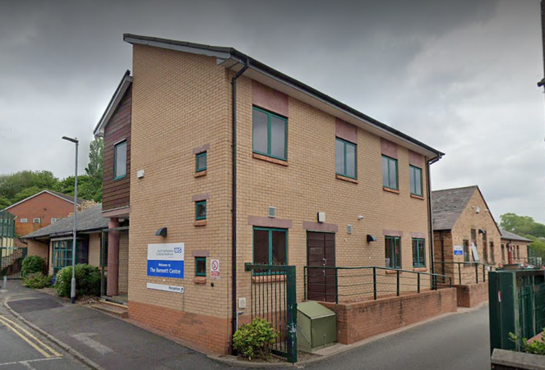
Who We Are
North Staffordshire Neuropsychology (NSN)
📍 Based at:
The Bennett Centre, Richmond Terrace, Shelton,
Stoke-on-Trent, Staffordshire, ST1 4ND
  Dr Lorraine King, Consultant Clinical Neuropsychologist (0.4)
  Dr James Reilly, Principal Clinical Neuropsychologist (0.5)
  Dr Anna Isherwood, Senior Clinical Psychologist (0.4)
  Dr Connor Watkins, Clinical Psychologist (0.9)
  Emily Lamb, Assistant Psychologist (1.0)
Notes:
Lorraine

Slide 3
North Staffordshire Neuropsychology (NSN) and the Neurocommunity MDT
  North Staffordshire Neuropsychology (NSN) works within a wider Neurocommunity MDT (comprising neuropsychiatry, community psychiatric nurses (CPNs), advanced nurse practitioner (ANP), occupational therapy, physiotherapy technical instructor, and support, time and recovery (STR) workers) which aims to meet the needs of those with both neurological and mental health needs.
  The Neurocommunity MDT is commissioned to provide a Young-onset Dementia (YoD) assessment service, with most referrals coming via GP services.
Notes:
Lorraine

Slide 4
Inclusion Criteria for neurocommunity team
  Adults (18-65 years) who suffer from psychiatric, cognitive or behavioural changes caused by brain damage or disease.
  Under age 60 for assessment of subjective cognitive concerns (60 and above to memory clinic).
  Residential or GP address within Stoke on Trent North Staffs locality.
  Internal neuropsychology referrals from the team considered from the above, for cognitive assessment or brief (6-session) therapy input.
  Exclusions:
    alcohol excess
    FND
    Peripheral nervous system conditions
Notes:
Lorraine

Slide 5
What is Young Onset Dementia?
  Objective cognitive deficits (frequently in executive function, attention and processing speed) on formal testing that go beyond normal aging or stress effects.
  Evidence of decline over time — symptoms worsen and can spread to other domains
  Functional impact: noticeable difficulties in daily life, work, or independence (managing finances, multitasking, navigation, etc.).
Notes:
Anna

Slide 6
What is Young Onset Dementia?
  Insight often reduced: the person may underestimate or be unaware of their difficulties, often family members will highlight their concern before the patient.
  Neuropsychiatric and behavioural changes may appear early (e.g., personality change, apathy, disinhibition, language changes) depending on the dementia subtype (e.g., frontotemporal, Alzheimer’s, Lewy body).
  Supportive evidence on neuroimaging or biomarkers (e.g., MRI changes, CSF markers, PET findings).
  Consistency: cognitive symptoms are typically consistent across time and context (not fluctuating with stress or fatigue or setting).
Notes:
Anna

Slide 7
Incidence figures
  Young-onset dementia is mercifully rare, much rarer than the number of people who are worried about it....
  Hendriks et al (2021) Systematic review of global young-onset prevalence (figures for all dementia types):
    Age 30-34 0.8 per 100,000
    Age 35-39 0.9 per 100,000
    Age 40-44 3.5 per 100,000
    Age 45-49 6.4 per 100,000
    Age 50-54 11.1 per 100,000
    Age 55-59 24.3 per 100,000
    Age 60-64 112.4 per 100,100
  A 2022 systematic review using UK GP records data (Aurum dataset) suggests UK prevalence of 92 per 100,000 diagnosed between the ages of 30 and 64 (Carter et al)
Notes:
Anna

Slide 8
Incidence figures
  Over time, trends towards lower age of onset have been observed particularly in second-generation family members (Carter et al, 2022) . Lots of potential reasons hypothesised for this.
  Prevalence in younger age groups are likely to be underestimated (30-59 years) (given use of registers to identify rates / longer time to diagnosis)
  Assuming constant prevalence, the number of people with early-onset dementia in the UK is projected to increase to 50,401 by 2025 and 50,979 by 2051 – an increase of 20% over the next 38 years (projected by Prince et al in 2014).
  So, whilst rare, YoD is potentially increasing over time, and thus its important we offer an effective assessment service to identify positive cases.
Notes:
Anna

Slide 9
Referral numbers and waiting times-Neuropsychology
Referral year | Total annual referrals | Average waiting times
2020 | 93 | 23 weeks
2021 | 109 | 19 weeks
2022 | 90 | 19 weeks
2023 | 123 | 21 weeks
2024 | 115 | 28 weeks
Notes:
Anna

Slide 10
Referral Numbers and Wait Times
  High referral numbers may have been influenced by post-COVID societal awareness of dementia (in similar ways to that seen within ADHD and ASD assessment services), with associated heightened concern about cognitive symptoms.
  Consistently high referral numbers, given our small service provision, has resulted in increased waiting times for YoD assessment. Implications for people getting appropriate treatment.
  A typical GP referral would be an individual in their 50s, noticing a worrying decline in memory function over the past few months / years (those aged 60 are referred to the local memory clinic for assessment).
Notes:
Anna
Global incidence of young-onset dementia: A systematic review and meta-analysis
Stevie Hendriks, Kirsten Peetoom, Christian Bakker, Raymond Koopmans, Wiesje van der Flier, Janne Papma, Frans Verhey, Young-Onset Dementia Epidemiology Study Group, Marjolein de Vugt, Sebastian Köhler
First published: 17 June 2022
https://doi.org/10.1002/alz.12695
Sixty-one articles were included. Global age-standardized incidence rates increased from 0.17/100,000 in age 30 to 34 years, to 5.14/100,000 in age 60 to 64 years, giving a global total age-standardized incidence rate of 11 per 100,000 in age 30 to 64. This corresponds to 370,000 new YOD cases annually worldwide. Heterogeneity was high and meta-regression showed geographic location significantly influenced this heterogeneity

Slide 11
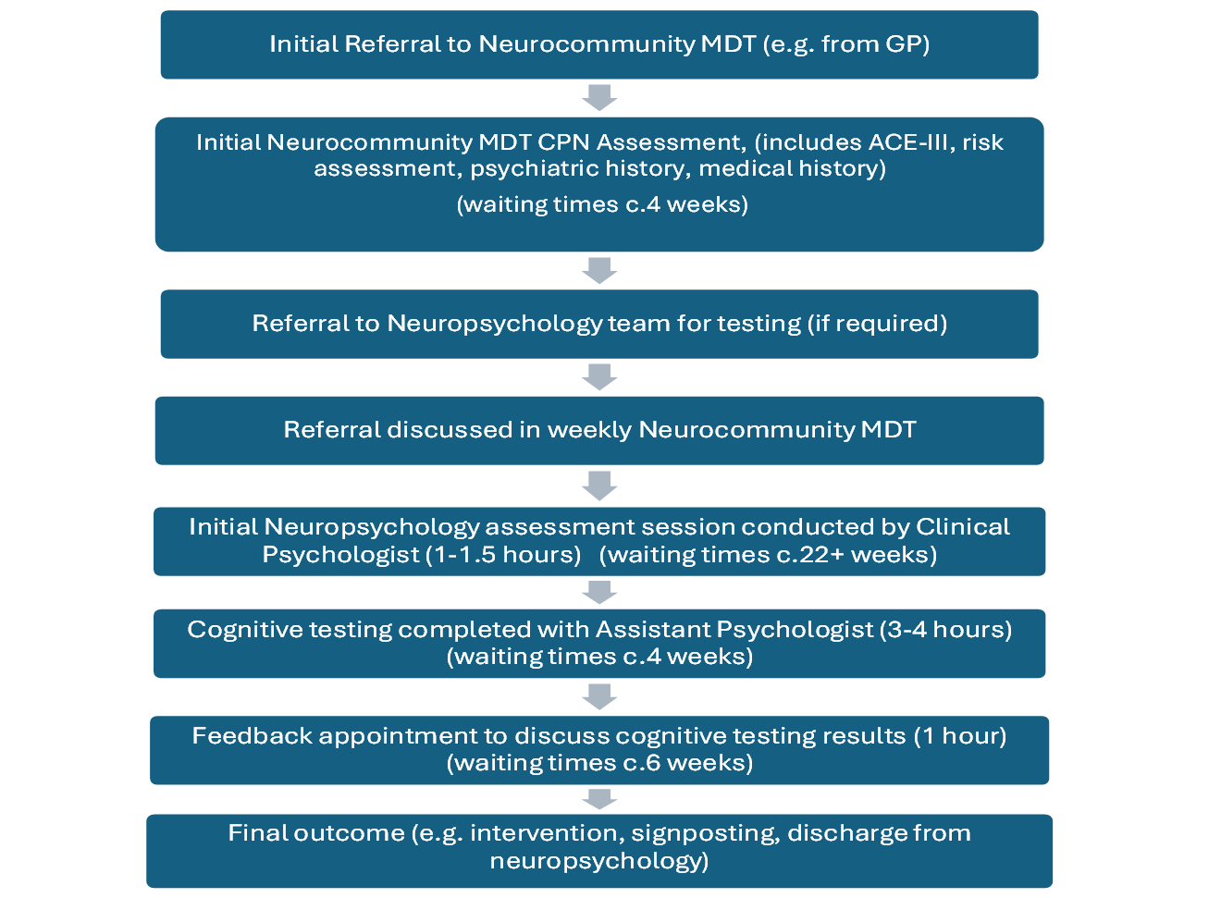
Old Neuropsychology Pathway
Notes:
James

Slide 12
Changing Approach
We wished to continue to:
  Provide a thorough assessment service to ensure positive YoD cases are identified.
  Whilst also meeting the needs of those presenting with cognitive problems with other underpinnings (e.g. TBI, HD, PD)
  Reduce waiting times.
Notes:
James

Slide 13
Changing Approach
‘Pathways Meeting’ (March 2024) including the wider MDT, service managers:
  All agreed that referral numbers were increasing, and that the current waiting times were unacceptable.
  Most cases are individuals without organic basis for subjective cognitive concerns. Delay in getting best service for them.
  Those we treat with a diagnosed neurological condition are waiting longer to be seen/delay in their treatment.
Notes:
James

Slide 14
Changing Approach
Young Onset Dementia Pathway, referral criteria:
  The patient has had evidential changes in cognition (attach your cognitive screening scores)
  The patient is aged between 50 and 59 years old (if younger than 50, please refer to UHNM neurology for investigation; if 60 or over, please refer to the Older Persons Memory Clinic)
  The patient has been referred for an MRI head scan (Dementia Protocol), unless contraindicated.
  Dementia blood screen completed, abnormal blood results have been addressed.
  If there is a history of anxiety, depression or a mood disorder, this has been appropriately assessed and adequately treated (consider referring to Talking Therapies or CMHT if mental health problems are likely affecting cognition).
  No history of stroke in the 6 months preceding referral (refer to Stroke Psychology if so).
  Please note that the team will be unable to reliably complete the required assessment on individuals who have been actively consuming alcohol to excess or using recreational drugs.
Notes:
James

Slide 15
What we did – Streamlining the Neuropsychology Pathway
  Revised appointment structure to streamline the service.
  Patients now seen first for cognitive testing by Assistant Psychologist rather than for an initial interview with a Clinical Psychologist (and then attending for testing). (aka- YOD pathway)
  Reduced test battery.
  Trialled initially on 5 patients (2 required more investigation, 3 discharged at feedback)
  Some patients remain on ‘old pathway’ seeing Clinical Psychologist prior to cognitive testing (complexity, non-English speaking).
Notes:
James

Slide 16
What we did – Streamlining the Neuropsychology Pathway
  Due to Community Psychiatric Nurse (CPN) risk assessment at first contact, this approach enabled assistant psychologist to do cognitive testing whilst still ensuring appropriate and safe clinical oversight.
  We implemented a weekly ‘records review’ slot for our Assistant Psychologists, where they have time blocked out to check the medical notes ahead of the next weeks’ YoD testing appointments and escalate any potential issues to senior clinicians in supervision prior to the session.
Notes:
James

Slide 17
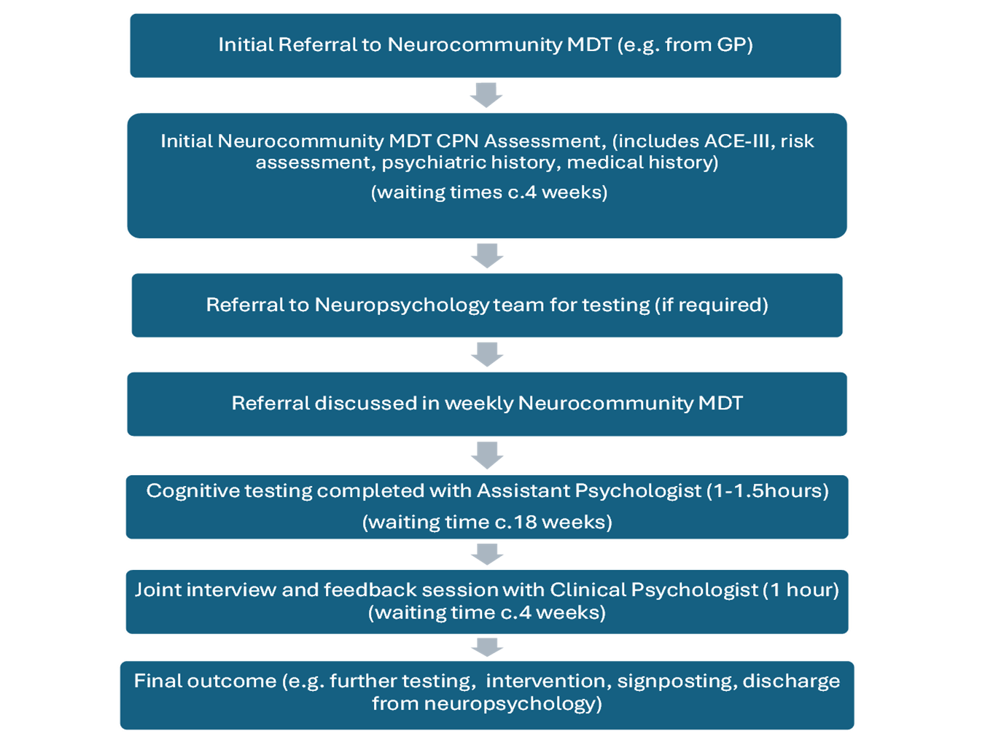
New ‘YoD’ Pathway
Notes:
James

Slide 18
Current 1.5-hour Cognitive Test Battery
🧩 Performance Validity Tests (x2)
Assess consistency and effort — indicate whether results reflect true cognitive ability or if other factors (e.g. fatigue, mood, anxiety, pain, medication) may limit engagement.
(No test names shown for security)
📖 Premorbid Functioning
  Wechsler Test of Premorbid Function (TOPF; Wechsler, 2011)
Estimates prior intellectual ability from reading accuracy (reading correlates strongly with IQ).
💭 Mood & Emotional Functioning
  PHQ-9 — Depression symptoms
  GAD-7 — Anxiety symptoms
🧠 General Cognitive & Memory Screen
  Repeatable Battery for the Assessment of Neuropsychological Status (RBANS; Randolph, 2012)
Broad measure of attention, language, visuospatial, and memory domains.
⚙️ Executive Function
  Trail Making Test (D-KEFS; Delis et al., 2001)
Attention, processing speed, set-shifting.
  Verbal Fluency (Letter & Category conditions) (D-KEFS)
Phonemic and semantic fluency.
  Colour–Word Interference Test (D-KEFS)
Response inhibition.
  Clock Drawing Task (ACE-III; Hsieh et al., 2013)
Planning, organisation, visuospatial–executive skills.
✋ Praxis
  Luria’s 3-Step (Fist–Edge–Palm) Test (Luria, 1966)
Motor sequencing and conceptual motor control.
👁️ Visuospatial Perception
  Visual Object and Space Perception Battery (VOSP) – Incomplete Letters (Warrington & James, 1991)
Visual object recognition and perceptual integrity.
Notes:
Connor

Slide 19
Outcomes So Far
🕒 More Efficient Use of Time
  Initial assessment and feedback now delivered within a single one-hour appointment with a Clinical Psychologist.
  Requires approximately one hour of preparation (reviewing case notes, risk assessment, test scores and observations).
📉 Reduced Waiting Times
  February 2024: average wait ≈ 35 weeks for testing.
  Following introduction of the Young-onset Dementia pathway (coupled with slightly increased clinical provision within the team) waits reduced to ~28 weeks by late 2024.
  Current average: 16–18 weeks (and currently continuing to improve each month)
Notes:
Connor

Slide 20
Outcomes So Far
⚡ Faster Pathways for Clear-Cut Cases
  Patients with straightforward clinical presentations no longer wait ‘in limbo’ for test results.
  They can be swiftly discharged or offered appropriate therapeutic input.
🧩 Flexibility for Complex Presentations
  For those with more complex or atypical profiles, we retain the option to undertake further cognitive testing or additional investigations.
✅ Maintaining Diagnostic Integrity
  We’ve set a low threshold for supplementary assessment to ensure that time-saving measures do not compromise diagnostic accuracy or confidence.
Notes:
Connor

Slide 21
Case study 1 - positive YoD diagnosis
  Male, Age 54, adopted - no family history known
  Made redundant 2 years ago - long-held IT job - employers said restructuring,
also citing performance issues - not able to secure another job, despite attempts.
  Wife very worried - having difficulty setting the table/putting trolley back when food shopping; getting lost in unfamiliar environments; difficulty doing minor electrical jobs in the house which he would have done previously; difficulty structuring his time during the day.
  Testing confirmed deficits, across the board, unusual for his age and premorbid abilities.
  Young-onset Alzheimer’s diagnosis confirmed with PET scan (prev. clear CT and MRI scans)
  Prescribed Donezepil, Referred to Alzheimer’s Society as they wanted to speak to other YoD sufferers, offered couple support sessions/strategy advice/virtual memory course (more on this later).
Notes:
Lorraine

Slide 22
Case study 2
Referral: 54, male, memory, word finding problems (1 year), LACI Stroke.
PMHX- asthma, pre-diabetes, HTN, 20 per day smoker (40 years), substance misuse, ADHD?
Personality changes, “no filter”, irritable, “less bothered”
Stopped working, previous busy salesman
Notes:
James

Slide 23
Case study 2
Test scores:
  Immediate memory: low average (16th percentile)
    Story, SS = 11
    List learning, SS = 4
  Delayed memory, below average (5th percentile)
    Lists= 3rd 9th percentile
    List recognition, 17/20, exceptionally low
    Story, SS = 9
    Figure, SS = 6
  Executive Functions
    Verbal fluency, SS=11
    Category fluency, SS=12
    Trails, all average
    CWI , all average
    Clock, 4/5
  Mood Measures
    Depression- Moderately severe
    Anxiety- Moderate
Notes:
James

Slide 24
Case study 2
Plan:
  Struggled on less structured memory task, did well on story memory and retained this.
  We agreed further testing would be beneficial to look in greater detail at executive functioning skills and some aspects of memory.
  Hayling
    Average-good
  Zoo Maps
    average, task 1 completed well
  Tower Test
    Average range
  WMS
    Visual reproduction- Low average-average
    Verbal paired associates Imm- low average
    Verbal paired associates Del- below average (5th percentile)
    Recognition- average
  WAIS
    Processing speed average range (50th percentile)
Notes:
James

Slide 25
Case study 2
Feedback:
  We discussed how testing has shown some changes in verbal memory and impulsivity.
  Why: Stroke, although there was a clear MRI scan and organic factors were hypothesised by neurology to be less of a factor.
  Consider PET scan which will give further information on organic factors.
  We discussed the impact of attention on his cognition, and the influences on this.
  Pertinent factors discussed included, loss of self-esteem, loss of identity, reduced exercise and increased substance misuse (now clean for several months).
  We said how improving these factors will likely improve his cognition.
  Report done for Neuropsychiatry with my opinion.
Notes:
James

Slide 26
Case study 3
  40 year old female with 2-year history of reduced short-term memory and concentration, difficulties multi-tasking and ‘brain fog’
  Struggling increasingly with the work / life ‘juggle’
  84/100 on ACE-III
  Significant FHx of early-onset Alzheimer’s
  Highly anxious about the prospect of a dementia diagnosis in light of history
  Scored at or above expected levels on all areas of cognitive testing
  MRI scan reported normal
  Reassured that no evidence of young-onset dementia
  Seen for follow-up, reported that she had been “released from anxiety” and the impact of previous cognitive difficulties had reduced
Notes:
Anna – Group discussion point after this around how to give feedback

Slide 27
Interventions
  ‘Watch and wait’
    Option to re-test in 12-18 months time
  Memory group - face to face / virtual
  1:1 cognitive rehabilitation
  Psychological therapy - Acceptance and Commitment Therapy (ACT) / CBT / systemic work
Notes:
Anna

Slide 28

Memory Skills Group
  4-week face-to-face small group programme.
  Aims: Psychoeducation, group support & practical strategies for memory difficulties.
  Referrals: from all areas of Neuropsychology.
  Facilitators: Minimum of two Assistant or Trainee Clinical Psychologists per group.
  Materials: PowerPoint slides & Memory Skills Workbook for participants.
  Weekly Content
    Week 1: Introduction, goals, expectations, overview of cognition & memory, why difficulties occur.
    Week 2: Mindfulness & grounding, internal & external memory strategies with practical examples.
    Week 3: Mood & memory, communicating difficulties, breaking vicious cycles, mindfulness practice.
    Week 4: Keeping well, course review & endings.
Notes:
Connor

Slide 29
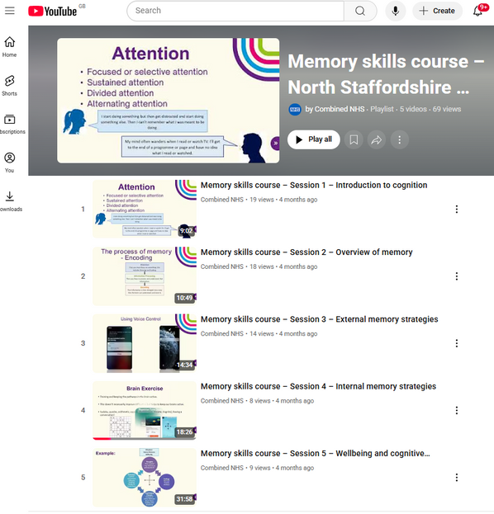
Virtual Memory Skills Course
  Pre-recorded Online Programme designed for clients with memory difficulties.
  Based on the in-person Memory Skills Group.
Why Developed?
  To increase access to evidence-based strategies for managing memory difficulties.
  Developed in response to engagement barriers with group delivery, including:
    Accessibility and travel difficulties
    Fixed session times and scheduling challenges
    Discomfort or anxiety in group settings
  Enables clients to learn at their own pace and in their own environment.
  Offers an alternative route to self-management for those unable to attend groups.
Who is it for?
  Any clients open to Neuropsychology, where beneficial.
  Useful at discharge, or alongside other input.
Notes:
Connor

Slide 30
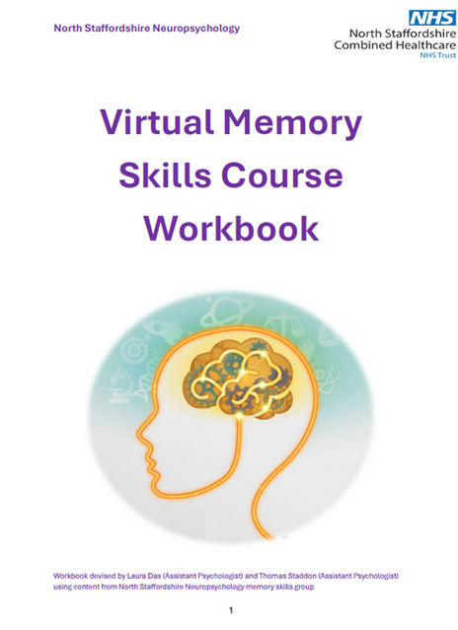
Virtual Memory Skills Course
  Aims:
    Increase knowledge of cognitive functioning.
    Understand the process of memory.
    Learn strategies to support memory.
    Increase awareness of the impact on wellbeing.
    Develop strategies to support psychological & emotional wellbeing.
How it Works
  5 pre-recorded sessions on a closed YouTube playlist:
    Introduction to Cognition
    Overview of Memory
    External Memory Strategies
    Internal Memory Strategies
    Wellbeing & Cognitive Functioning
  Accessed via QR codes or link.
  Participants can watch at their own pace and revisit as needed.
  Comes with a course workbook containing key information & exercises.
Memory skills course – Session 4 – Internal memory strategies
https://youtu.be/5o1zYr-NKjk?t=476
Notes:
Connor

Slide 31
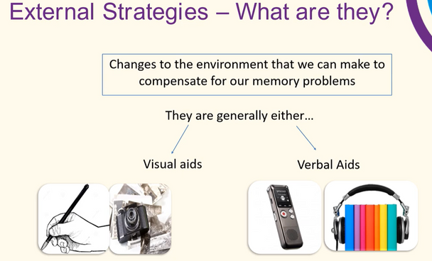
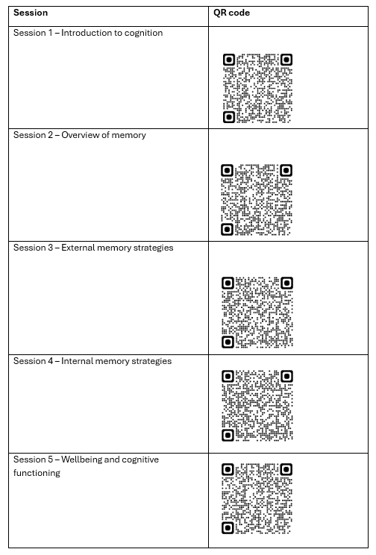
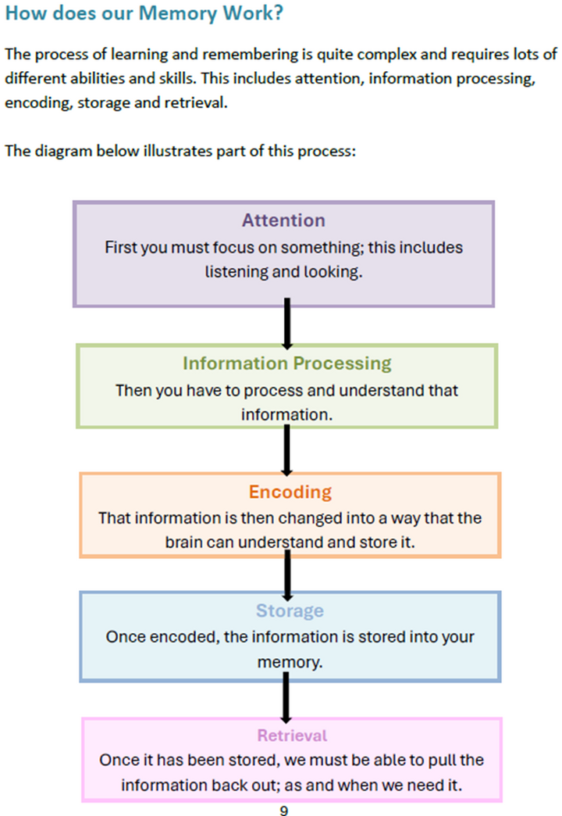
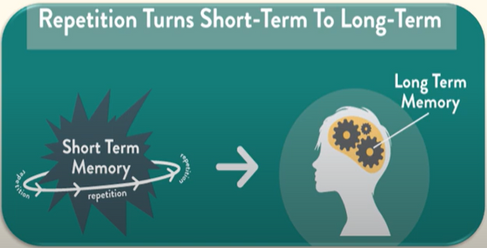

Notes:
Connor

Slide 32

Reflections on the Virtual Memory Skills Course
  Greater flexibility and accessibility for clients
  Easy to share and revisit, supporting ongoing learning
  Reduces clinical time while maintaining therapeutic value
  Addresses barriers such as travel, scheduling, and group anxiety
  Demonstrates how technology supports self-management and cognitive rehabilitation
  Participants engage well via smartphones and QR codes, with no reported access issues
  1-to-1 sessions remain available for those needing additional support
🚀 Future Developments
  Ongoing evaluation of both the face-to-face and virtual Memory Skills programmes
  Expansion of QR code use to share additional recorded psychoeducational and therapy content
  Exploration of digital approaches and emerging technologies to enhance rehabilitation:
    AI – Potential to simplify and personalise planning and organisational strategies
    Voice-assisted devices (e.g. Amazon Echo, Google Home) – May provide prompts and memory aids throughout the home
    Virtual Reality (VR) – Opportunities for safe, interactive practice of visuospatial skills and real-world functional tasks.
Notes:
Connor

Slide 33

Adjustment to YoD using Acceptance and Commitment Therapy (ACT)
Living with YoD:
  Certainty & Uncertainty
    Certain: illness will progress; risk of death from the condition or related complications.
    Uncertain: course, speed, and nature of decline are unpredictable.
  Areas of Impact
    Activities of daily living.
    Cognitive function, fatigue, pain, impulse control.
    Motor skills & mobility.
    Communication, social skills, and sense of self.
  Consequences
    Strain on relationships and interpersonal dynamics.
    Increased psychological challenges for person and caregivers.
  Adaptation & Coping
    Balance living in the present with planning for the future.
    Adjust and let go of plans when needed.
    Learn to request, accept, and use support effectively.
    Preserve independence where possible.
Notes:
Lorraine

Slide 34

Adjustment to YoD using Acceptance and Commitment Therapy
  Why ACT?
    Supports present-moment awareness, openness, and flexible responding.
    Helps individuals and their loved ones negotiate challenges of progressive neurological conditions.
    Growing evidence for ACT in supporting acceptance, willingness, values-based living, and coping.
ACT is about…
  Living with Awareness
    Skills in present-moment awareness.
    Balance between maintaining independence and asking for help.
    Pragmatic focus: doing what is workable.
  Living with Openness
    Developing acceptance and willingness to experience difficult emotions.
    Letting go of unhelpful struggle.
  Living with Values
    Identifying and committing to what matters most - why are you here? (e.g. 80th birthday speech)
    Building flexible, values-guided plans for the future.
Notes:
Lorraine

Slide 35
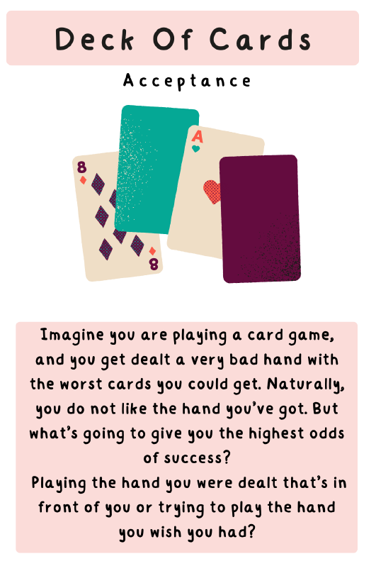
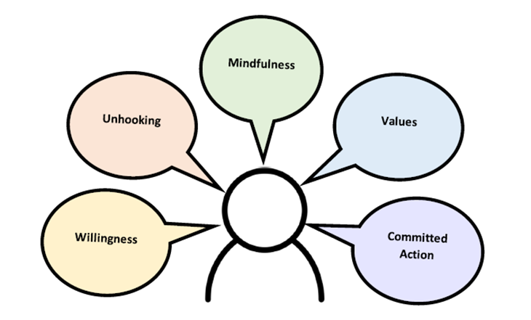
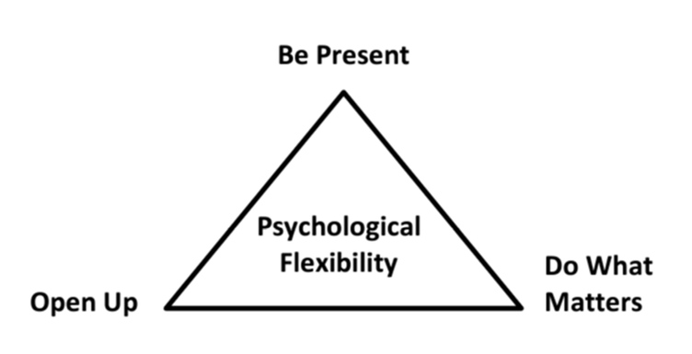
ACT in a nutshell:
👉 Open up, Be present, Do what matters
Russ Harris ACT Video:
https://www.youtube.com/watch?v=C-ZuqeyxULM
Notes:
Lorraine

Slide 36
Thank You for Listening
Questions or reflections?
Notes:
Lorraine

