Slide 1

MEDICATION IN
BRAIN INJURY
THE SCIENCE AND ART
OF SAFE PRESCRIBING
DR BRUCE MOORE MD
Consultant Neuropsychiatrist

Slide 2
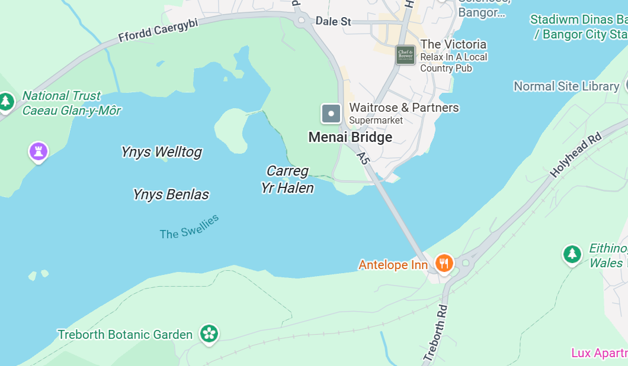

Slide 3
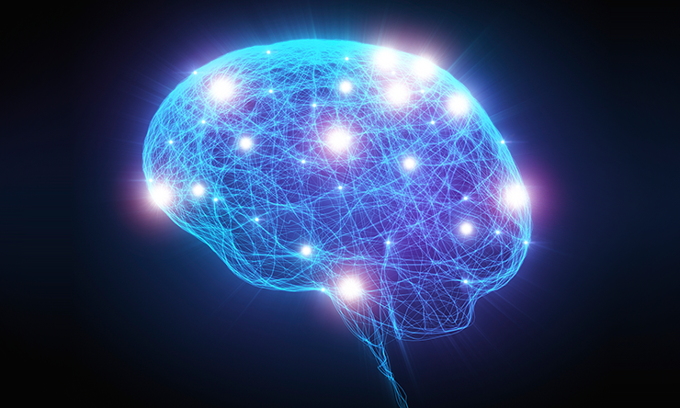
NERDS LIKE ME LIKE NEURAL NETWORKS !

Slide 4
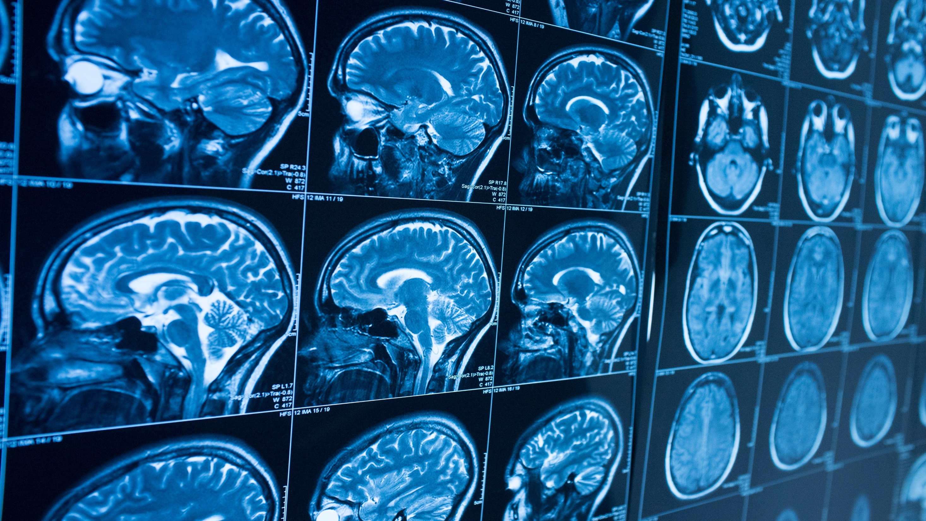

Slide 5
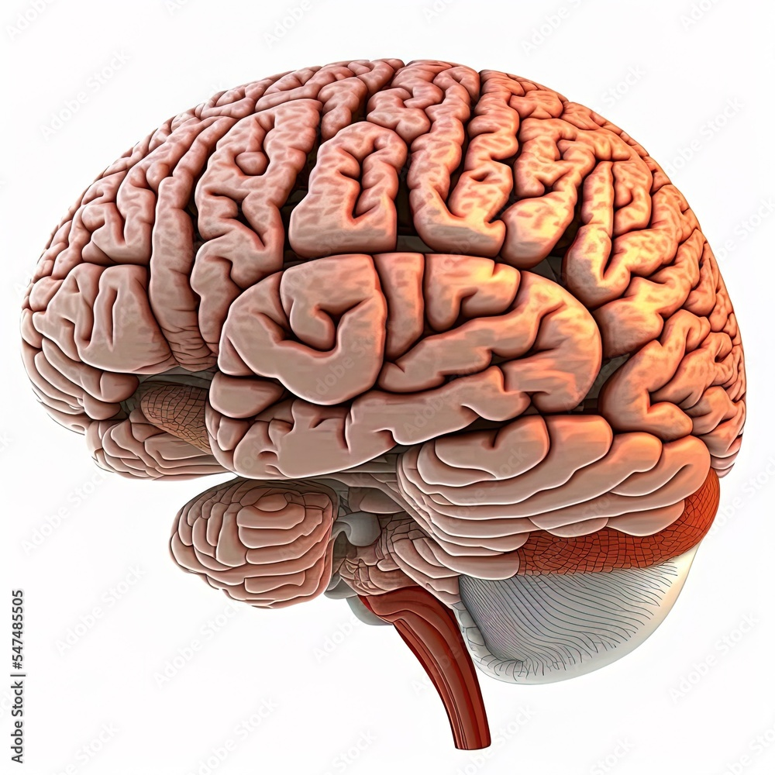
Did this 1.4kg organ paint the Sistine Chapel compose the
Ave Maria
Go to the moon and invent
Nuclear weapons
?

Slide 6
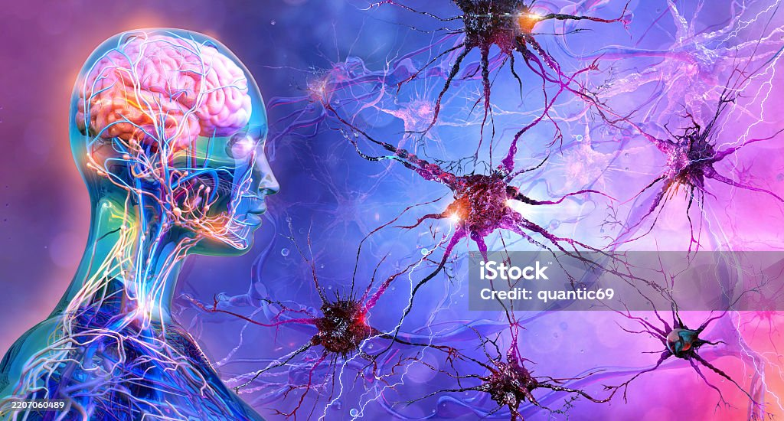
But of course we don’t treat just a brain we treat a person

Slide 7

And a person with family or close friends

Slide 8

And hopefully a team of professionals

Slide 9
PRESCRIBING INFLUENCES
CLINICAL TEAM
PATIENT
FAMILY & FRIENDS
TRENDS
& MEDIA

Slide 10
Highly specialised prescribing in neuropsychiatry
Meds rarely used in other disciplines

Slide 11
Understanding the specifics of specialised drug regimes
Successful prescribing takes all parameters into account
IS IT THE RIGHT MEDICATION
FOR THE DIAGNOSED CONDITION
AT THE RIGHT DOSE
AT THE RIGHT TIME OF DAY
CONSIDER PREGNANCY
OTHER MEDICAL CONDITIONS
POTENTIAL ADVERSE EFFECTS
DO BENEFITS OUTWEIGH RISKS ?

Slide 12
WHO OR WHAT
ARE YOU TREATING ?
A ‘Puritanical’ or biological reductionist model of prescribing may satisfy the intellectual quest for results based solely on a knowledge of brain function
BUT are we treating a brain or a person ?
Or are we treating a brain in a person ?
Or maybe a brain in a person in a family ?
Or all the above and the support team ?
Or maybe also managing psychosocial factors ?
Eg ‘meaning of meds’ or peer pressure etc
And old habits – eg illicit drug use

Slide 13
PRIMUM NON NOCERE (or primum non litigare)
… not for the faint hearted !
THE MINEFIELD OF MEDICATION IN BRAIN INJURY
Extra-pyramidal motor impairment (& opisthotonus & death)
Serotonin syndrome (autonomic instability, death) COMPLAINT!
Neuroleptic malignant syndrome (autonomic instability, death)
Lithium neurotoxicity (tremor, ataxia, coma, death)
Haematological abnormalities (transfusion or death)
Cardiac conduction deficit (sudden death - dothiepin)
Cerebrovascular disease (stroke and death)
Endocrine disorders (diabetes mellitus & complications)
Dermatonecrolysis (eg Stephens Johnsons syndrome)
Seizure threshold reduction (seizures, brain injury, death)
Liver disease (transplant or death)

Slide 14
And then the non-fatal adverse effects
Not to mention less hazardous yet serious adverse effects eg
Excessive sedation
Cognitive impairment
Erectile dysfunction
Female infertility
Orthostatic hypotension
Oedema
Obesity
Diabetes
Heart disease

Slide 15
KNOW WHAT YOU’RE TREATING
(is it brain injury related?)
Just because someone has a head injury doesn’t mean they have a brain injury (despite what the claimant expert might say!)
A mild concussive head injury can have profound effects
A severe brain injury doesn’t change premorbid history
So get as much info as possible prior to treating…
Ideally do joint reviews with neuropsychology

Slide 16
Function of Frontal lobe regions: main seat of behaviour
Dorsolateral – planning (ie what needs to be done)
Damage leads to poor planning, organizing, prioritising)
Mediofrontal – initiates activity (connected to limbic/emotion circuits)
Damage leads to avolition or worse (abulia = zombie-like absence of initiative)
Orbitofrontal – monitors activity and inhibits unwanted impulses
Damage leads to socially disinhibited behaviour and aggression

Slide 17
Common symptoms and disorders seen in brain injury
Neurocognitive and behavioural disorder = a catch-all term
Includes a wide range of symptoms and impairments affecting
Executive function - planning organising prioritising initiating motivating monitoring inhibiting behaviour appropriate to the relevant task and environment – and multitasking
And problems with motivation, aggression, impulsivity, disinhibition – particularly sexual and high arousal (orbitofrontal damage and/or elevated testosterone)
Cognitive function - receptive and expressive language, understanding, processing and assimilating information, calculation, anterograde memory, visuospatial, navigating, deducing, extrapolating etc) - defer to neuropsychology

Slide 18
Psychiatric / psychological problems
anxiety, panic, depression, suicide
bipolar, ultra-rapid cycling mood disorder,
obsessive compulsive disorder (OCD)
post-traumatic stress disorder (PTSD)
Secondary attention deficit hyperactivity disorder (ADHD)
methylphenidate lisdexamphetamine (worldwide shortage in recent years due to four-fold increase in diagnosis)
Post-traumatic psychosis

Slide 19
Antidepressant medication
Tricyclic eg amitriptyline, nortriptyline - low dose for migraine and neuropathic pain but cardiotoxic at high dose
SSRI sertraline, citalopram seizure-neutral and non-sedating BUT tend to be associated with erectile dysfunction
Mirtazepine (sedating but NOT erectile dysfunction)
SNRI duloxetine, venlafaxine – also for neuropathic pain
Vortioxetine - serotonin, noradrenaline and dopaminergic
versatile and well-tolerated antidepressant shown to improve cognitive function independent of antidepressant effects

Slide 20
mood-stabilising medication
Various forms of mood-stabilising medication have been ‘borrowed’ from anti-epileptic medication
Sodium valproate, lamotrigine, well-tolerated
but beware of topiramate, levetiracetam - severe dysphoria
Gabapentin, pregabalin (also used for neuropathic pain)
Carbamazepine (Tegretol) the ultimate ‘chemical cosh’
Quetiapine – started as antipsychotic then licensed as mood-stabilising, but sedating so should be taken at night
Lithium – caveat emptor !

Slide 21
antipsychotic medication
Older antipsychotics eg haloperidol, stelazine
typically associated with hazardous side effects –
extra-pyramidal side effects (EPSE) eg stiffness tremor,
opisthotonus, orofacial dyskinesia, sedation, weight gain
Clozapine - for treatment resistant psychosis, no extra-pyramidal side effects (EPSE) hence can be used for Parkinson’s psychosis
Better tolerated ‘newer’ antipsychotics eg
Risperidone – effective for psychosis and aggression
Aripiprazole – non-sedating or alerting
Depot (long acting) – older drugs sedation and weight gain
Long-acting aripiprazole - non-sedating, even alerting

Slide 22
Niche (highly specialised) prescribing
Cyproterone acetate to decrease testosterone in over-sexualised and disinhibited patients (happy partners!)
Early dementia – donepezil ?
Alcohol and illicit drug use – various approaches
Modafinil for excessive fatigue
Residual PAID syndrome - paroxysmal autonomic instability and dystonia, may respond to beta-blockers eg propranolol (sweaty guy story)
Weight loss – OZEMPIC ?!

Slide 23
CAVEAT EMPTOR!
Extreme caution in brain injury medication
The injured brain is usually highly sensitive to the effects of medication (therapeutic and adverse effects)
LAB INVESTIGATIONS – ECG, Biochem (TFT, LFT,FBC)
BEWARE : seizure threshold / EPSE / drug-interaction / QTC
hypotension / oedema / serotonin syndrome /
neuroleptic malignant syndrome (HELLLP!)
START LOW AND GO SLOW
CAREFUL MONITORING
‘TELL ME WHAT I TOLD YOU’

Slide 24
The curse of polypharmacy
Patients may accumulate many prescription drugs over the years
WHY ? seeing different Doctors for brief reviews
BUT potentially hazardous effects on metabolism
Harmful drug-drug interactions
Medications ‘negating’ each other
Undue burden on liver, CNS, and undue side effects
Management – gradual reduction of medications
MUST involve whole team – MDT (and hospital staff)
Explain rationale and what to look for – be consistent
Then consider re-introducing some meds if needed
eg to manage mood, pain, unhelpful behaviours

Slide 25
When patients don’t agree to medication
Why don’t they want medication ?
?urban myths or misunderstanding
Lack of insight - Don’t think they need meds
Ideally joint assessment with neuropsychology
MANAGEMENT
MDT best interests meeting and consider DoLS under
Mental Capacity Act (MCA) and ? covert medication
In extreme cases may consider more restrictive management
Mental Health Act (MHA) and CTO for treatment
Benefits of Section 3 (117 care) and CTO

Slide 26
And don’t forget Bio magnetic & electro brain stimulation and peripheral neuromodulation
And when all else has failed …
TMS transcranial magnetic stimulation
DCS transcranial direct current stimulation
VNS vagal nerve stimulation (VNS)
DBS deep brain stimulation (DBS)
Effects of rTMS and tDCS on neuropathic pain after brachial plexus injury: a randomized placebo-controlled pilot study – Nature Research Scientific Reports 2022

Slide 27
When one story can tell it all
BRIAN …
Brian – 40yr old single male welder
RTA car vs motorbike – severe traumatic brain injury
Long history of ‘social’ cannabis use pre-accident
Discharged from hospital to home with 24hr support
Resumed cannabis use (brother and dad helped)
Florid psychosis with extreme paranoia with auditory hallucinations
Attacked case manager with knife – police took him to psychiatric hospital
Detained under Mental Health Act (MHA) and discharged after 28 days !
New case manager and new therapy and support team
I was asked to assess for neuropsychiatric treatment
Over 1hr he denied he had any mental health problems
Knowing the history, I asked if he thought I was going to ‘section’ him – ‘YES’
Asked about cannabis – couldn’t imagine living without it !

Slide 28
Saga of Brian continues
BRIAN continued…
Anxious depressed agitated not sleeping, undercurrent of paranoia and admitting to active suicidal ideas (train track at back of house)
Over a few weeks got him stable on quetiapine and sertraline
Miracle – volunteered that he didn’t feel the need for cannabis (score!)
Became engaged in therapeutic activity – in home and community
For six months stable and enjoying good quality of life BUT THEN …
Brother out of prison – stayed with Brian – resumed cannabis (and Dad)
Disengaged, refusing treatment and support and rapidly deteriorated
Florid psychosis again, extreme paranoia and auditory command hallucinations
The team made every effort to have him assessed by statutory services for emergency admission under the MHA –
when they eventually visited, had a 10 minute chat and declined to section him

Slide 29
Brian had already sacked his entire support team – only allowing Mum to help
Urgent call to case manager from his mother – then call to me for urgent review
For hours – Brian wielding a kitchen knife and yelling that he was going to kill her
Eventually statutory services (NHS, AMHP) attended but ran out !
Then called me outside and asked me to sign MHA Section 2 – no way !
Then Police attended and took him to psychiatric hospital under Section 3
Later transferred to private rehabilitation service for 18 months
He was prescribed depot Paliperidone – weight up by 4 stone
Eventually discharged home BUT ONLY ON CTO (whole team agreed)
Marked fatigue, withdrawn and lack of initiative and motivation
Seemed stable but still undercurrent of paranoia – weighing 18 stone

Slide 30
OZEMPIC ??
(semaglutide)
Brian’s expert Dietician had success using Ozempic (semaglutide) in another patient and after lengthy discussion with MDT he agreed he would trial it
BUT a member of the support team felt it was a good idea to tell Brian about all the celebrity Ozempic horror stories
Joint assessment (Dietician, Neuropsychology and Neuropsychiatry re MENTAL CAPACITY for treatment
Agreed he had mental capacity – worked with team to avoid undermining treatment plan and agree close monitoring
Requested range of blood and biochem investigations (not good)
Referred to specialist weight loss clinic to prescribe Semaglutide
Awaiting outcome from specialist clinic …

Slide 31
PRESCRIBING INFLUENCES
CLINICAL TEAM
PATIENT
FAMILY & FRIENDS
TRENDS
& MEDIA

Slide 32
SAFETY & SUMMARY
MEDICATION IN BRAIN INJURY
ACKNOWLEDGE THE MINEFIELD
ALWAYS INVLOVE THE WHOLE TEAM – AND FAMILY
KNOW WHAT YOU’RE TREATING, WHY AND HOW
ORGANIC VS PSYCHOLOGICAL OR BOTH
MEDICAL / LAB INVESTIGATIONS ESSENTIAL
START LOW AND GO SLOW
CAREFUL MONITORING
Only once made formal complaint re prescribing

Slide 33
THANKYOU FOR LISTENING
ANY QUESTIONS ?

Slide 34
Case studies
(any likeness to any one of your clients is entirely intended)
Mr Angry
22 year old, RTA at 19, severe brain injury
Angry, aggressive, threatening, paranoid
Road rage, trashing flat and getting evicted
On assessment – feel pumped, stoked, agitated, on edge all the time, ‘paranoid’ feeling (insurance surveillance) and sweaty
Asked GP for LFT – raised enzymes – asked re steroids (yes)
Hence no LMG till LFT normal – SSRI plus Qtp
Hyperhydrosis – propranolol pending axillary botox

Slide 35
Mr Grumpy
Mr Grumpy – 57 year old inpatient rehabilitation service
Severe traumatic brain injury (RTA) 8 years before
Couldn’t tolerate any stimulation so isolated himself
Irritable, low threshold for anger outbursts
On assessment – my head wont stop – crammed, racing, never stops – I cant switch it off – as soon as I wake up it starts
Was on SSRI and Carbamazepine
Prescribed quetiapine – gave early relief !

Slide 36
Mr Sleepy
Awaiting green light to treat 55 year old man at home
NOT abulic – but hypersomnolent !
When not in bed, disinhibited
On assessment – very animated, and marked dysphasia
Able to communicate via writing and drawing
Wants to recover as much as possible
Meds alone insufficient and risky – needs support ++
MODAFINIL was the easy answer (safe ECG so OK)

Slide 37
Mr Hopeless
34 year with old brain injury who had lost best friend in RTA
Partner left him with his two daughters who were his delight
Severely depressed and self-medicating with alcohol and drugs
Admitted to hospital following serious overdose BUT
H/O post-injury epileptic seizures (treated with anticonvulsant)
Willing to accept antidepressant medication, but risk of seizures
Answer = seizure-neutral antidepressant eg sertraline
‘Start low go slow’ gave steady response and discharged in 6/12

Slide 38
Behavioural problems – organic personality disorder
‘Frontal lobe syndrome’ actually 3 conditions that may overlap:
Dorsolateral dysfunction
  Dysexecutive ftn (planning and problem solving )
  Poor May respond to cholinergic drugs
Medial-frontal dysfunction
  Non- initiation / motivation
  May respond to DA-ergic agents (for the brave!)
Orbitofrontal dysfunction
  disinhibition, (+/- aggression)
  Often responds to AEDs eg CBZ or LMG
  Carbamazepine sledgehammer
  Lamotrigine precision tool
  Gabapentin & pregabalin
  Impulsivity - methylphenidate

Slide 39
Psychological and psychiatric complications
Also need to consider
fatigability Modafinil 5 – 10 mg OD
irritability antidepressant (SSRI or QTP)
anxiety SSRI / propranolol
depression antidepressant / Qtp
cannabis anxiolytic / QPT (chill pill) / LMG
psychosis antipsychotic (Risperidone)
Aggression – depends on cause:
  Limbic rage (episodic dyscontrol) AED eg CBZ/LMG
  Orbitofronal impairment Antipsychotic or AED
  eg RISPERIDONE
  ? ELEVATED TESTOSTERONE

Slide 40
Neurological complications
Headache Gabapentin for pain (and agitation/anxiety)
Epilepsy Lamotrigine, Carbamazepine, Leviteracetam
Hyperhidrosis Botox, propranolol, sympathectomy
Paresis/paralysis Botox for spasticity
Orthostatic hypotension Avoid hypotensives eg Beta-blockers
Diabetes insipidus Medical emergency (&SIADH)
Dysphagia SLT assessment and advice
Autonomic instability
  Temperature regulation vasopressin / propranolol
  Cardiovascular instability medical emergency

