Slide 1
Autoimmune encephalitis and psychiatry: beyond the antibodies.
Autoimmune encephalitis and psychiatry: beyond the antibodies.
Richard Hackett
November 2025

Slide 2
1960s: paraneoplastic syndromes
Association recognised between lung cancer (mostly) and localised lymphocytic injury to CNS/peripheral nerves.
Syndromes included peripheral neuropathy, cerebellar, limbic etc.
Mechanism unclear.

Slide 3
1990s
Immune mechanism identified.
Molecular mimicry – epitopes on neuronal surface similar to tumour epitopes→ immune attack.
Tumour specific and syndrome-specific antibodies recognised – paraneoplastic panel.
Paraneoplastic limbic encephalitis – psychosis (affective)
- amnesia
± seizures
Associated antibodies Hu (SCLC), Ma2 (testicular), CRMP5 .

Slide 4
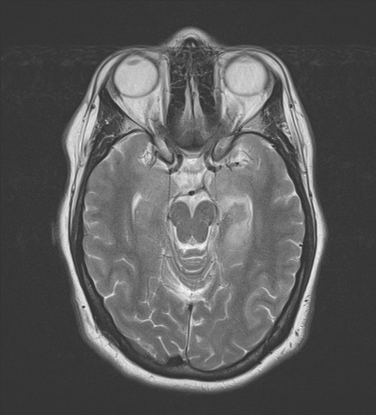

Slide 5
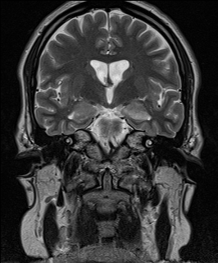

Slide 6
Case 2
HB age 18, admitted to adolescent unit.
Daughter of a Bolton pakistani family.
Admitted 1 month before with delusion she was married.
Confused and disorientated on adm. Unable to retain info.
Obs suggest auditory hallucinations which she denies.
Neurological examination normal.

Slide 7
MR brain normal.
CSF – normal, no oligoclonal bands
NMDA receptor weakly positive.
Started on prednisolone 60mg/day.

Slide 8
Dalmau 2007
NMDAR autoimmune encephalitis
100 patients from 1 city over 2 years.
77% initially seen by psychiatrist with psychosis
Onset over a few days:
Brief psychotic prodrome then:
confusion
Seizures
Hypoventilation
Facial movement disorder (rabbit movements)
Autonomic instability

Slide 9
Anti-NMDA receptor Ab disease
Dalmau’s original series:
MR abn. 55% (cortex, med temp lobes)
LP WBCs↑ (ie. 5+) 91%
EEG slow 71%
Ovarian teratoma common
Most seronegative after 1 year.
Relapses occur.

Slide 10
The range of syndromes due to NMDA
Classic anti-NMDA encephalitis
(Psychosis → confusion + hypoventilation +
movement disorder + seizures)
Acute “pure” psychosis
Catatonia
Epilepsy
Narcolepsy

Slide 11
NMDA receptor antibodies
Associated triggers
Teratoma
Herpes simplex Covid 19
Varicella Zoster Japanese encephalitis
HIV Toxoplasma
Human herpes type 6
Postpartum*
Cryptococcus

Slide 12
Autoimmune Psychoses
(So far) recognised antibodies:
Anti-NMDA
Anti-Voltage gated potassium channel antibodies
- LGI1 (anti-leucine rich glioma inactivated 1)
- Caspr2 (anti-Contactin associated protein 2)
Anti GAD (anti-Glutamic acid decarboxylase)

Slide 13
Autoimmune psychosis antibodies continued:
Available from regional/Oxford neuroimmunol lab:
GABAA
DPPX (Dipeptidyl-peptidase-like protein-6)
AMPA (glutamate receptor 1)
GABAB
SLE antibodies
Glycine receptor antibodies

Slide 14
No new antibodies discovered in last 10 yrs:
Not routinely available from laboratories:
GFAP (Glial fibrillary protein antibodies)
D2 (dopamine 2 receptor antibodies)
Adenylate cyclase 5
Neurexin 3-alpha
mGluR1 (metabotropic glutamate receptor type 1)

Slide 15
Seronegative patients
Possible reasons for seronegativity
The disease process isn’t autoimmune.
Anti-neural antibodies in CSF, not in serum.
Too limited a range of antibodies tested ie. the Oxford 3.
The (presumed) anti-neural antibody hasn’t yet been discovered.
The immunological process has burnt out.

Slide 16
Case 3
April: 22 year old admitted to local psychiatry dept. with 1 week H/O persecutory delusions and auditory hallucinations.
Started on antipsychotic.
Increasingly mute and immobile
After 2 weeks mother takes her home, often has to feed and bathe her. On no medication.
Neuropsychiatry clinic September: psychotic, catatonic.

Slide 17
LP not done.
All serum antibodies negative

Slide 18
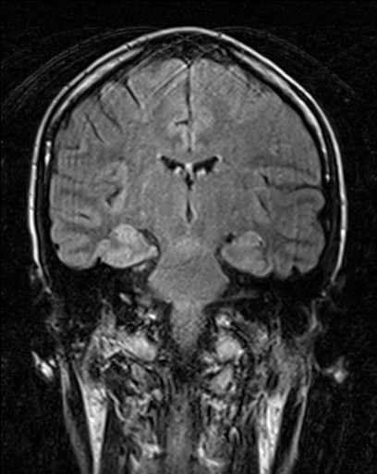

Slide 19
Treatment and outcome
Prednisolone 60mg od, Vit D/Calcium, Omeprazole
December psychosis and catatonia resolved.
January - healthy baby delivered!
2 years later single tonic clonic seizure.
Mild anterograde memory deficit.

Slide 20
What if seronegative and MR negative and CSF is normal?

Slide 21
Female 29
Onset vis, aud hallucinations & delusions. 2 week h/o amnesia. Risperidone from psychiatrists (poor response).
Age 25 onset rheumatoid arthritis. Currently severe joint pain. On methotrexate.
Antibodies VGKC 1290. LGI1/CASPR2 etc. negative.
MR: a few deep white matter spots, h/o migraine.
CSF not done.
Cognitive impairment and psychosis coincides with joint pain.
After 2 months of high dose PRED, mental state & joints better

Slide 22
Male 17
Nov 2021 dels, aud halls, catatonia. 4 wk on ANU. (transferred from adolescent unit).
Age 8 aloplecia areata, skin relapses age 14 and Nov 2021.
All antineural antibodies negative, MR and CSF normal.
Psychosis coincided with 3rd relapse of aloplecia.
Psychosis and hair started to improve on PRED 60mg (stopped after return to adolescent unit).

Slide 23
Female 24
age16 psychosis+elation. age21 dep/elation (psych adm)
age 23 psychosis+elat.+ 1 wk amnesia (3m psych adm).
Arthritis+ erythema nodosum. ∆ sarcoid. Also crohn’s disease.
All antineural antibodies negative. MR normal. CSF (inc Abs) negative.
Each psychiatric relapse assoc with relapse of sarcoid/arthritis.
Physical and psych symptoms respond to methotrex+PRED
Risperidone/quetiapine no benefit.

Slide 24
Male 21
Age 17 1st episode psychosis, catatonia + dyskinesia (adm. Neurol unit ×1m→adolescent→EIT). 2022 (age 20) Ψ relapse.
No h/o autoimmune disorder.
All antineural antibodies negative. MR and CSF normal.
No autoimmune symptoms.
Not immunosuppressed on neurology unit.
Bad outcome; negative psychotic symptoms+++ (previously grade As at school).

Slide 25
Non-autoimmune
Psychoses
Autoimmune
Psych osis
Specific Ab+
CSF+
MR+

Slide 26
Problems:
1) Need for early immunosuppression to prevent brain atrophy and worse long term outcomes? Ideally treat within 2 weeks of onset.

Slide 27
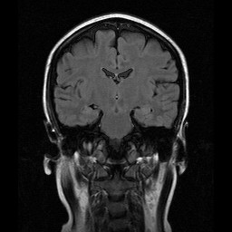

Slide 28
NMDA positive in patient with 20 yr H/O psychosis.

Slide 29
Patient with psychosis + NMDA antibodies +teratoma BUT father and sister had chronic NMDA-seronegative psychosis.

Slide 30
Availability of LPs in psychiatry departments.

Slide 31
Why do we get relapse of psychosis in patients who no longer have evidence of inflammation? Has the damage already been done?

Slide 32
problems continued:
Serum positive but CSF negative - ?brain acting as an immunoprecipitator. ¾ respond to immune treatment.

Slide 33
If you suppress psychosis with antipsychotics at the same time as immunosuppression, how do you know when you have got the patient better?

Slide 34
Suggested approach to new-onset psychosis
On all new-onset psychosis patients check serum for antibodies:
NMDA
LGI1/CASPR2
Anti-GAD
Glycine receptor
GABAb, AMPA
GABAa
DPPX
(If 40+ years, consider paraneoplastic antibody screen)

Slide 35
On all new onset psychosis patients:
MR brain
LP – send CSF for antibodies (previous slide)
oligoclonal bands
IgG ratio
protein,cells

Slide 36
Features pointing to autoimmune cause (esp if antibodies/MR/CSF are normal):
History of autoimmune disorder.
Memory deficit; retrograde and/or anterograde.
Catatonia.
Movement disorder esp. dystonia, rigidity, dyskinesia (none are pathognomic.)
?Excessive sensitivity to antipsychotics.

Slide 37
Speculation
autoimmune brain injury
Acute Chronic psychosis

Slide 38
Final comment.
Psychiatrists will have to develop their own processes for identifying potentially autoimmune psychoses and treating with high dose prednisolone.

