Slide 1





Combined Pay Gap Report 2025 incorporating:- 1. Gender Pay 2. Ethnicity Pay 3. Disability Pay
For the period 1st April 2024 to 31st March 2025
(9th Year of Gender Pay Reporting; 2nd year of reporting for Ethnicity Pay Gap & Disability Pay Gap)

Slide 2
Contents
Trust Pay Gaps Summary as at 31.3.25 (p3)
Trust Gender Pay Gap Report as at 31.3.25 (p4-11)
Ethnicity Pay Gap Report as at 31.3.25 (p12-18)
Disability Pay Gap Report as at 31.3.25 (p19-23)
Cultural Factors & Challenges Influencing Trust Pay Gaps (p24)
What we are doing now and next (p25)
Aligning Pay Gap Findings with Inclusion Priorities (p26)
Appendix:
Ethnicity Pay Gap Data (as at 31.3.25) with and without medical staff (p27-28)

Slide 3
1. Trust Pay Gaps Summary (2025)
This year’s pay gap analysis covering gender, ethnicity and disability show areas of progress alongside challenges that require continued focus.
Gender: The mean gender pay gap narrowed slightly from 13.30% in 2024 to 11.45% in 2025, although it continues to favour men on average. At the midpoint of pay, the gap has reversed, with women earning £0.23 more per hour than men, a median gap of –1.23%. These figures already take into account that women make up the majority of the workforce and reflect progress for a typical member of staff, while higher average pay for men reflects continued underrepresentation of women in the most senior roles.
Ethnicity: Global Majority staff continue to earn more on average than White staff, but the gap has Global Majority staff continue to earn more on average than White staff, with a mean gap of –13.06% in 2025, reduced from –15.65% in 2024. This average is skewed by a high proportion of Global Majority staff in medical roles, which are among the highest paid. At the midpoint of pay, the picture reverses, with White staff earning 4.30% more than Global Majority staff, indicating concentration of Global Majority staff in lower and mid paid roles and underrepresentation in senior Agenda for Change (Afc) and leadership positions.
Disability: Staff who have not declared a disability earn more than disabled staff, with a mean gap of 9.52% and a median gap of 7.22% in 2025, both wider than in 2024. Disabled staff are underrepresented in the highest pay quartile and received no bonus payments in 2025, highlighting continued barriers to progression into senior and higher paid roles.
Together, these findings show that while some progress is being made in reducing pay gaps, inequalities persist and in some cases are increasing rather than closing. This underlines the importance of sustained action to address structural barriers, improve representation at senior levels and create fairer progression pathways for all staff.

Slide 4
1. GENDER PAY REPORT 2025
Reporting period 1st April 2024 to 31st March 2025

Slide 5


This year’s gender pay* data tells us…
The total headcount, including bank staff, was 2,061 (1,610 = women).
The mean hourly gender pay gap narrowed slightly from 11.70% in 2024 to 11.45% in 2025. Women were paid 35p per pound less than men on average (mean).
The median hourly gender pay gap moved from 1.26% in 2024, when men were paid slightly more than women, to -1.23% in 2025, meaning women were paid slightly more than men (when using median).
The mean bonus gap reduced from 2.90% to 1.14% in 2025, and the median bonus gap fell from 0.41% to 0.12%, showing greater parity in bonus value.
The proportion of staff receiving a bonus fell sharply in 2025. Men receiving a bonus dropped from 64.26% in 2024 to 23.44% in 2025, while the share of women fell from 64.55% to 34.62%. The larger fall for men narrowed the gap.
Women’s representation in the top quartile increased from 72.80% to 74.08%, and in the upper-middle quartile from 78.97% to 83.04%, showing stronger presence at higher pay levels.
In the lower-middle quartile, women’s representation dropped from 76.32% to 72.78%, which may reflect movement into higher pay bands.
In the lowest quartile, women’s representation rose from 81.85% to 82.65%, highlighting a concentration in the lowest-paid roles.
Women earned 65p for every £1 paid to men in 2025
The *Gender Pay Gap shows the difference in average hourly earnings between men and women across an organisation. It highlights how men and women are spread across roles and pay levels, rather than unlawful unequal pay for the same job.
Changing the Gender Pay Gap is a long-term process shaped by cultural and societal factors. We are encouraged to see a continued reduction in our Trust’s Gender Pay Gap this year, but we recognise there is more to do. Our aspiration remains to make further progress towards achieving true equity in the years ahead.

Slide 6
NSCHT Gender Pay Gap Journey
Mean pay gap (average difference in hourly pay) started at 15.6% in 2017, peaked at 17.7% in 2019 and 2020, then steadily fell to 11.5% in 2025. This shows, on average, women earned about 11.5% less than men in 2025 compared to over 15% less in 2017.
The median dropping faster than the mean indicates good progress in everyday roles, but also highlights that disparities may remain in senior, higher-paid positions.
Median pay gap (difference at the midpoint of the pay distribution) was 4.5% in 2017, peaked at 9.1% in 2019, and then declined sharply in 2025 at -1.23%. Showing that women earned slightly more than men at the midpoint of earnings.
The drop in both measures, especially the median, indicates a narrowing of the GPG over time. The shift shows that men and women now earn roughly the same at the median, with women slightly ahead. It signals progress, but the small margin means it may be down to workforce changes rather than a major structural shift (e.g. women in higher-paid roles or fewer men in certain pay bands).

Slide 7


Workforce Gender Profile
* Headcount includes bank staff (Total = 2,061)
*Women: 1,610
Our proportion of female staff has fluctuated between 77% & 79% since 2017
Head-count: 528*
*Men: 451
Correspondingly, our proportion of male staff has fluctuated between 21% and 23%
Note: Non-binary gender is not currently recorded in ESR. The Trust fully recognises all genders, including non-binary and trans identities (female includes trans women, male includes trans men). However, ESR does not currently have the functionality to record this information
The Trust’s workforce is more female-dominated than the NHS overall, with women making up 78.11% compared to the NHS average of 74.1%. Men account for 21.88% at the Trust, slightly below the NHS average of 25.9%

Slide 8
Trust GPG (Average Hourly Pay) Women’s average hourly pay compared with men’s
MEAN
The data shows that the Trust’s mean gender pay gap has been steadily narrowing over time, though a difference remains.
In 2017, men earned on average £2.91 more per hour than women, representing a 15.6% gap. By 2024, this gap reduced to £2.55 (13.3 narrowed further to £2.66 (11.45%) in 2025.
(in 2025 women earned £20.56 for every £23.22 men earned → £0.89 for every £1)
While men continue to earn slightly more on average, the gap has decreased by 4% since 2017, reflecting ongoing progress towards greater pay equality.
MEDIAN
The data shows a clear improvement in median hourly pay equality over time, with the gender pay gap not only narrowing but reversing in 2025.
In 2017, men earned £0.68 more per hour than women, but by 2025 this had reversed, with women earning £0.23 more per hour at the midpoint of pay, which is important because it reflects what a typical member of staff earns and is not skewed by a small number of very high salaries.
This improvement already takes into account that women make up most of the workforce, while the headline figure that women earn 65p for every £1 men earn reflects total pay across the year, shaped by hours worked, seniority, and the types of roles people hold, not just pay per hour.
Mean (Hourly Pay Rate) | 2017 | 2024 | 2025
Male | £18.63 | £21.77 | £23.22
Female | £15.72 | £19.21 | £20.56
Difference | £2.91 | £2.55 | £2.66
Gender Pay Gap | 15.60% | 13.30% | 11.45%
Median (Hourly Pay Rate) | 2017 | 2024 | 2025
Male | £15.07 | £18.18 | £18.86
Female | £14.38 | £17.95 | £19.09
Difference | £ 0.68 | £0.23 | -£0.23
Gender Pay Gap | 4.50% | 1.28% | -1.23%

Slide 9
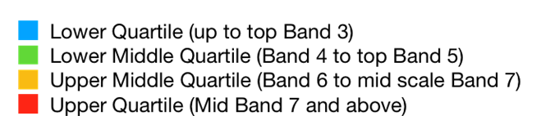
Salary Quartiles (comparing 2025 with 2017 & 2024)
Although women make up most of the workforce even in the highest pay quartile, there is a higher representation of men in B7+ compared with the lowest quartile.
Women are steadily increasing their representation at the top of the pay distribution, pointing to progress in tackling gender imbalances in senior and higher-paid roles.
This shows that women form the majority in every quartile. Men are relatively more represented in the second and top quartiles, while women are especially dominant in the first and third quartiles. 2025 saw a small but rise in women’s representation in the lowest, middle-upper, and highest quartiles, while men gained a little more presence in the lower-middle quartile.
NB The numbers displayed represent the ratio of female to male workers in each pay quartile

Slide 10
Gender Bonus Pay
In 2025, the gender bonus pay gap narrowed* demonstrating a positive year-on-year improvement.
Women received an average bonus of £11,545 compared to £17,658 for men, bringing the gap down to 34.62%. At the median, the gap was smaller still at 23.45%, with women’s median bonus now matching men’s at £11,545.
This marks a notable improvement compared to 2024, but men still receive higher bonus payments overall, influenced in part by legacy Clinical Excellence Awards (CEA) that continue to benefit a predominantly male consultant group.
In 2024, approximately 33.3% of bonus recipients in the Trust were women—closely mirroring the national average of 32.4% (37.2% in 2024) of female consultants receiving Clinical Excellence Awards nlg.nhs.uk. However, in 2025 the Trust proportion fell to only 22.2%, indicating a marked decline in women’s representation among bonus recipients compared with national norms).
*While the gender bonus pay gap reduced sharply in 2025, this change must be viewed in context. The number of consultants receiving a bonus fell from 21 in 2024 to 9 in 2025, with women dropping from 7 recipients to only 2.This means the narrowing gap reflects both fewer awards overall and shifts in distribution, rather than a consistent improvement across the workforce. Fewer women actually received a bonus in 2025, so the figures should not be read as evidence of full equity.
 | 2024 |  | 2025
Gender | Avg. Pay | Median Pay | Avg. Pay | Median Pay
Male | 10,422.23 | 4,001.81 | 17,657.92 | 15,080.03
Female | 3,694.19 | 1,430.20 | 11,544.60 | 11,544.60
Bonus Pay Gap % | 64.55% | 64.26% | 34.62% | 23.45%

Slide 11

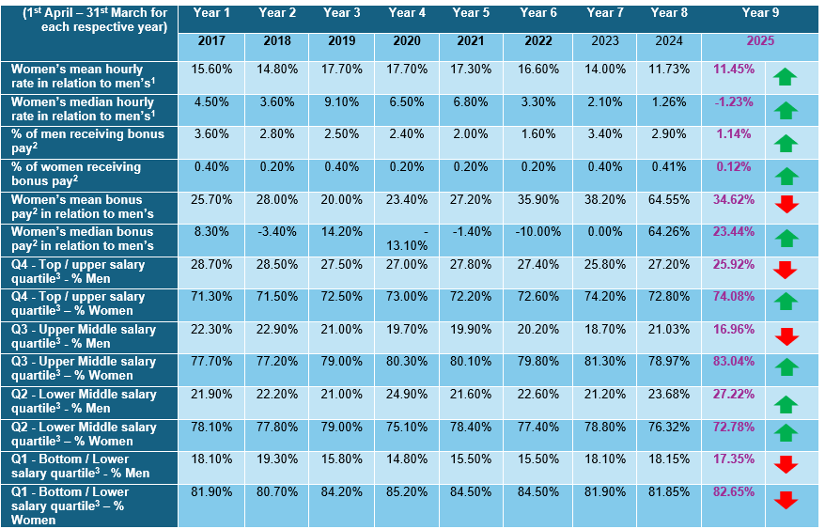
NSCHT Gender Pay 9-year Summary
In 2025, women’s overall pay gap position improved. The mean hourly gap narrowed slightly, and the median gap shifted in women’s favour, meaning average female earnings overtook men’s. Both the mean and median bonus gaps reduced, although this was partly due to far fewer staff receiving bonuses overall, with a sharper drop for women. Looking at pay quartiles, women made gains in the top and upper-middle quartiles, showing better representation at higher pay levels. Their share also fell slightly in the lower-middle quartile, which may indicate some upward movement. However, women’s presence in the lowest quartile increased, leaving them even more concentrated in the lowest-paid roles.

Slide 12
2. ETHNICITY PAY REPORT 2025
(Reporting period 1 April 2024 to 31st March 2025)
Note: Ethnicity Pay Gap Reporting currently not mandated in UK legislation. It is requested as part of NHS EDI Improvement Plan). Employers are encouraged to publish this data voluntarily to support transparency and accountability.
The 2025 ethnicity pay gap report has been prepared using the same methodology as gender pay gap reporting, drawing on ESR data and our EDI Dashboard.

Slide 13

Our 2025 ethnicity pay* data tells us..
The ethnicity pay gap shifted further in favour of Global Majority staff when comparing 2024 and 2025. The mean gap narrowed slightly, moving from –15.65% in 2024 to –13.06% in 2025, indicating that Global Majority staff continue to earn more on average than White staff, though by a smaller margin. However, the median gap shifted from 0.0% in 2024 to +4.30% in 2025, showing that White staff now earn more than Global Majority staff at the midpoint of the pay distribution.
Global Majority staff have the highest mean hourly rate (£23.44) compared to White staff (£20.73), meaning that on average they are paid more per hour. This is largely driven by medical roles, where 63.3% of Trust medical staff are from a Global Majority background and sit at the highest pay levels. The median hourly rate shows a different picture, with Global Majority staff earning £18.27 compared with £19.09 for White staff, indicating concentration in lower and mid paid roles. When medical staff are excluded, the ethnicity pay gap shifts, with White staff earning 10.21% more than Global Majority staff, based on 1,982 staff where ethnicity was known.
The difference shows:
Mean pay: White staff are paid 13.06% less than Global Majority staff; Median pay: White staff are paid 4.30% more than Global Majority staff.
The Not Known median pay (£21.47) is higher than both Global Majority and White staff, though the small sample size (18 staff) limits reliability.
White staff earned 88p for every £1 paid to Global Majority staff.

Slide 14
Mean and Median Ethnicity Pay Gap
In 2024 the ‘Not known’ data showed very low pay levels (mean = £15.29, median = £14.53), which pulled down averages and widened apparent gaps. By 2025, however, the same category reported much higher pay (mean= £22.07, median = £21.47), above White staff and close to Global Majority. This large shift suggests that outcomes for the “unknown” group may be heavily influenced by data quality issues or small sample sizes, making year-to-year comparisons less reliable.
The 2025 data shows notable differences in pay outcomes across the broad ethnic groupings.
Global Majority staff recorded the highest mean hourly pay at £23.44 but the lowest median at £18.27, indicating a wide spread of earnings where highly paid medical roles raise the average, while many staff remain concentrated in lower and mid paid positions.
White staff are at the lower end overall, with a mean of £20.73 and a median of £19.09, both below Global Majority staff.
The Not Known group reported a mean of £22.07 and a median of £21.47, with the closeness of these figures suggesting a more consistent distribution of pay, though the small group size makes this less reliable.

Slide 15
Mean and Median Ethnicity Groupings
Ethnic Origin Grouping | Total Full Pay Relevant Employees
Asian | 102
Black | 156
Mixed | 34
NULL | 8
Not Stated | 10
Other | 12
White British | 1,689
White Other | 50
Under Agenda for Change(Afc), pay rates are fixed, so ethnicity pay gaps are not about unequal pay for the same role. Our data shows that Global Majority staff are overrepresented in highly paid medical roles, raising average pay, but underrepresented in senior Agenda for Change bands, which lowers the midpoint and explains why White staff earn more at the typical pay level (i.e. £19.09 for White staff and £18.27 for Global Majority staff.).
Asian staff continue to earn the highest mean pay (£27.76 in 2025, up from £26.41 in 2024), but their median pay has stayed flat around £19, showing uneven pay distribution.
Black staff had a mean pay of £20.07 and median of £17.77 in 2024, rising slightly in 2025 to a mean of £20.48 but falling in median to £17.18, leaving them the lowest paid group overall and highlighting persistent disadvantage.
White British staff had lower pay than Asian and White Other staff, with a mean of £20.57 and median of £19.09, close to Black staff and well below Asian mean pay (£27.76).
Smaller ethnic groups show the strongest outcomes, with the “Other” group reaching the highest mean pay (£30.71 in 2025) and White Other staff reporting consistently high mean (£26.27) and median (£21.69) pay, though results are influenced by small group sizes..

Slide 16
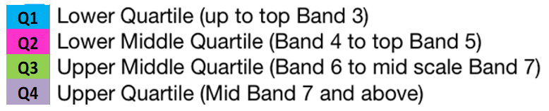
Pay Quartiles and Ethnicity
This the distribution of White and Global Majority staff across pay quartiles in 2025.
In the lowest pay quartile (Q1), 89% of staff are White and 11% are from the Global Majority.
Q2, the proportion of Global Majority staff rises to 22%, though White staff still form the majority (77%).
Q3, representation of the Global Majority falls back to 12%, with White staff making up 86%.
The highest pay quartile (Q4), White staff are most dominant at 93%, with only 6% from the Global Majority.
This data highlights a clear underrepresentation of Global Majority staff in higher pay quartiles, particularly in the top quartile, where they make up just 6%. Conversely, they are more concentrated in the lower quartiles, especially Q2. This points to potential barriers to career progression and pay equity for Global Majority staff, suggesting that further action is needed to improve representation at senior and higher-paid levels.
*Equity for Global Majority staff means comparing their share in each pay quartile against their overall workforce share of 18%.

Slide 17
Pay Quartiles by Ethnic Group
Upper quartile – Asian staff numbers fell from 42.9% in Q4 (2024) to 6.3% in 2025, and White Other from 48% to 0%.
Lower quartile rise – Mixed staff increased in Q1 from 4.8% to 20.6%, and White British stayed high at 26% in both years.
Asian staff (4.95%): Most are concentrated in Quartile 2 and Quartile 4. This suggests stronger representation at the upper quartile than at the lower-middle (Q3).
Black staff (7.57%): Black staff (7.57%) are mainly concentrated in lower and mid pay quartiles, with 46.79% in Quartile 2 and only 14.10% in Quartile 4, showing underrepresentation in the highest paid roles. This explains why typical pay for Black staff is lower, even though overall averages can sometimes appear higher when a small number of very senior or medical roles are included.
White British (81.9%): Largest group, with a relatively balanced distribution across all quartiles. Slightly fewer in Quartile 2 compared with the others.

Slide 18
Bonus Pay
The suspension of Clinical Excellence Awards reduced bonus opportunities overall and, combined with the very small number of award holders and the movement of consultants who already hold CEAs, shifted average bonus outcomes between groups in 2025. The apparent gains for Asian and White British staff reflect changes in award allocation and workforce movement, not structural improvement in access to rewards.
2025 average NSCHT CEA £8,569.90
Bonus pay figures are based on Clinical Excellence Awards (CEA) and apply to only nine individuals, so the data is highly sensitive to small changes. In addition, where an individual is recruited into the Trust already holding a CEA, which they bring with them, further skewing the results. As a result, year to year changes reflect movement of a very small number of consultants and changes in award status, rather than meaningful differences in performance or reward across the wider workforce.
Asian staff: Bonus payments more than doubled, rising from £6,850.84 in 2024 to £14,313.00 in 2025.
Black staff: Bonuses fell slightly, from £17,993.00 in 2024 to £16,588.00 in 2025.
White British staff: Bonuses almost tripled, from £3,895.84 in 2024 to £10,036.00 in 2025.

Slide 19
3. DISABILITY PAY GAP REPORT 2025
(Reporting period 1 April 2024 to 31st March 2025)
Note: Ethnicity Pay Gap Reporting currently not mandated in UK legislation. It is requested as part of NHS EDI Improvement Plan). Employers are encouraged to publish this data voluntarily to support transparency and accountability.
The 2025 ethnicity pay gap report has been prepared using the same methodology as gender pay gap reporting, drawing on ESR data and our EDI Dashboard.

Slide 20
Our 2025 disability pay* data tells us..
192 staff (9.32%) declared a disability, up from 8.95% in 2024 and above the national NHS average of 5.7% (WDES 2024).
The disability pay gap has widened when compared with 2024.
Mean gap: 9.52% (up from 5.98% in 2024) – disabled staff earn £19.30 per hour compared with £21.33 for non-disabled staff.
Median gap: 7.2% (up from 2.3% in 2024) – disabled staff earn £17.72 compared with £19.09.
Pay quartiles show disabled staff are evenly spread across the lower three quartiles (around 9–11%) but fall sharply to 5.5% in the highest quartile, where senior and consultant roles sit. This mirrors the pattern seen in 2024, with little movement.
Bonus pay worsened the gap. In 2025, no disabled staff (0.0%) received a bonus, compared with 0.29% of non-disabled staff. In 2024, 0.62% of disabled staff received a bonus, versus 0.86% of non-disabled staff. The suspension of Clinical Excellence Awards (CEAs) has removed one of the few mechanisms for additional earnings, disproportionately affecting disabled consultants and further widening inequity.
For every £1 earned by a nondisabled member of staff, disabled staff earn 90.48p
Overall, the data shows disabled staff are paid less on average, underrepresented in the most senior roles, and do not receive bonus payments, creating a compounded disadvantage that has worsened since 2024.

Slide 21
Hourly Pay and Disability
The average hourly rate for disabled staff was £19.30, compared with £21.33 for non-disabled staff, a gap of 9.52%, up from 5.98% in 2024.
The average disability pay gap widened to 9.52%, with disabled staff earning £19.30 per hour compared with £21.33 for non-disabled staff.
At the median, the gap also grew to 7.22%, with disabled staff earning £17.72 versus £19.09. This is has worsened from 2024, when the gaps were 5.98% (average) and 2.27% (median).
At the median, disabled staff earned £17.72 per hour versus £19.09 for non-disabled staff, a gap of 7.22%, compared with 2.27% in 2024.
NHS’s median disability pay gap of 7.22% lies below the national median of 12.7%, per ONS (2024).
Nationally (ONS 2024), the median pay gap between disabled and non-disabled employees was 12.7%. A 9.7% median gap suggests the NHS is performing slightly better than the broader workforce context.
Without a national average pay gap figure, direct comparison on that front isn’t possible, but NHS’s average gap of 9.52% indicates there’s still work to be done.
This shift shows that disabled staff in the Trust are falling further behind their non-disabled colleagues, both on average and at the midpoint of earnings. The sharp rise in the median gap is particularly concerning as it points to widening inequality for typical disabled staff, not just those at higher pay levels. Focused action is needed to address this deterioration and prevent further disparity
In 2025, 162 staff (7.86%) did not declare whether they had a disability. Their data was excluded from the pay gap calculation, which compares only staff who answered “yes (9.32%)” or “no (82.82%).”
The presence of this “unknown” group may be skewing the results.
If a large share of these staff are in higher-paid roles, the reported pay gap could be understated;
if more are in lower-paid roles, the gap could be overstated.
The widening gap between 2024 and 2025 is therefore important, but it should be read with caution.

Slide 22
Pay Quartiles and Disability
In 2025 disabled staff were fairly evenly represented across the lower three quartiles (around 9–11% in comparison to their organisational representation of 9.32%), but representation dropped to 5.47% in the highest quartile, where non-disabled staff accounted for 94.5%.
The quartile profile is largely unchanged from 2024, where disabled staff also made up 9.7% in Q1, 10.0% in Q2, 10.7% in Q3, and 5.5% in Q4.
Disabled staff earn on average 9.5% less than non-disabled colleagues, and at the midpoint of pay the gap is 7.2%.
This demonstrates that equity has not yet been achieved: disabled staff are not progressing at the same rate as non-disabled peers.
Addressing this requires more than equal treatment; it requires targeted action to remove barriers, enable progression, and provide the support disabled staff need to thrive. Without this, disparities will persist, staff morale may be impacted, and inclusion goals will remain unmet.
Pay quartile analysis shows that while disabled staff are fairly represented across the lower three quartiles, they are underrepresented in the highest-paid quartile (5.47%), where career progression and leadership roles are concentrated.

Slide 23
Bonus Pay and Disability
As in the sections above, bonus pay* relates only to those in receipt of Clinical Excellence Awards (9 consultants).
In 2025, no disabled staff received a bonus. In 2024, 1 disabled staff received a bonus.
While access to bonuses was limited for both groups, disabled staff still had some representation in bonus payments in 2024, unlike in 2025.
The suspension of Clinical Excellence Awards (CEAs) has contributed to this disparity. CEAs previously provided a key route for consultants to receive additional earnings, but their removal has had a disproportionate effect on disabled consultants, who are already underrepresented in senior and higher-paid roles.
This shift highlights a widening disparity: disabled staff now receive no share of bonus pay, further entrenching the disability pay gap and reducing opportunities for recognition and reward.

Slide 24
5. Cultural Factors & Challenges affecting our Trust Pay Gaps
Even with national NHS pay scales in place, pay gaps remain—particularly for gender, ethnicity, and disability. Within our Trust, several cultural factors contribute:
Occupational segregation: Women, ethnic minorities, and disabled staff are more likely to work in lower-paid administrative or support roles. Senior, higher-paid clinical and leadership positions have far fewer women, Global Majority, and disabled staff.
Unconscious bias in career progression: Promotion and development opportunities are not always applied equally. Stereotypes about race and gender can shape perceptions of leadership ability, slowing progression for some groups.
Part-time and flexible working disparities: Women and disabled staff are more likely to take part-time or flexible roles, often linked with lower status, limited advancement, and reduced access to higher pay bands.
Intersectionality: People facing more than one disadvantage—such as women of colour or disabled women—experience compounded pay inequalities.
Under-representation in leadership: Senior positions remain disproportionately held by non-disabled, White staff, limiting diversity in decision-making and policy-setting.
Improving declaration rates will provide greater confidence in the accuracy of future disability pay gap reporting and ensure that any inequalities are properly identified and addressed.
Closing these gaps requires sustained cultural change, with a stronger focus on inclusion and removing structural barriers across the Trust and the wider NHS.

Slide 25
6. What we are doing now and next
We recognise that pay gaps remain a challenge across gender, ethnicity and disability, despite some progress. Our response focuses on practical steps that we are currently undertaking and making a positive difference going into 2026.
This will be undertaken through:
Talent and Progression – build fairer recruitment, development, and promotion processes to open up opportunities at every level.
Flexible Working – expand flexible working options for new and existing staff, with particular emphasis on groups who are most affected by inequalities.
Inclusive Culture – continue strengthening networks, raising awareness, and embedding civility and respect across the Trust.
Communication and Visibility – highlight inclusive policies, celebrate progress, and ensure staff know where to find support and information.
Strengthening our culture of inclusion, civility, and respect by expanding the role and influence of staff networks; promoting inclusion awareness months; publicising our flexible working policy; and improving communication via our dedicated webpage.
We will also endeavour to work collectively as a Staffordshire Integrated Care System (ICS) to identify, consider and act on common local pay gap themes.
1. Develop our approach to fair and equitable Inclusive Talent Management, Inclusive Recruitment and Inclusive Career Progression for all - at every level of the Trust
2. Extend our offer of Flexible Working for all - for both new and existing staff; and focus on typically disadvantaged groups
3. Enhance our Culture of Inclusion and Belonging - through all we do and how we do it
- intersectional approach across equality groups; focus on disadvantaged groups

Slide 26

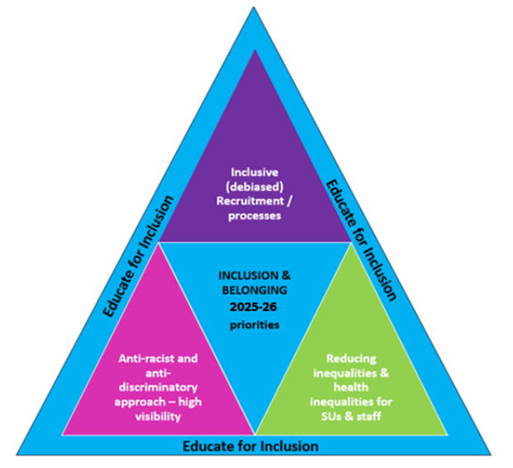
7. Aligning Trust Pay Gap Findings with Inclusion Priorities
The Trust’s pay gap findings line up closely with its planned actions, NHS inclusion priorities and wider ICS goals. Here’s how they connect:
Trust Pay Gap Findings
Gender: Gap narrowing but still favours men.
Ethnicity: Global Majority staff earn more on average, though patterns differ by pay band.
Disability: Gap persists, though slightly reduced in 2025, showing barriers to progression.
Trust Planned Priorities
(for 2025–26)
Fair and inclusive recruitment and career progression directly address structural barriers shown in the pay data.
Flexible working for all, especially for disadvantaged groups, supports retention and progression of women, disabled staff, and minority ethnic staff.
Culture of inclusion and belonging tackles the underlying inequalities reflected in pay gaps.
Pay Gap Reporting in Line with NHS and Statutory Frameworks
Provides evidence that supports statutory compliance (PSED, Gender Pay Gap reporting) and aligns with NHS equality frameworks (WRES, WDES, People Plan/Promise),
Focus on intersectionality – looking at how gender, ethnicity, disability, and other characteristics overlap, which is at the heart of national NHS inclusion strategy.
Alignment with ICS Priorities
Collective working across the system on pay gaps mirrors the system-wide approach encouraged nationally.
Shared focus on tackling health inequalities and workplace equity means local action on pay gaps contributes to wider system goals.
The data shows where inequalities persist, and our planned actions are designed to tackle these directly. This approach aligns with NHS national frameworks and supports ICS-wide inclusion and belonging priorities, strengthening accountability and driving progress at both levels.

Slide 27
Appendix: Ethnicity Pay Gap Data (2025) with and without medical staff
For purpose of understanding behind the surface of our ethnicity pay gap, the following information provides the data reworked for additional information with and without medical staff:-
When medical staff are excluded, the underlying disparity becomes clearer. The mean gap widened from +6.03% in 2024 to +8.08% in 2025, and the median gap rose more sharply from +1.85% to +10.21%. This shows that, outside of the medical workforce, White staff are consistently paid more than Global Majority staff, and that this difference has grown year on year.
In 2024, some Global Majority groups (e.g. Asian –37.52%, Other –31.56%) appeared to earn more than White British staff on average, reflecting the influence of medical staff pay. By 2025, the position reversed: Asian staff moved from –37.52% to +8.2%, and Black staff from –4.51% to +8.6%, showing both groups now earn less than White British staff.

Slide 28
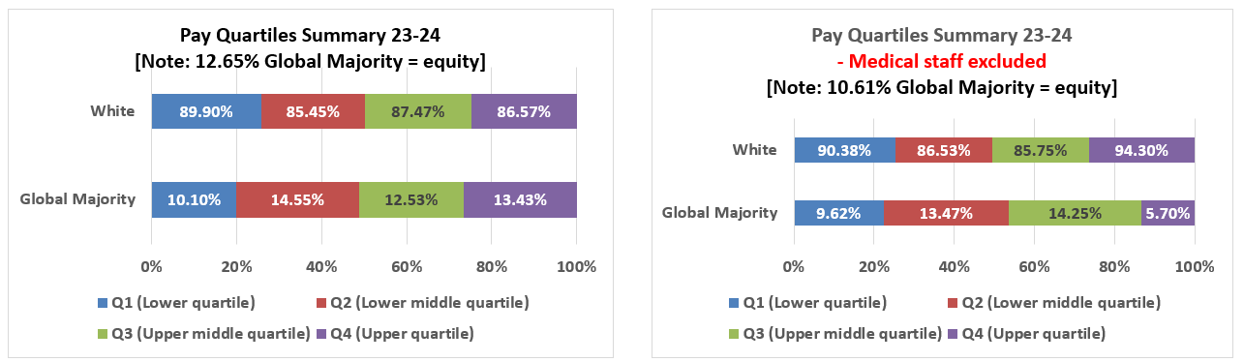
Appendix contd: Ethnicity Pay Gap Quartiles (2025) with and without medical staff
Medical staff boost ethnic minority representation in upper pay quartiles, especially for Asian and Other ethnic groups. Excluding medical staff increases clustering in Quartile 2 and 3 for most minority groups, highlighting concentration in mid-level pay bands. White British staff show minimal change, indicating a more consistent distribution across pay levels regardless of medical roles.

