Slide 1
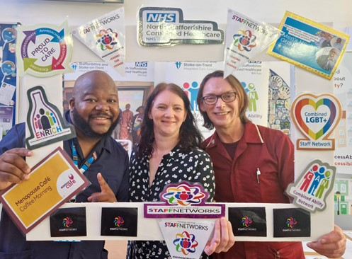
Trust Diversity Data Book 2025 (reporting period for 1 April 2024 to 31 March 2025) Addendum to the Trust’s Inclusion and Belonging Annual Report 2025
Comments and Queries about this information?
Please contact: Janice Ogonji, Trust Inclusion & Belonging Lead
E-mail: Diversity@combined.nhs.uk or contact on MS Teams

Slide 2
Introduction
Thank you for reviewing our Trust Diversity and Inclusion Databook as part of our 2025 Inclusion and Belonging Annual Report. This information helps us to understand in more detail both the people who work for us and the people we serve. It is one of the ways that the Trust meets its requirements under the Equality Act 2010 and our associated Public Sector Equality Duty (PSED).
Our workforce data is based on our substantive workforce (i.e. excludes bank staff, agency workers and third party contractors, except where specifically stated). Bank worker age, disability, ethnicity and gender data is provided as separate charts.
Our substantive workforce headcount increased in 2025 to 2,000* (1,775 WTE) compared to 2024 which was 1,935 (1,712 WTE).
Service user data is based on information held in our Lorenzo Electronic Patient Record (EPR) system on service user encounters.
Key Directorate level workforce and service user data is included (further details may be made available on request.
This data is intended to encourage further reflection on inclusion. It should be used to assess how well the organisation supports people from different backgrounds and with different characteristics. Please ask if you require further information. Contact: Diversity@combined.nhs.uk
*Workforce total figures may differ slightly from those reported in the Workforce Race Equality Standard (WRES), Workforce Disability Equality Standard (WDES), and Pay Gap reports. This is due to differences in reporting requirements and the timing of data extraction.

Slide 3
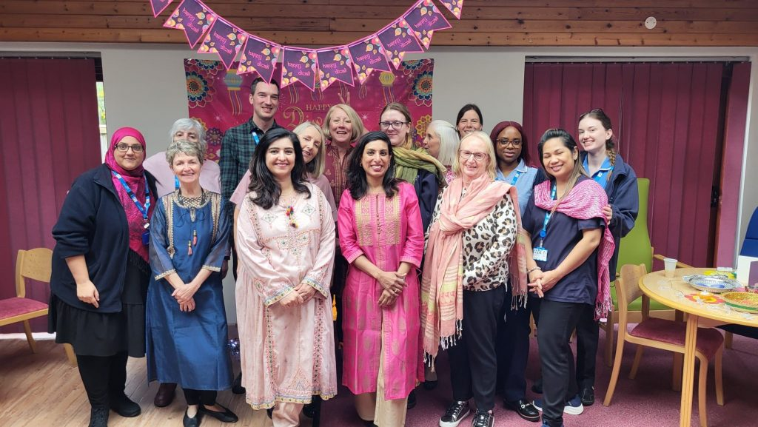
PART ONE: Workforce Demographic Profile as at 31st March 2025 (NB bank workers and third-party workers are excluded, unless specifically stated)

Slide 4

Full-Time & Part-Time Working
The data highlights that women are more likely to be in part-time and bank roles. This reflects the value of flexible working in supporting participation, but also underlines the importance of ensuring that career development, training, and pay opportunities are equally accessible across all contract types

Slide 5

Workforce Profile: Gender*
Both substantive and bank workforces are female-dominated, in line with the wider NHS and care sector trends.
Bank workforce shows greater gender balance, with more men (31.94% vs 20.7%), suggesting that bank roles may attract a broader gender mix compared to substantive roles.
* The Electronic Staff Record does not currently capture data on trans and non-binary identities. This is being reviewed nationally and we hope to begin gathering this information in the future. At Combined, we are committed to creating a culture where colleagues feel safe, supported and confident to share their sexual orientation and to be their authentic selves at work.

Slide 6

Workforce Age Profile
The profile is broadly mid-career heavy, with the largest groups in the 41–45 (276 staff) and 51–55 (271 staff) brackets, reflecting a more experienced, mid-to-late career profile.
The Trust workforce is mainly mid-to-late career, while the Bank has a more even age spread with stronger representation of older staff. This suggests an opportunity to strengthen pathways for younger staff and continue supporting older colleagues to maintain a balanced workforce for the future.
Age distribution is younger overall, with higher representation in the 26–40 range

Slide 7
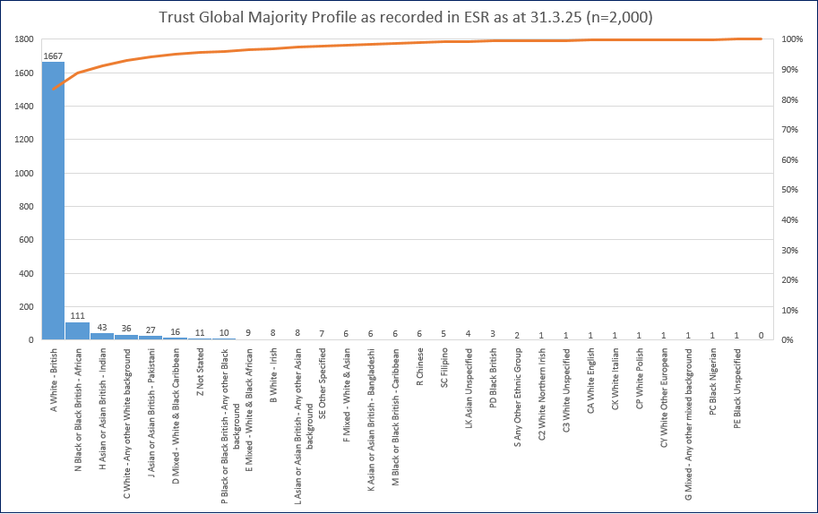
Workforce Ethnicity Data
NB Data may differ slightly from our Workforce Race Equality Standard (WRES) and Ethnicity Pay Gap data due to variations in the reporting requirements and date of data extraction.

Slide 8
Bank Workforce Ethnicity Data
The substantive workforce is much less reflective of the local community profile (11.17% Global Majority), while bank staffing exceeds this significantly. This could indicate barriers to progression into permanent roles, or that bank work is more accessible/flexible for Global Majority staff. This highlights a potential equity issue: diversity is present, but disproportionately concentrated in less secure, temporary employment.
*n=1990 does not include the NEDs
Black staff are almost four times more likely to be represented in bank roles (28.9%) than in substantive roles (7.74%), while Asian staff are represented at over twice the rate (12.17% compared with 4.72%).

Slide 9
Workforce Ethnicity Data by Directorate
Representation of Global Majority staff across the Trust is not uniform.
Acute & Urgent Care (20%) – significantly higher than the local population.
Community (8.7%) – lower than local levels.
Corporate (14.24%) – slightly higher than local levels.
Primary Care (9.96%) – slightly below local levels.
Specialist Services (13.6%) – slightly above local levels.
NB Data may differ slightly from our Workforce Race Equality Standard (WRES) and Ethnicity Pay Gap data due to variations in the reporting requirements and date of data extraction.
Local Global Majority population 11.17%

Slide 10
Workforce Ethnicity by Staff Group
Diversity is stronger in some staff groups, such as Medical and Dental and Additional Clinical Services, while others have lower representation. This highlights an opportunity to share learning from areas with greater diversity and to continue developing approaches that support more balanced representation across all staff groups.

Slide 11

Workforce Religion & Belief
Christianity is the majority religion or belief, but there are also large non-religious groups (Atheist + Do not wish to disclose) represented. The high proportion of staff choosing not to disclose indicates gaps in declaration and suggests more could be done to build confidence in disclosure.
The Hindu swastika is an ancient symbol of good fortune and well-being. It may face right or left and holds deep religious meaning. The Nazi version, turned diagonally, is a modern distortion associated with hate and antisemitism.
Religion | Percentage
Christianity | 43.15%
Do not wish to disclose | 22.15%
Atheism | 16.35%
Other | 10.90%
Unspecified | 4.90%
Islam | 1.90%
Buddhism | 0.25%
Hinduism | 0.25%
Sikhism | 0.10%
Judaism | 0.05%

Slide 12
Workforce Disability
This data shows that 10.20% of staff in have declared a disability, which is notably higher than the 2024 NHS WDES average of 5.7%, suggesting stronger disability representation and disclosure locally compared with the wider NHS.
Although the 7.7% non-declaration rates are positive compared with national benchmarks (14.3% non-declaration reported in national WDES 2024), this highlights ongoing gaps in data completeness. This indicates the need to continue building trust and confidence in sharing disability information, while ensuring robust systems for accurate recording.
Disabled | Non-disabled | Unspecified | Not declared | Prefer not to say
10.20% | 82.10% | 5.70% | 1.70% | 0.30%
204 | 1642 | 114 | 34 | 6
NB Data may differ slightly from our Workforce Disability Equality Standard (WDES) data and Disability Pay Gap reporting due to variations in the reporting requirements and date of data extraction.
Breakdown provided in Slide 13

Slide 13
Nature of Main Disability Declared
 | Headcount | %
Learning disability | 51 | 25.00%
Long standing condition | 45 | 22.06%
Mental health condition | 29 | 14.22%
No | 11 | 5.39%
Not declared | 3 | 1.47%
Other | 20 | 9.80%
Physical impairment | 11 | 5.39%
Sensory impairment | 14 | 6.86%
Yes - Unspecified | 19 | 9.31%
Prefer not to answer | 1 | 0.49%
Currently, ESR does not allow staff to record more than one disability or to identify neurodiversity as a category, making it difficult to measure representation in our workforce. National estimates suggest that 15–20% of people may be neurodivergent, yet only 31% are in employment compared with 54.7% of disabled people overall. This highlights a significant employment gap and the need for inclusive workplace practices that better support neurodivergent colleagues.
Notes:
Data from WF spreadsheet

Slide 14

Workforce Sexual Orientation
LGBTQ+ colleagues are represented in our workforce, but the high rate of non-disclosure signals the need to build greater trust and confidence in how we use this data. By fostering an inclusive culture, increasing visibility of LGBTQ+ role models and strengthening allyship, we can help create an environment where more colleagues feel comfortable to share their identity.
Gender Orientation | Percentage
Bisexual | 2.45%
Gay or Lesbian | 2.25%
Heterosexual or Straight | 74.10%
Not stated (declined to provide a response) | 15.70%
Other sexual orientation not listed | 0.35%
Undecided | 0.30%
Unspecified | 4.85%
* The Electronic Staff Record does not currently hold data on trans and non-binary identities. This situation is being reviewed nationally, and we hope we will soon be able to gather this information. At Combined, we hope to encourage more people to feel comfortable and safe to be open about recording their sexual orientation and being free to be their authentic selves at work.
Notes:
Complete

Slide 15
Recruitment & Selection - Ethnicity
Despite being the majority at the point of application (57.33%), Global Majority candidates are less likely to be shortlisted and even less likely to be appointed, dropping to just 35.10% at the final stage. In contrast, White applicants experience the opposite trajectory: starting as a minority at application (41.30%) but increasing steadily through shortlisting and appointment to 65.53%.
This highlights a potential equity gap in recruitment outcomes. It suggests that while attraction of Global Majority candidates is strong, more needs to be done to ensure fair progression through shortlisting and appointment.
Headcount and Percentages
2024 | Application | Shortlisted | Appointed
Global Majority Heritage | 3843 (55.7%) | 612 (29.5%) | 149 (24.8%)
Not disclosed | 124 (1.8%) | 40 (1.9%) | 34 (5.7%)
White | 2931 (42.5%) | 1422 (68.6%) | 418 (69.6%)
Total | 6898 (100%) | 2074 (100%) | 601 (100%)
Global Majority candidates made progress at shortlisting and appointment compared with 2024, narrowing the equity gap, though White candidates remain more successful overall.
Notes:
Data from WRES and WDES

Slide 16
Recruitment & Selection - Disability
Applications from disabled candidates rose to 7.92% in 2025, up from 6.8% in 2024, while non-disabled applicants’ share declines slightly. This shows stronger attraction to Trust roles. Their progression to shortlisting (9.4%) and appointment (9.13%) remained steady, slightly exceeding their application share.
Disabled applicants progress strongly, increasing from 7.9% at application to 9.13% at appointment,
2024 | Applications | Shortlisted | Appointed
Disabled | 469 (6.8%) | 196 (9.5%) | 55 (9.2%)
Non-Disabled | 6305 (91.4%) | 1829 (88.2%) | 504 (83.9%)
Unknown | 124 (1.8%) | 49 (2.4%) | 42 (7.0%)
Total | 6898 (100%) | 2074 (100%) | 601 (100%)
Unknown” disability status rises to 7% at appointment, suggesting hesitancy to disclose and highlighting the need to build confidence and improve data capture.

Slide 17
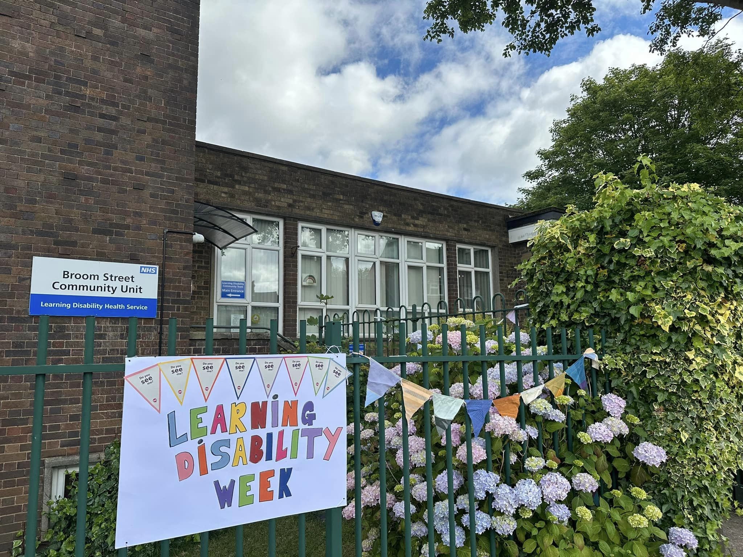
PART TWO: Service User Data as at 31st March 2025
Please note: our service user data* is based on information held in our Lorenzo system on service user encounters. Data from IAPTUS and HALO is not included.
Data is not available for Primary Care Directorate.
*The Diversity Data Book presents both the number of individual service users (n = 35,404) and the directorate-level total (n = 46,823). The individual service user figure ensures accuracy by showing how many unique people access services, avoiding double-counting. However, the directorate-level total reflects service demand and workload more fully, as some individuals are referred multiple times across different services or points of entry. By including both, the report offers a balanced view: one figure highlights the reach of services to distinct individuals, while the other captures the true scale of activity, resourcing and pressures faced by directorates. This distinction helps understand both the breadth of service access and the operational demand.
.

Slide 18

Service User Gender*
*Similar to the situation in the Electronic Staff Record, the Electronic Patient Record (EPR) does not yet facilitate recording of gender identities other than male and female (eg non-binary or other gender identity).
Trust supported 16,892 male, 18,497 female and 15 did not specify their gender. When compared with 2024, the pattern is consistent with slightly more female service users (52.25%) than male (47.71%).
Acute & Urgent Care is almost evenly split between males (10,630) and females (11,082);
Community services show the largest difference, with nearly 2,000 more females (11,763) than males (9,791);
Specialist Services are closely balanced, with 1,817 females and 1,717 males.

Slide 19
Service User Ethnicity
In 2025, most service users identified as White (72.6%), while smaller proportions identified as Asian (2.3%), Mixed Race (1.6%), Black (0.8%), or Other (0.5%). Together, these groups make up 5.2% of recorded service users, which is significantly lower than the 11.17% local population from Global Majority heritage backgrounds reported in the 2021 Census.
Data completeness remains an area for improvement, with over one in five individuals choosing not to share their information(22.21% data gap). This suggests that people from Global Majority communities may be under-represented in the dataset, but the size of the data gap makes it difficult to draw firm conclusions.
*11.17% Based on combined data - Newcastle upon Tyne, Staffordshire Moorlands and City of Stoke on Trent
More than 1 in 5 service user records lack ethnicity information, which limits how confidently the Trust can assess representation and equity across different ethnic communities.

Slide 20
Service User Ethnicity compared to local population
Our ethnicity profile broadly reflects the local population, with service users recorded as White (72.6%), Asian (2.3%), Black (0.8%), Mixed Race (1.6%) and Other (0.5%), closely matching Census 2021 figures. However, a significant proportion of service users (21.8%) had no recorded ethnicity, which limits the reliability of this comparison. While the available data suggests services are reaching communities in line with local demographics, improving the completeness of ethnicity recording is essential to provide a clearer and more confident picture of equity and representation.
Trust Users
 | Asian | Black | Mixed Race | Not Known | Not Stated | Other | White
Acute & Urgent Care | 477 | 187 | 399 | 3826 | 1763 | 115 | 14957
Community | 443 | 157 | 335 | 1624 | 2013 | 117 | 16874
Specialist Services | 145 | 43 | 41 | 418 | 202 | 21 | 2666
Count | 1065 | 387 | 775 | 5868 | 3978 | 253 | 34497
% of total | 2.27% | 0.83% | 1.66% | 12.53% | 8.50% | 0.54% | 73.68%
Community services support the largest number of users across most ethnic groups, while Acute & Urgent Care also serves a large population but has high numbers of undeclared ethnicity records. Specialist Services have smaller numbers overall yet mirror the same White majority and high levels of missing data.
The number of service users is shown as n = 46,823 at Directorate level. Where an individual has multiple referrals, their demographic information is repeated, and this is also reflected in the Directorate-level data.

Slide 21

Service User Sexual Orientation
Nearly 80% of service users have no recorded sexual orientation data, limiting meaningful analysis of representation and inclusion. Improving data collection is essential to better understand and meet the needs of LGBTQ+ communities.
Data gaps vary by directorate: Community Services had the lowest at 69%, while Acute & Urgent Care (86%) and Specialist Services (88%) showed higher gaps, indicating limited recorded information.
 | Not Stated | Bisexual | Gay or Lesbian | Not Known | Heterosexual or Straight | Other
Acute & Urgent Care | 106 | 30 | 67 | 18486 | 3029 | 6
Community | 93 | 54 | 89 | 14804 | 6506 | 17
Specialist Services | 98 | 6 | 9 | 3030 | 387 | 6
Count | 297 | 90 | 165 | 36320 | 9922 | 29
% of total | 0.6% | 0.2% | 0.4% | 77.6% | 21.2% | 0.1%
*n = 37,851 - Total number of service users dsupported by a Directorate during the reporting period. Ifa service user is supported by more than one Directorate, their details may be counted more than once.

Slide 22
Age of our Service Users
Shows a concentration at the youngest and oldest age groups. By contrast, working-age adults are more evenly spread across the age ranges. This creates a “U-shaped” pattern, where demand is highest among the youngest and oldest service users.
Acute & Urgent Care sees the largest numbers of younger service users, while Community Services are most used by older adults. Specialist Services, though smaller, are more concentrated among working-age adults with complex needs. This highlights the different pressures on each directorate and the need to align resources to the distinct age profiles they serve.
 | Under 18 | 18-24 | 25-34 | 35-44 | 45-54 | 55-64 | Over 65
Acute & Urgent Care | 6456 | 2101 | 2633 | 3264 | 2272 | 1784 | 3214
Community | 4900 | 1889 | 2942 | 2153 | 1324 | 1167 | 7188
Specialist Services | 308 | 291 | 468 | 577 | 676 | 786 | 430
Total | 11664 | 4281 | 6043 | 5994 | 4272 | 3737 | 10832
% of Total | 24.91% | 9.14% | 12.91% | 12.80% | 9.12% | 7.98% | 23.13%

Slide 23
Service User Religion
In 2025, religion was not recorded for the majority of service users, with a 63% data gap. Among those who did share, the largest groups were Christian (18%) and Not Religious (17%), while Muslim and other faith groups each accounted for around 1%. The high level of missing data limits understanding of religious diversity across service users, making it difficult to assess how well different faith communities are represented or to tailor services to spiritual and cultural needs.
While all directorates have large gaps, Community services capture religion more consistently (data gap of 50.8%.) Acute & Urgent Care (65.4%) and Specialist Services (63.3%) show that two-thirds of records incomplete – highlighting an area for improvement.
 | Asked But Refused | Buddhist | Christian | Hindu | Jewish | Muslim | Not Known | Not Religious | Other Religions | Pagan Religions | Sikh
Acute & Urgent Care | 568 | 11 | 2454 | 9 | 1 | 218 | 14938 | 3345 | 148 | 29 | 3
Community | 350 | 9 | 5594 | 22 | 2 | 239 | 10868 | 4208 | 219 | 43 | 9
Specialist Services | 44 | 4 | 623 | 3 | 2 | 91 | 1864 | 825 | 53 | 17 | 10
Count | 962 | 24 | 8671 | 34 | 5 | 548 | 27670 | 8378 | 420 | 89 | 22
% of total | 2.1% | 0.1% | 18.5% | 0.1% | 0.0% | 1.2% | 59.1% | 17.9% | 0.9% | 0.2% | 0.0%

Slide 24

Janice Ogonji Inclusion & Belonging Lead Email: Diversity@combined.nhs.uk
Further Information
If you have any queries about this data or require any further information, please contact:

